Slide 1



www.lightwave.community
The Suffolk Discipleship Pathway

Slide 2
Why don’t people who love our church’s special events start coming to our services?
For most people faith is something you grow into ….. there is a journey
Notes:
Church members sometimes find it hard to understand why someone will be happy tp support a church fete or social activity but that this doesn’t lead very quickly into coming to church on a Sunday.
Ofcourse sometimes the journey to becoming a regular worshipper is a short one but for many people it is a long road.

Slide 3
Why don’t people who love our church’s special events start coming to our services?
The Suffolk Discipleship Pathway is a way of describing the steps that most people take on their way to discovering and growing in faith.
It helps churches and small groups to think about how they can provide stepping stones to faith for the people they are in contact with.
Notes:
The Suffolk Discipleship Pathway is a way of describing the steps that most people take on their way to discovering and growing in faith.
It helps churches and small groups to think about how they can provide stepping stones to faith for the people they are in contact with.
The model is based on “Sowing, Reaping, Keeping” – an acclaimed book by Lawrence Singlehurst and used by the Fresh Expressions movement in their Mission Shaped Ministry Course.

Slide 4

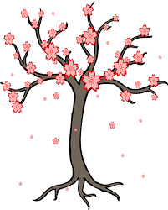

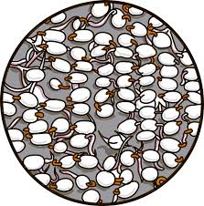

Suffolk
Discipleship Pathway
Sowing
Nurturing
Fruit
Flowering
www.lightwave.community
Based on Sowing, Reaping, Keeping model. (Lawrence Sunglehurst’s acclaimed book of the same name and developed by Fresh Expressions in MSM course.
Notes:
“Sowing Reaping Keeping” had just 3 stages.
Sowing – which was simple service activities
Reaping which was coming to faith
Keeping which was staying in the church.
Lawrence characterises the aim of the sowing as relational engagement with as many not-yet-Christians as possible, as helping them to re-think their misconceptions and so recognise that ‘God is good and we are OK!’ Then as folk move down at their own pace you get to the ‘fewest number of people and maximum Gospel content.’ Obviously the whole process should be covered by prayer.
In Suffolk we have added the stage of nurturing to more fully represent the rowing in spiritual interest before someone is ready to make a faith commitment. We have renamed the stage of commitment flowering, representing the flowering of faith and instead of “Keeping” we talk about “fruit” because of the way Christians continue to grow and be fruitful throughout their lives.
Any of these stages can occur either in a planned, prepared program/event or they can flow spontaneously in a developing relationship, with one-to-one opportunities and conversations.

Slide 5






Suffolk
Discipleship Pathway
Sowing
Nurturing
Fruit
Flowering
www.lightwave.community
Based on Sowing, Reaping, Keeping model. (Lawrence Sunglehurst’s acclaimed book of the same name and developed by Fresh Expressions in MSM course.
Notes:
So how does it work?
1. Sowing – This is the widest part of the diagram as sowing activities usually have wide appeal… In a sowing activity, a Christian group connects with people and shows the love of God by enjoying mutual interest or meeting a need. Its just seeds in terms of faith – so the the spiritual content of the activity may be quite small. The group needs to be unconditionally committed to love and serve the people, while they hope they may one day respond to the gospel. As they serve they pray and look out for what God may be doing
EXAMPLES:
A Lightwave group starts a Parent and Toddler Group which gives them an opportunity to share Christian love. They pray for everyone who attends and seek to make it a place of fun safety and warmth.
A group of Christian men love singing and decide to start a “Fisherman’s Friends” style accapella singing group which will raise money for local charities. They invite non-church musical friends to join over a pint and start looking for gigs.
In social events, it can be powerful to have a group of Christians together. We have got so used to being together that we don’t realise just how different our relationships are, but not-yet-Christians do notice. The key is to include people in the things you do, i.e. Sunday lunch, socials etc.

Slide 6

Suffolk
Discipleship Pathway
Sowing
Nurturing
Fruit
Flowering
www.lightwave.community
Based on Sowing, Reaping, Keeping model. (Lawrence Sunglehurst’s acclaimed book of the same name and developed by Fresh Expressions in MSM course.
Notes:
Some of the seeds of faith sown through this loving service germinate and the Christians involved feel that some of the people involved would appreciate an opportunity to explore or engage with faith or the Christian community at a slightly deeper level. The arrow represents an invitation to do something more.
2. Nurturing – Not everyone who was involved with the sowing activity will be interested to engage with the Christian community or questions of faith, so this is represented by a smaller block than sowing.
EXAMPLES
For the Parent and Toddler Group, the team decide to invite parents who want to, to come to a “Praise and Play” Toddler Service or “Messy Church”. These events are designed around the needs and interests of the people they have been serving. They also give the parents opportunities to learn about christening and invite those who are interested to come to the prayer and planning for the toddler group.
The Men’s singing group sing both sacred and secular songs. Rehearsals always start and end with prayer and the leader seeks to explain the meaning of what they are singing to make it more meaningful. Some performances actually enable the audience to explore the spiritual themes behind the songs.

Slide 7
Don’t break the trust bridge!
The upward arrow in the Suffolk Discipleship Pathway diagram represents an invitation to a further activity, given in a way which respects the trust of the person invited.
2T
2T
2T
2T
2T
Two ton trust bridge
7
Notes:
The arrow from each stage to the next in the diagram represents an invitation to more involvement or faith exploration. It is important that this is an invitation and not an imposition.
Not-yet-Christians will get involved in these different stages entirely as they want: they move on further when they are interested. We merely give invitations and sensitively support them at their pace.
So in the case of the toddler group – it is great to invite those who attend ordinary sessions to come to a toddler service: However, don’t just suddenly introduce worship into the ordinary session if this isn’t what they expect. To do so would break the trust of participants and feel like an imposition. An invitation however doesn’t break trust. It offers an additional opportunity. It will normally be an opportunity which is tailor-made for the individual or the group and their interests so it shows you have really listened.

Slide 8

Suffolk
Discipleship Pathway
Sowing
Nurturing
Fruit
Flowering
www.lightwave.community
Based on Sowing, Reaping, Keeping model. (Lawrence Sunglehurst’s acclaimed book of the same name and developed by Fresh Expressions in MSM course.
Notes:
Flowering – Opportunity to find out in depth about Christianity and to commit. Taken up by fewer people so may join up with other small groups or parish activity to provide this.
EXAMPLES
The toddler group decide to offer “Alpha with Toddlers”. This is at the same time and day as the fortnightly toddler group and offers play opportunities, bible stories and crafts for the toddlers while the adults talk. The atmosphere is relaxed and the toddlers can wander in and out of the adult session without anyone minding
The founders of the singing group meet regularly as a Lightwave group which prays for the singers. They decide to invite anyone in the group who wants to explore confirmation to join them for a 6 week course. They base the course around some of the gospel songs they have been sining and some people who have been attending the groups gigs join too. Two or three people make a commitment and decide to get confirmed

Slide 9

Suffolk
Discipleship Pathway
Sowing
Nurturing
Fruit
Flowering
www.lightwave.community
Based on Sowing, Reaping, Keeping model. (Lawrence Sunglehurst’s acclaimed book of the same name and developed by Fresh Expressions in MSM course.
Notes:
Fruit – People continue to grow as disciples within some form of Church which could be a parish church or fresh expression of Church. The word fruit conveys on-going development and giving to others in witness and service.
EXAMPLES
A Parent and Toddler discipleship group grows from Alpha and the new Christian disciples reach out to more of their contemporaries, helping with holiday clubs and eventually starting a Café Church in the local school as their children grow up.
Those who were confirmed join the Lightwave group which led their confirmation preparation – and continue to learn about the faith and grow in offering their gifts too.

Slide 10

Using Alpha and other Christian Basics Courses
Sowing
Nurturing
Fruit
Flowering
Notes:
The Suffolk Discipleship Pathway helps understand how process courses like Alpha work so effectively. First, they are based on invitation and the groups allow and affirm questions and opinions at any level or stage on the journey. Then the welcome, the meals and the informal groups all allow people in a natural way to gain distinct friends and Christian fellowship (nurturing) In fact, something like Alpha can accompany folk on their journey from ‘nurturing’ to fruit as they learn all about the gospel and are offered opportunities to respond.
Furthermore, the diagram can explain two of the limitations of very effective programmes like Alpha. It shows that they don’t address ‘Sowing and Fruit At either end there are challenges that require other things. Some churches find that they run out of people to invite after they have run two or three Alpha-type courses Excellent process courses like Alpha work best when a church is continually developing contact with a wide pool of non-churched people through lots of ‘Sowing ’ activities. There are then plenty of people to invite to a third and fourth Alpha, whereas lots of churches that aren’t engaged beyond themselves run out of invitees.
At the other end there is the challenge of integrating into church those that make faith responses on Alpha. Research shows that a significant proportion are lost. The stark lesson here is that we cannot expect people to jump to a church experience that is totally different socially and culturally from that which they have enjoyed on Alpha! The message is, continue into Lightwave groups or similar ‘Alpha-style’ fresh expressions of church!

Slide 11
VIDEO
Watch Charlotte’s Story”.
What invitations did she receive to go deeper?
How do these relate to these different stages of the “Suffolk Discipleship Pathway”?
Sowing
Nurturing
Fruit
Flowering
Notes:
The video is downloadable from www.lightwave.community/resources
Look under Suffolk Discipleship Pathway
Watch Charlotte’s Story”.
What invitations did she receive to go deeper?
How do these relate to these different stages of the “Suffolk Discipleship Pathway”?

Slide 12
Suffolk
Discipleship Pathway
Sowing
Nurturing
Fruit
Flowering
www.lightwave.community
Based on Sowing, Reaping, Keeping model. (Lawrence Sunglehurst’s acclaimed book of the same name and developed by Fresh Expressions in MSM course.
Notes:
“Sowing Reaping Keeping” had just 3 stages.
Sowing – which was simple service activities
Reaping which was coming to faith
Keeping which was staying in the church.
In Suffolk we have added the stage of nurturing to more fully represent the rowing in spiritual interest before someone is ready to make a faith commitment. We have renamed the stage of commitment flowering, representing the flowering of faith and instead of “Keeping” we talk about “fruit” because of the way Christians continue to grow and be fruitful throughout their lives.

Slide 13
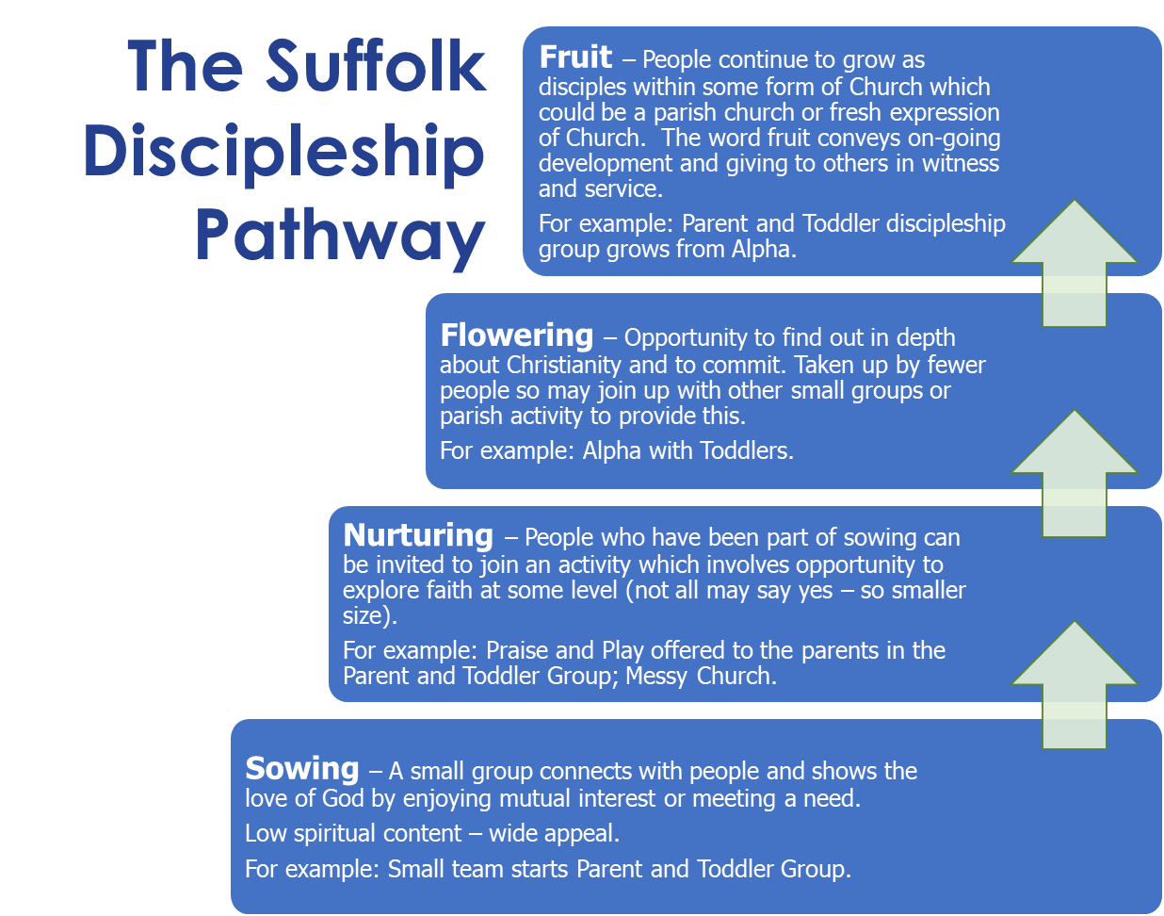
GROUP EXERCISE 1
Imagine your group wanted to reach out to particular people – imagine and draw a potential discipleship pathway for them including examples for sowing, nurturing, flowering and fruit. A worked example for parents with toddlers is provided right:
All ages caring for the planet
Men in local pub
People at a food bank
Teens on the street
Notes:
Divide the workshop into tables of 3 or 4 people. Get each to draw the Sowing- Nurturing – Flowering - Fruit diagram large on their sheet of paper and use it to map an example of outreach.

Slide 14

SOCIAL ACTION
with the Suffolk
Discipleship Pathway
Sowing
Nurturing
Fruit
Flowering
making Jesus visible through loving action
Notes:
In everyone’s path of faith there is an element of growing intellectual understanding – but there is also an element of felt experience of God and the difference he makes in our lives.
Many of our sowing activities will be activities which address social need such as pop up shops or food banks or CAP.
2 important points about this:-
Don’t separate the social action from your faith – faith needs to visible but not imposed. Those who participate need to be offered a path to explore faith if they want to. This could be through a prayer table or an invitation to a follow on event.
Exploring faith may come in the form of seeking to volunteer with you. Always pray with your volunteer team, welcome non-Christian volunteers and include them in the prayer time in a non-scarey way. Find them things which are safe for them to do and don’t let the widening of the group of volunteers dilute your Christian values.

Slide 15
GROUP EXERCISE 2
Think about an activity which your church or small group are already engaging in to reach out to particular people – Would it be best described as sowing, nurturing, flowering or fruit?
Is it connected by invitation to other steps of faith? Draw it on a diagram as on the right. Put in your ideas for filling any gaps.
Notes:
Divide the workshop into tables of 3 or 4 people. Get each to draw the Sowing- Nurturing – Flowering - Fruit diagram large on their sheet of paper and use it to map an example of outreach.
You could alter this and get them to map ALL the outreach activities of their church and how they connect (or not) Parish groups often find this revelatory.

Slide 16
ALL INVOLVED
with the Suffolk
Discipleship Pathway
Sowing
Nurturing
Fruit
Flowering
www.lightwave.community
Based on Sowing, Reaping, Keeping model. (Lawrence Sunglehurst’s acclaimed book of the same name and developed by Fresh Expressions in MSM course.
Notes:
The exciting thing about thinking about evangelism in this way is that actually everybody’s gifts can be included in the process of evangelism. People say, ‘I’m not an evangelist’ and they feel slightly guilty and may make desperate forays out to tell somebody about Jesus... and it doesn’t work and it’s excruciating. But actually, when a group owns evangelism together – one will be a good people-gatherer, another a good story teller, another a good cook or able to share a skill which is the focus of the activity. Everyone’s gifts can be honoured and used. They can all contribute to evangelism.

Slide 17
GROUP EXERCISE 3
Consider how you and other team members could best contribute to different stages of the discipleship pathway for the group you identified.
Sowing
Nurturing
Flowering
Fruit
Inviting
Pray for the people and for God’s guidance in anything you may need to further develop
Sowing
Nurturing
Fruit
Flowering

Slide 18
www.lightwave.community
Pray
Notes:
The Suffolk Discipleship Pathway is a useful model. The heart of evangelism is not a system – but LOVE – finish with prayer for God to enlarge our hearts so that we long for people to experience the gspel.

