Slide 1
SEEING SALVATION
The art and inspiration of Stephen Foster and Sieger Koder

Slide 2
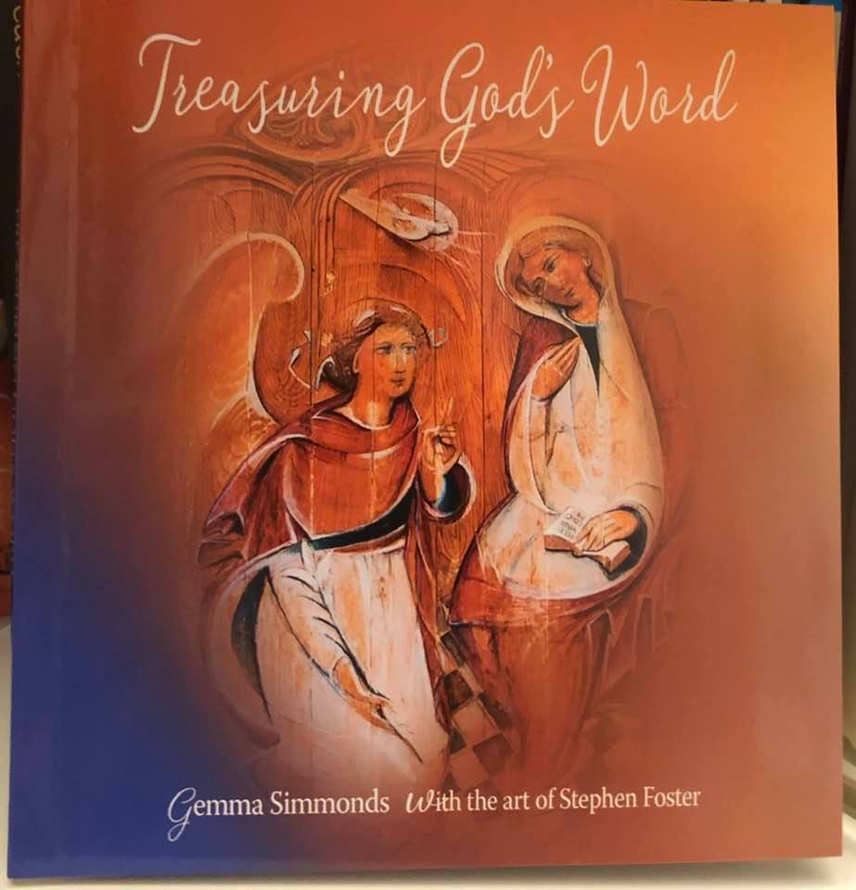

Slide 3
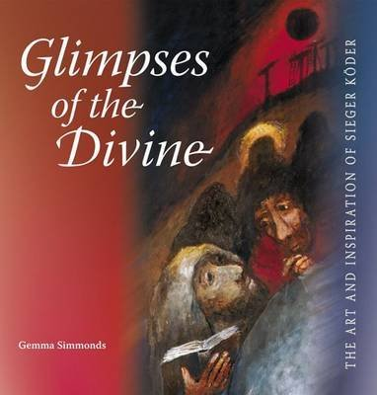
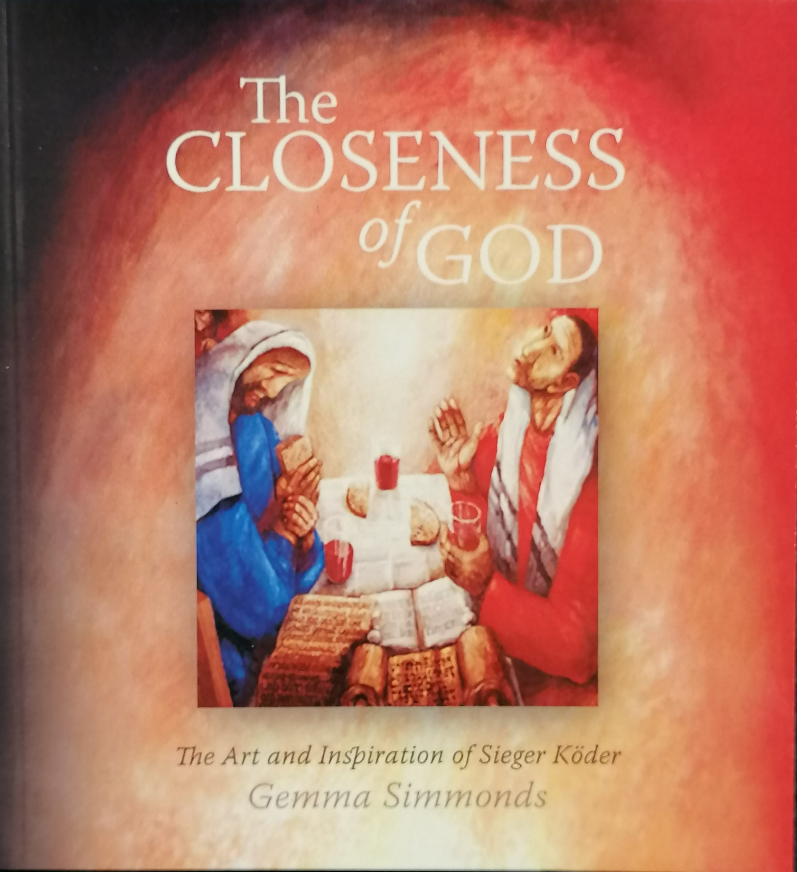

Slide 4
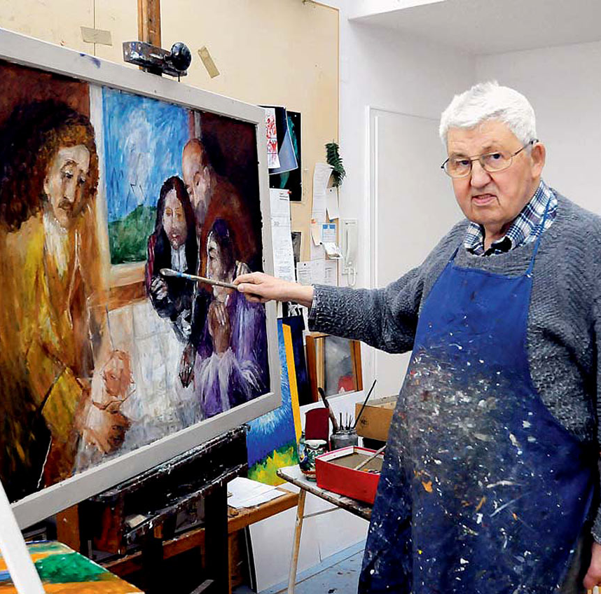
‘I hope I can preach with each painting, not just make pictures. I want people to look at the pictures, of course, but if the message of my deepest motivation for painting comes across, then I hope that the message of the Gospel comes with it as well’.
‘People come to Ellwangen asking to see the painter. If they’re that interested in the painter, then they haven’t understood the paintings’.

Slide 5
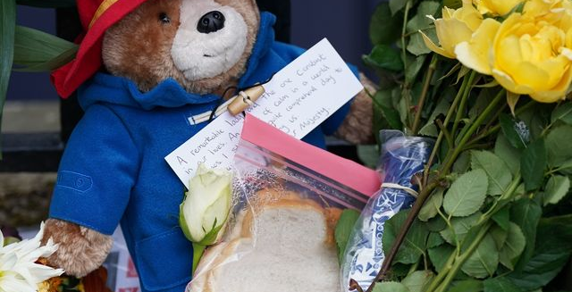

Slide 6
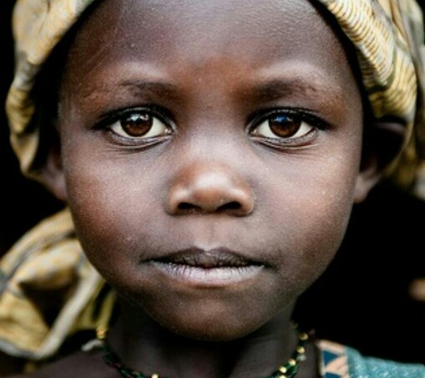
‘Blessed are the eyes
Then turning to the disciples, Jesus said to them, ‘Blessed are the eyes that see what you see! For I tell you that many prophets and kings desired to see what you see, but did not see it, and to hear what you hear, but did not hear it.’ Lk. 10:23-24

Slide 7
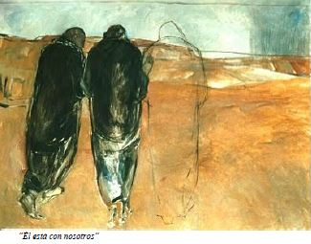
‘But their eyes were kept from seeing him…’
‘Nor did any of them dare to ask him who he was; they knew it was the Lord’.

Slide 8
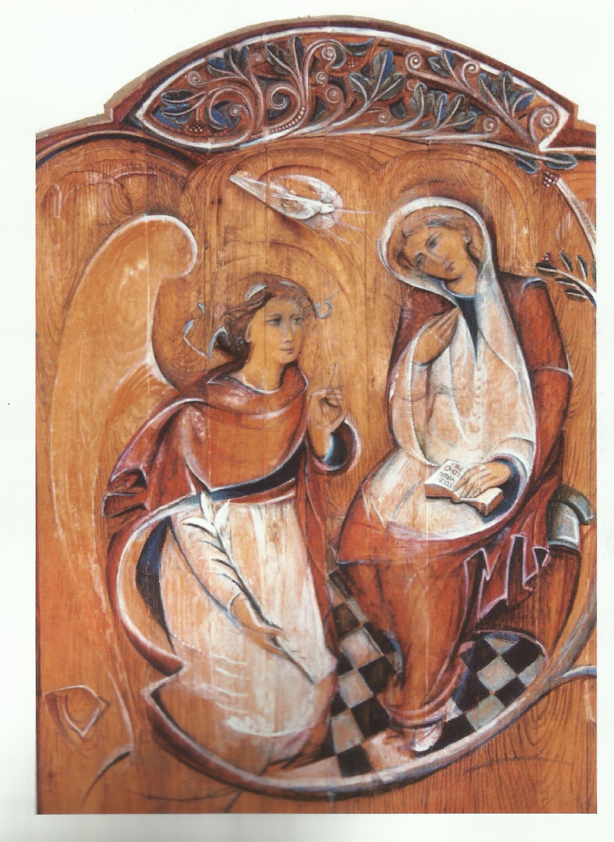
TREASURING GOD’S WORD
Image and imagination
The message of the word
Two different questions:
What’s happening?
What’s going on?
How might we respond?

Slide 9
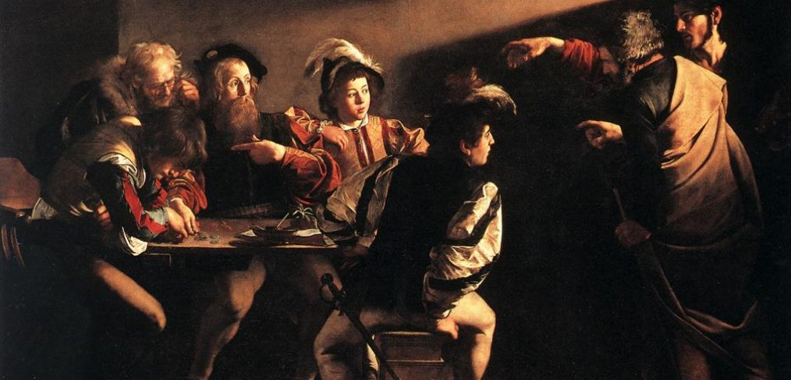

Slide 10
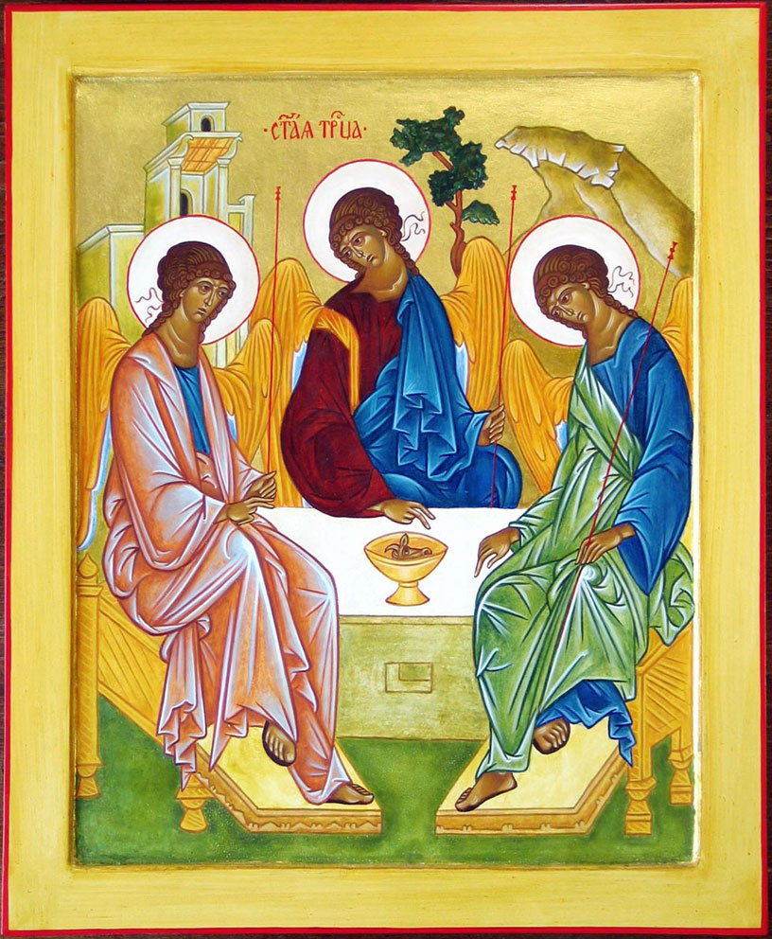
What happens
when we allow God to gaze at us?

Slide 11
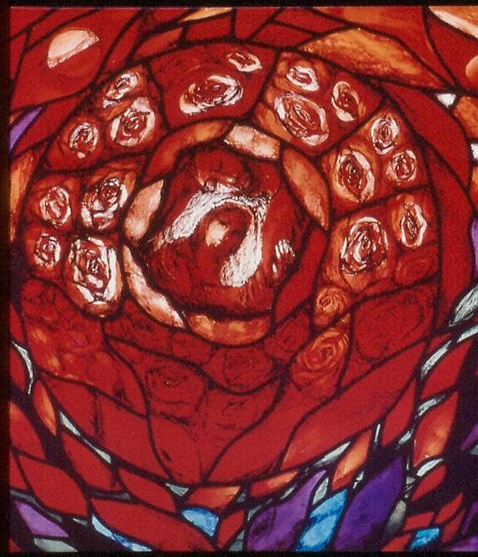

Slide 12
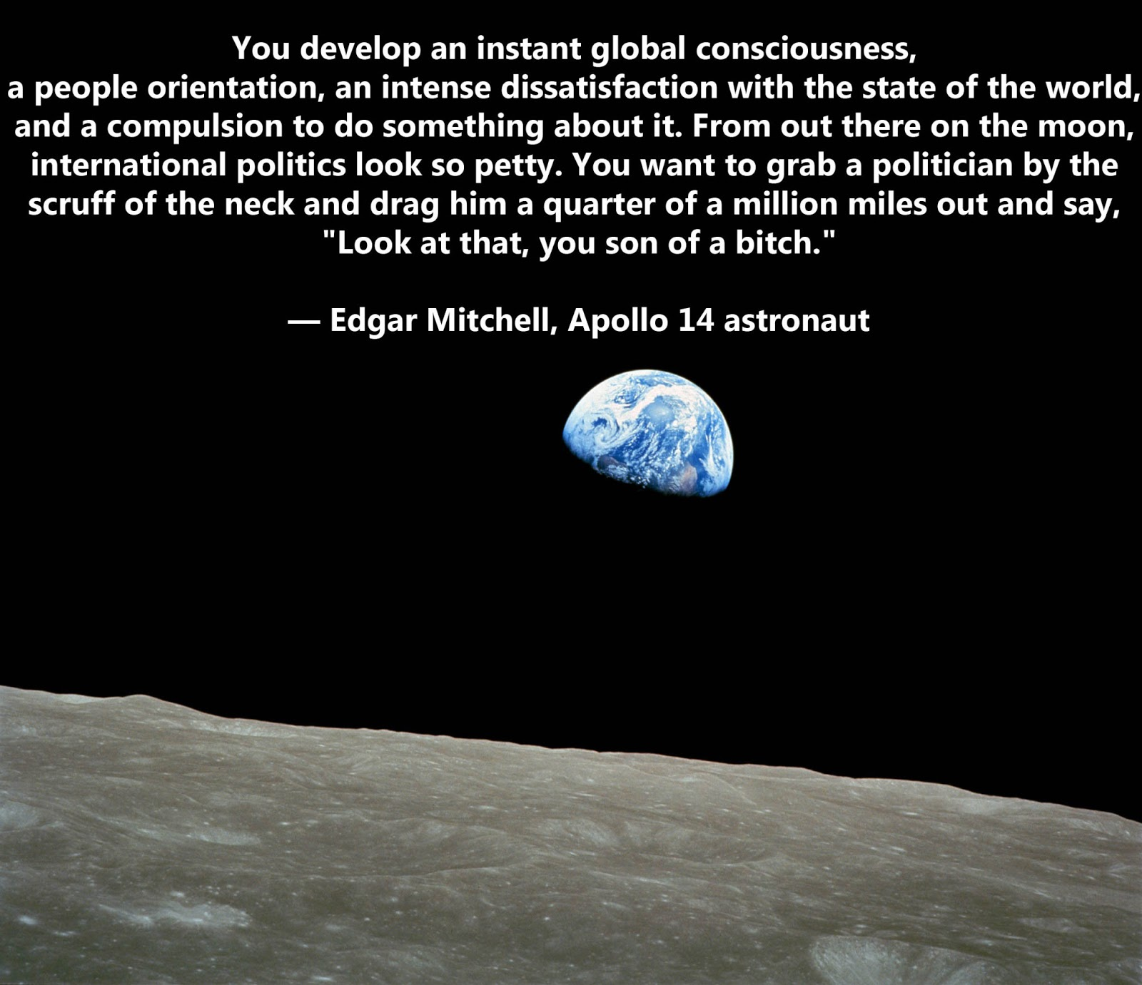
A CHANGE OF PERSPECTIVE

Slide 13
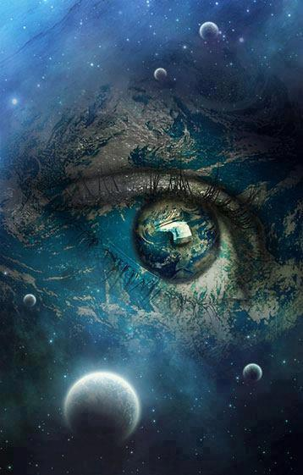
The options…
To refuse to change and re-define our understanding of who and what we are
Or, to…
mature into a more whole and integrated way of living - together and with the rest of life on Earth
open to a more expansive & inclusive vision for ourselves and the world
grow the way we see and feel about everything – to perceive differently, so that we begin to act differently

Slide 14
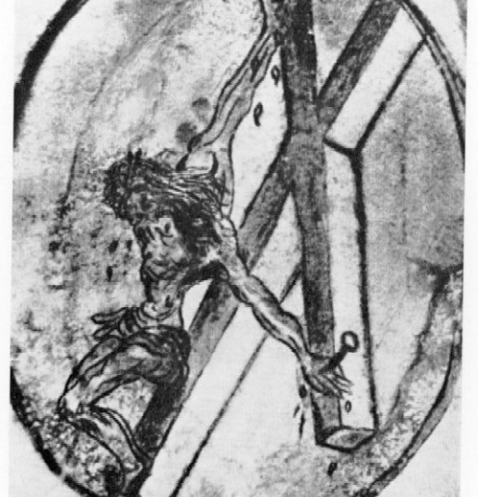
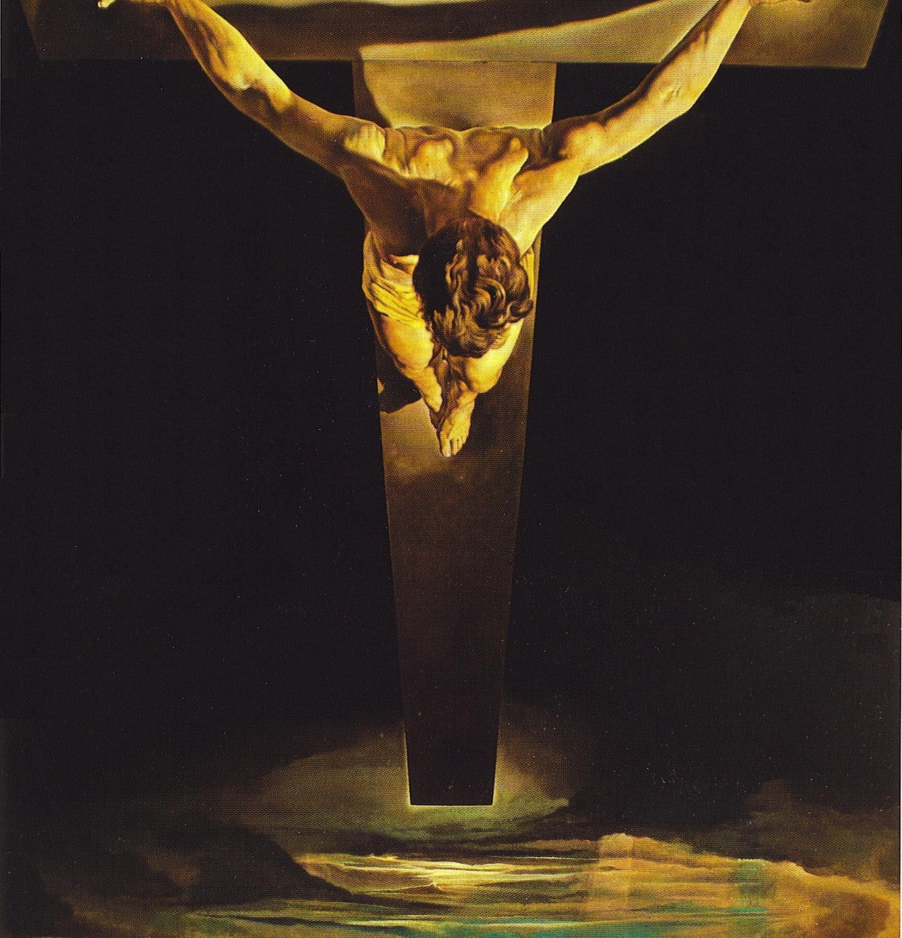

Slide 16
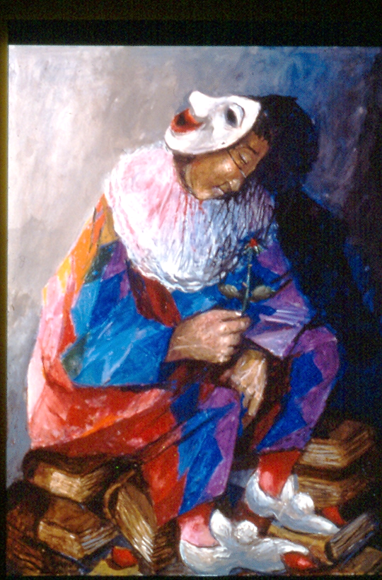
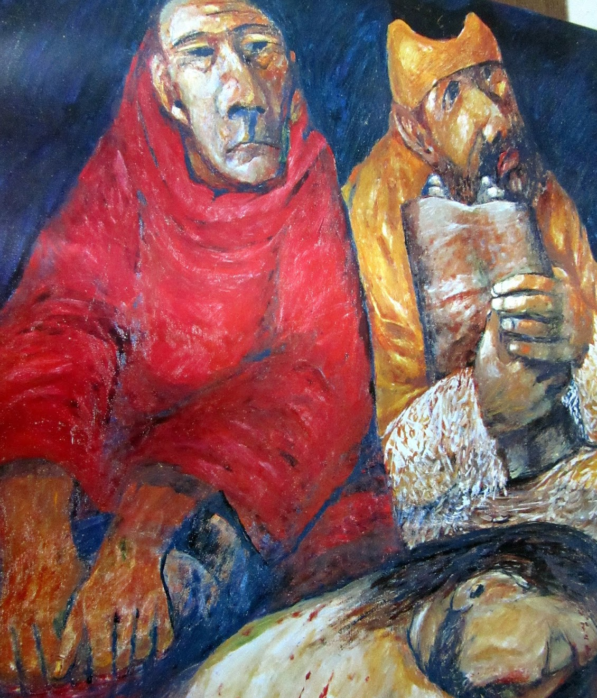
Who do you
say that
I am?

Slide 17
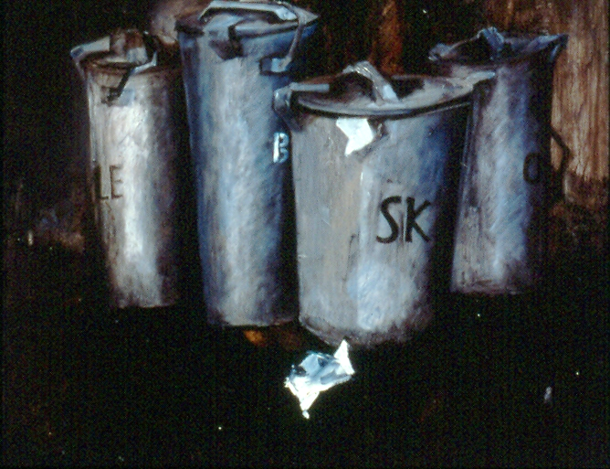

Slide 18
The ‘God of Little Things’
A genuine Christian must have the bold, but often hidden, confidence that ordinary daily life is the stuff of authentic life and real Christianity
‘That which is amazing and even confusing in the life of Jesus is that it remains completely within the framework of everyday living; we could even say that in him concrete human existence is found in its most basic and radical form. The first thing that we should learn from Jesus is to be fully human!’
Karl Rahner, ‘On the Theology of Worship’, 121

Slide 19
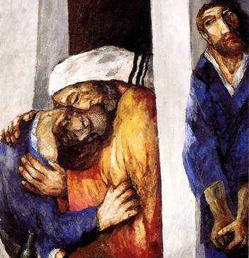
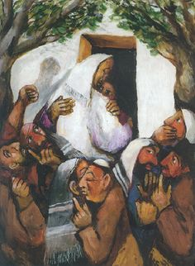

Slide 21
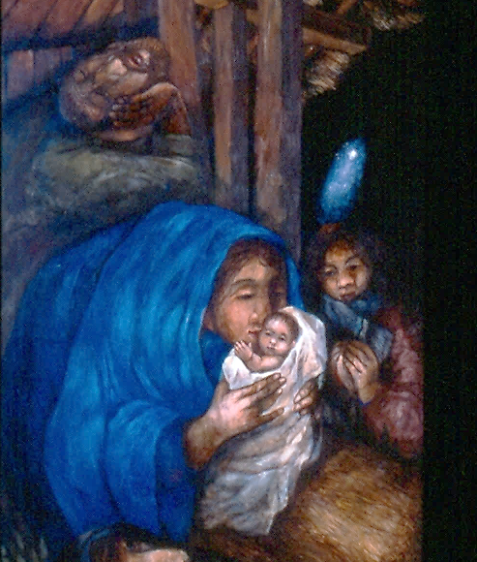
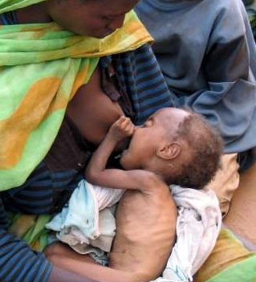
What do we see when we look?

Slide 22
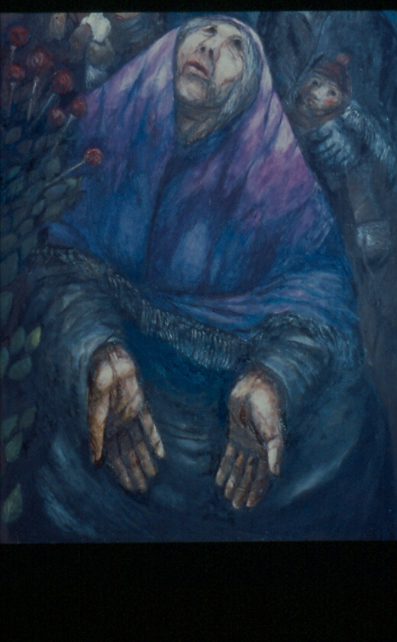
A voice is heard in Ramah,
lamentation and bitter weeping.
Rachel is weeping for her children;
she refuses to be comforted for her children, because they are no more.
Thus says the LORD:
Keep your voice from weeping,
and your eyes from tears; for there is a reward for your work, says the LORD […] there is hope for your future, says the LORD: your children shall come back to their own country. Jeremiah 31:15-17

Slide 23
Rachel is weeping for her children…
there is hope for your future, says the LORD

Slide 24
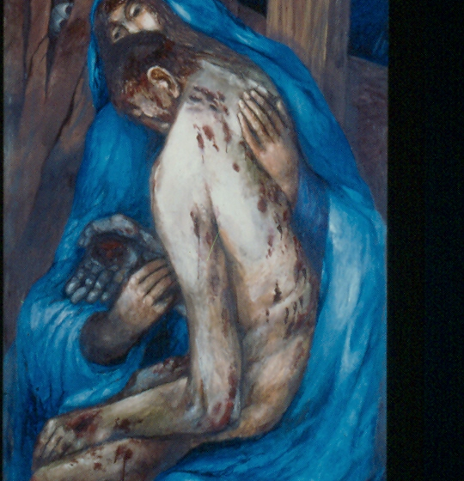
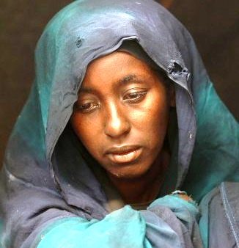

Slide 25
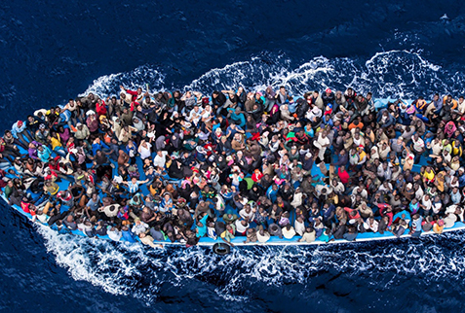
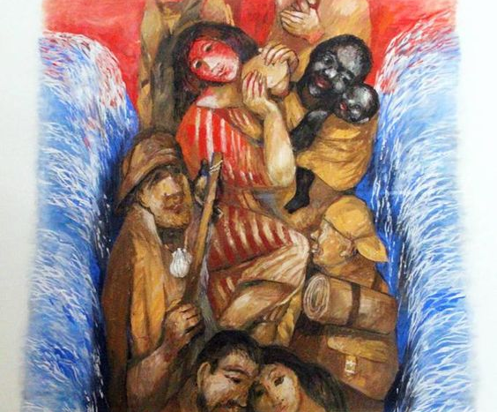
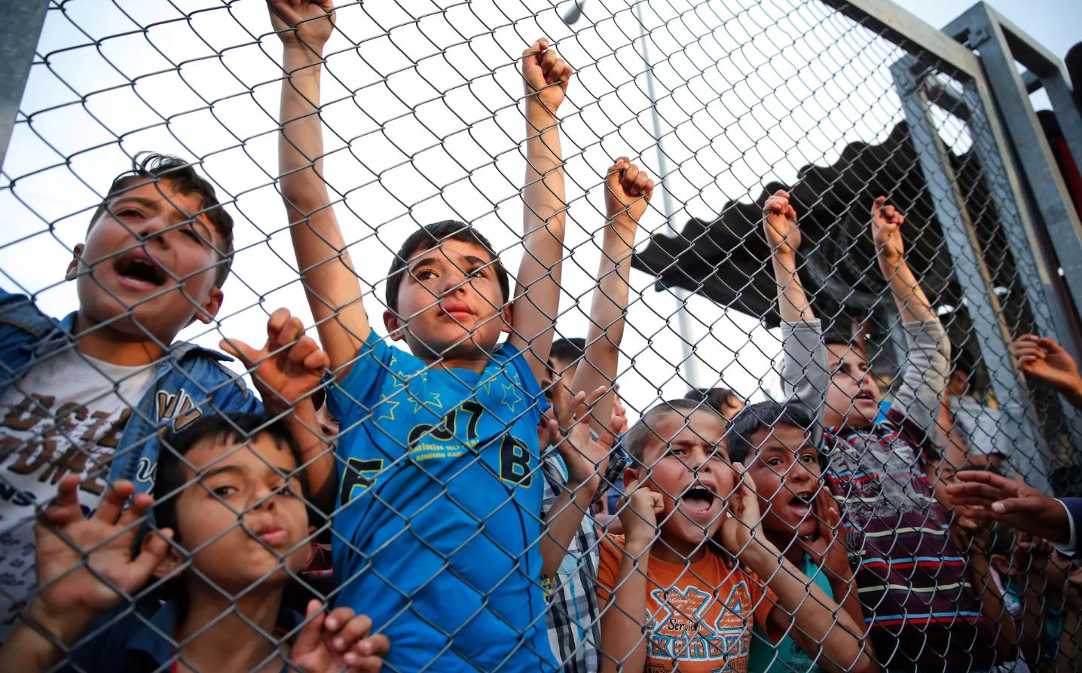

Slide 26
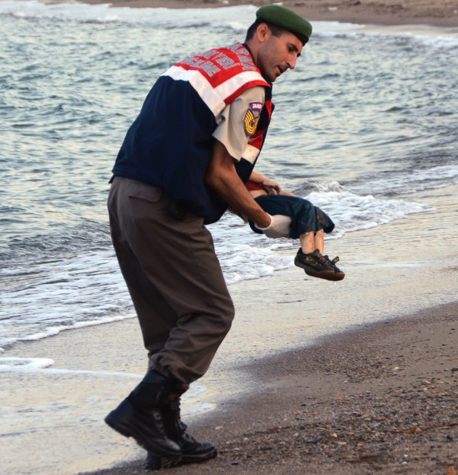

Slide 27
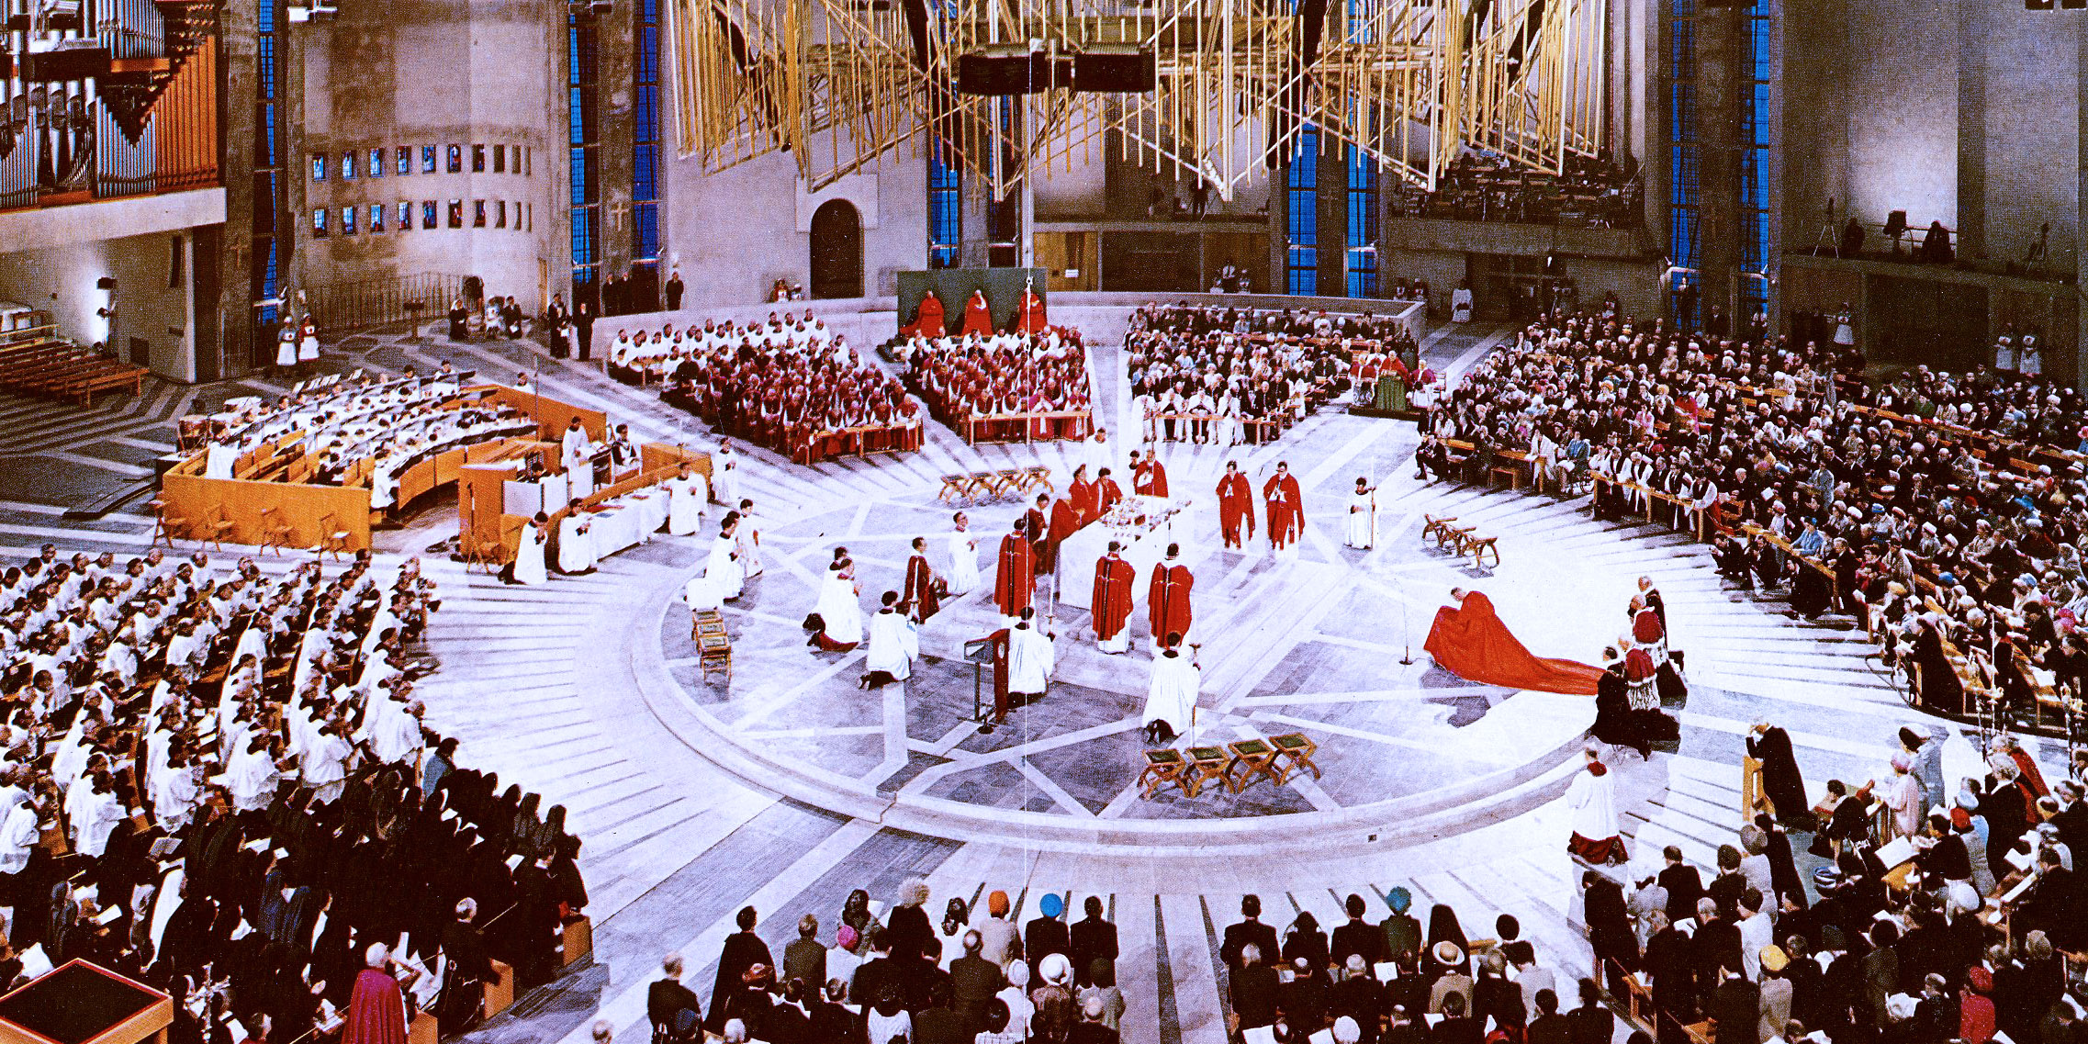
WHAT IS THE CHURCH? WHAT ARE SACRAMENTS?
SIGNS WHICH MAKE REAL WHAT THEY SIGNIFY …

Slide 28
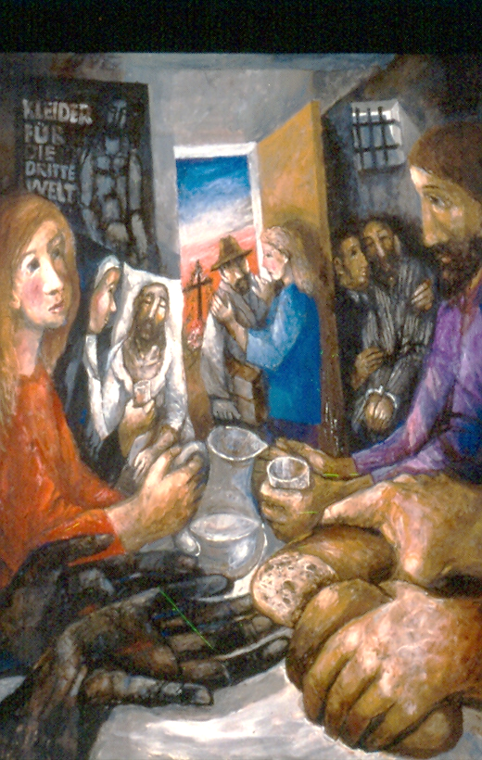
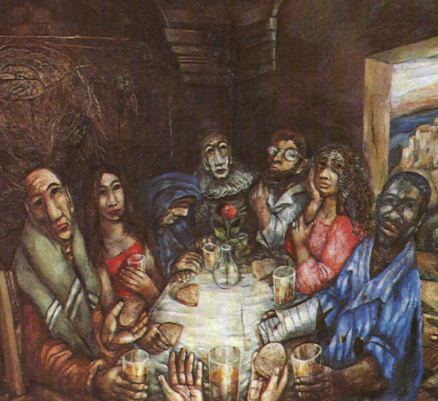
WHAT IS COMMUNION?
WHO IS WELCOME?

Slide 29
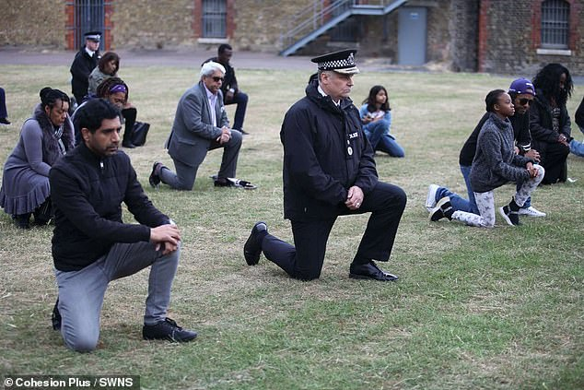
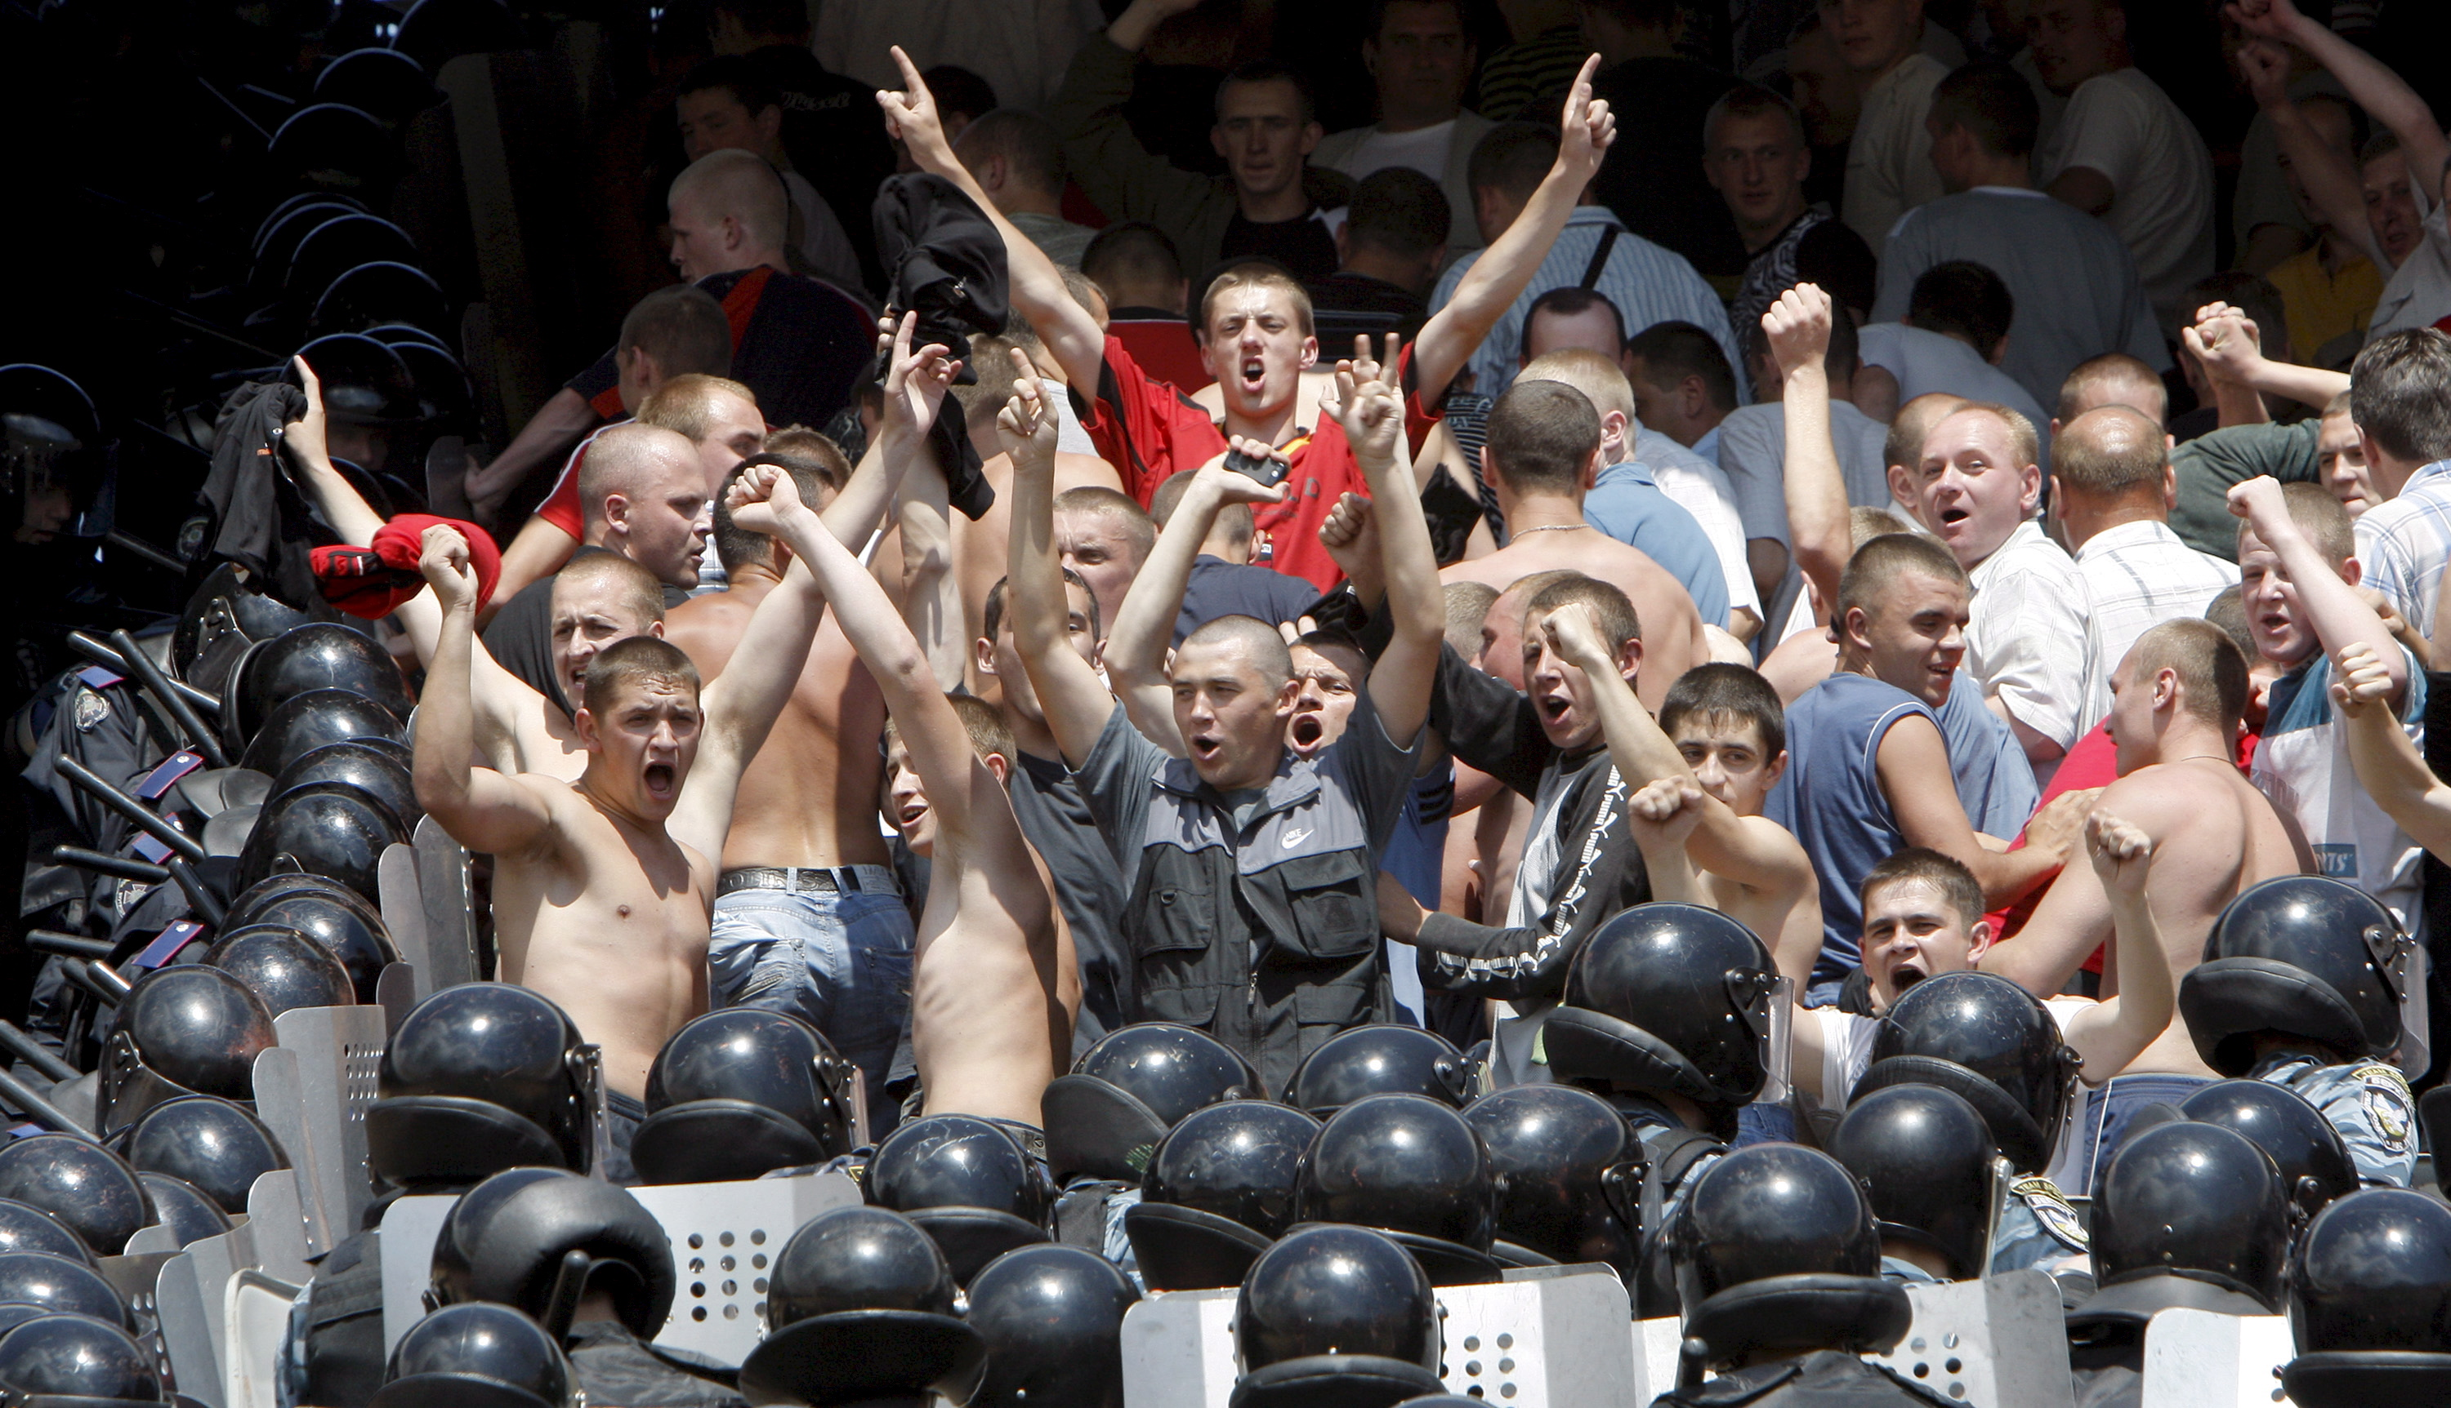
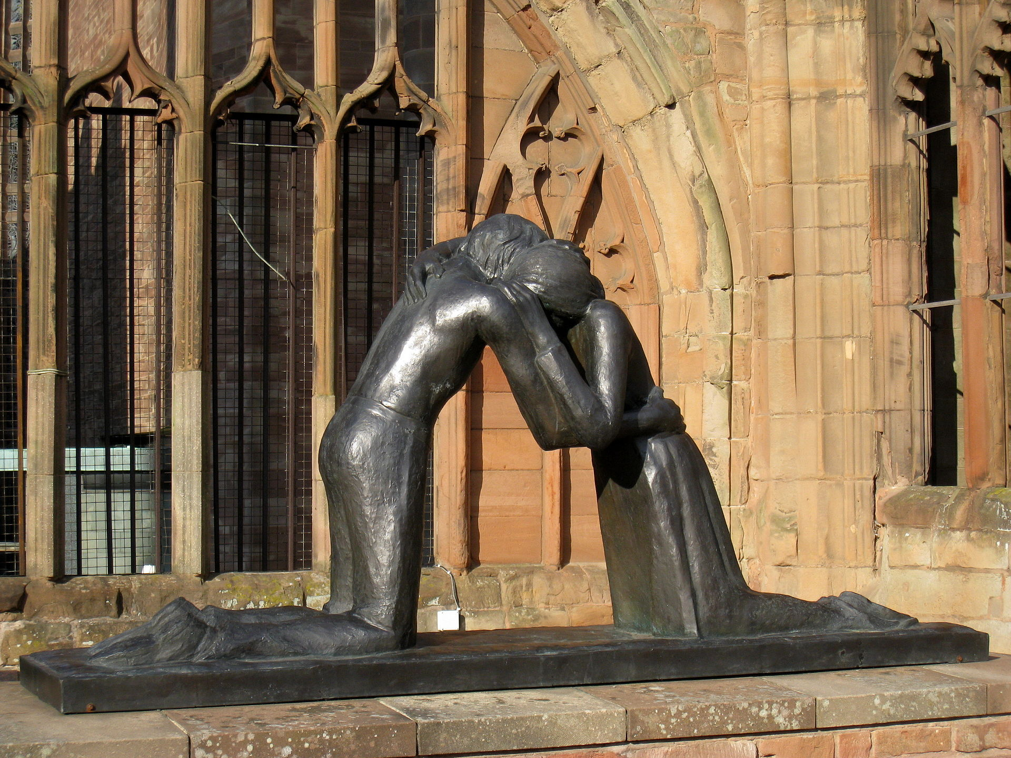
WHAT IS RECONCILIATION?

Slide 30
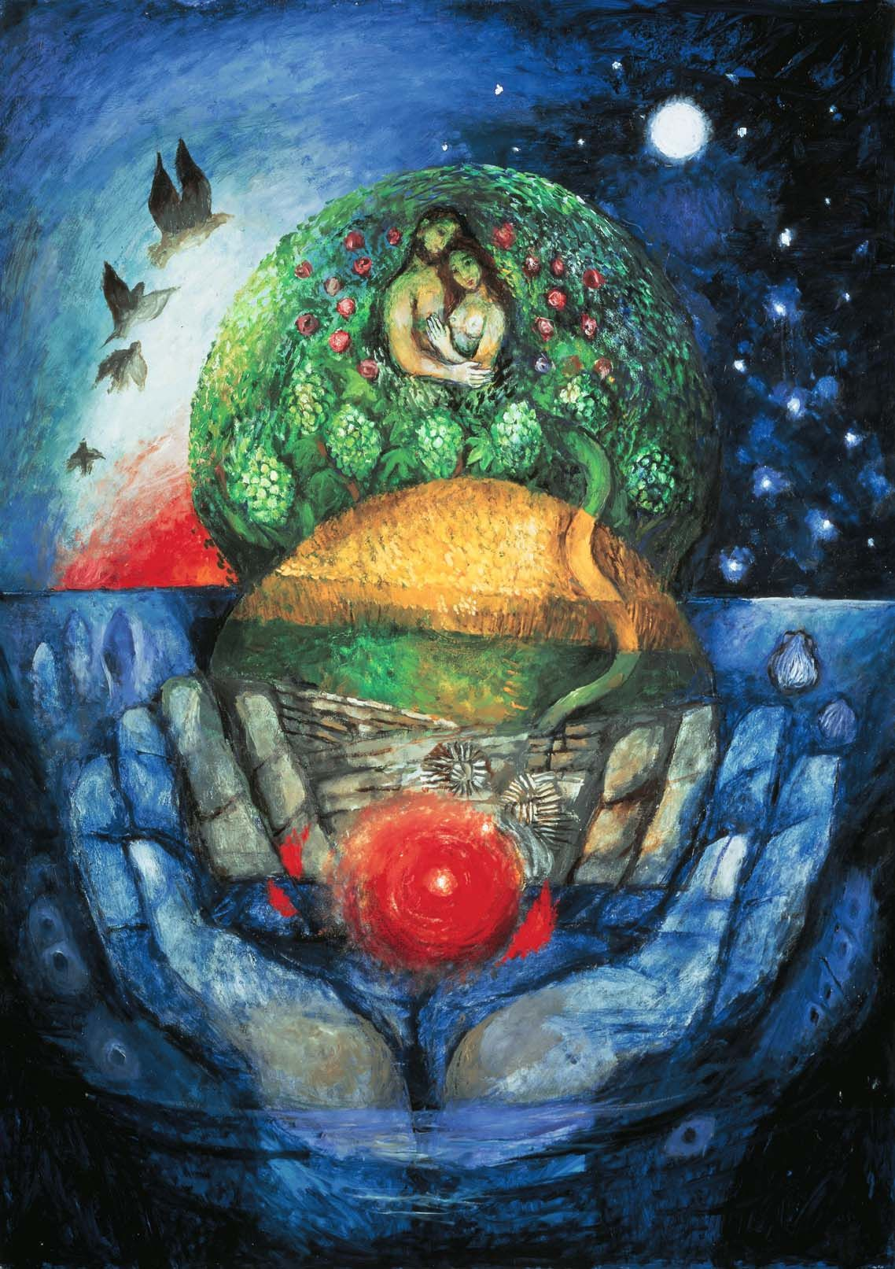

Slide 31
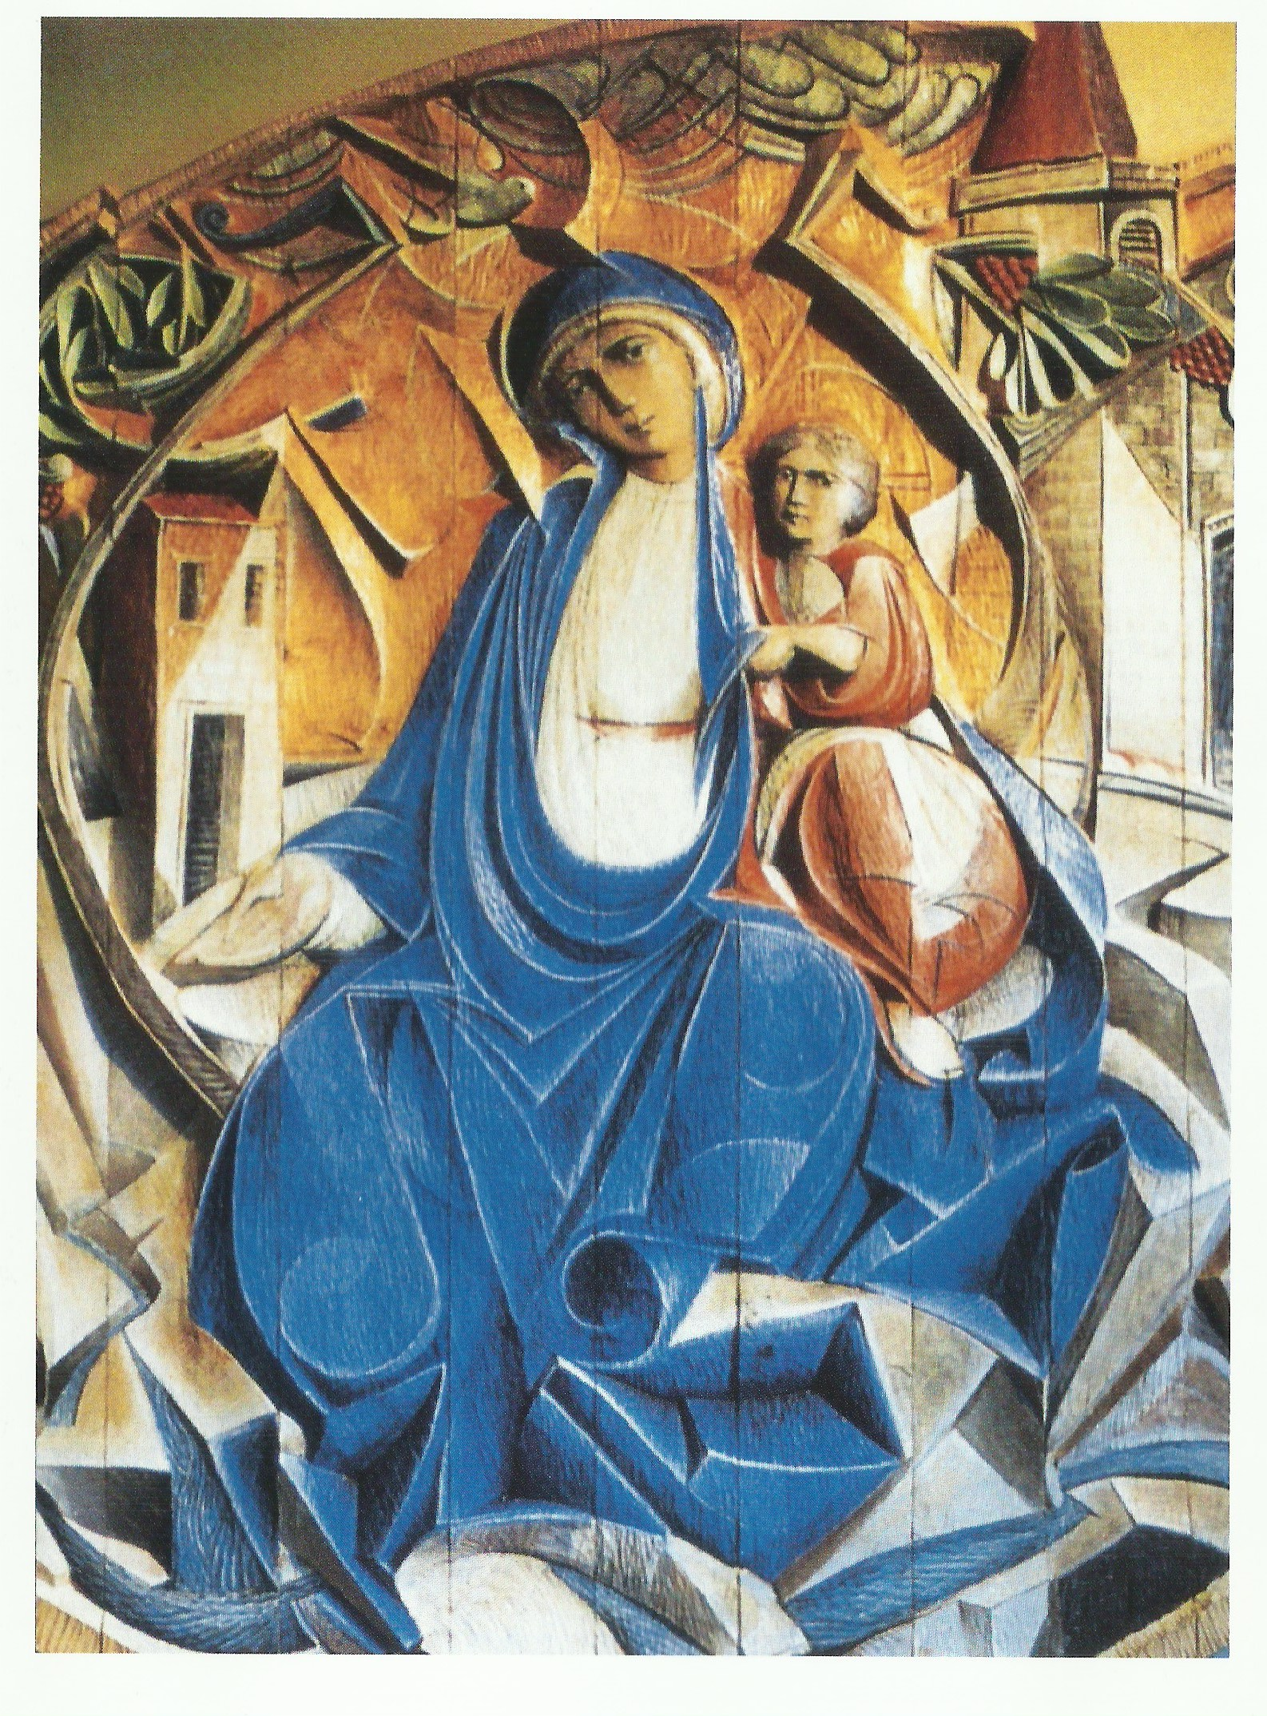

Slide 33
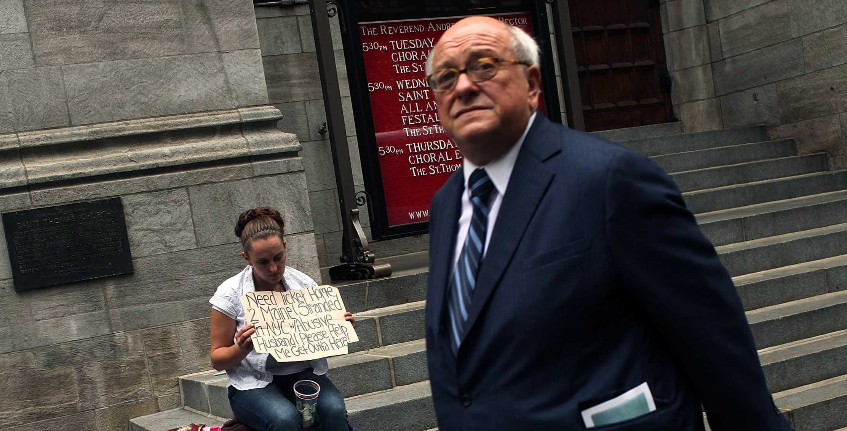

Slide 34
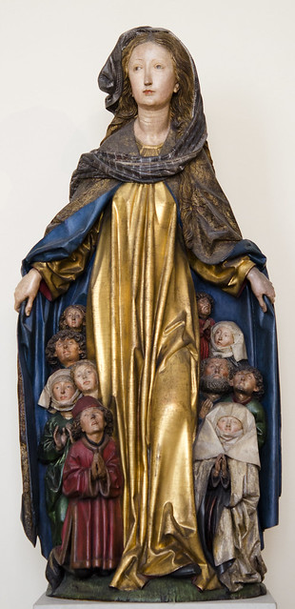
My soul glorifies the Lord,
my spirit rejoices in God, my Saviour.
He looks on his servant in her lowliness;
henceforth all ages will call me blessed.
The Almighty works marvels for me. Holy his name!
His mercy is from age to age, on those who fear him.
He puts forth his arm in strength and scatters the proud-hearted.
He casts the mighty from their thrones and raises the lowly.
He fills the starving with good things, sends the rich away empty.
He protects Israel, his servant, remembering his mercy,
the mercy promised to our ancestors,
to Abraham and his children for ever.

Slide 35
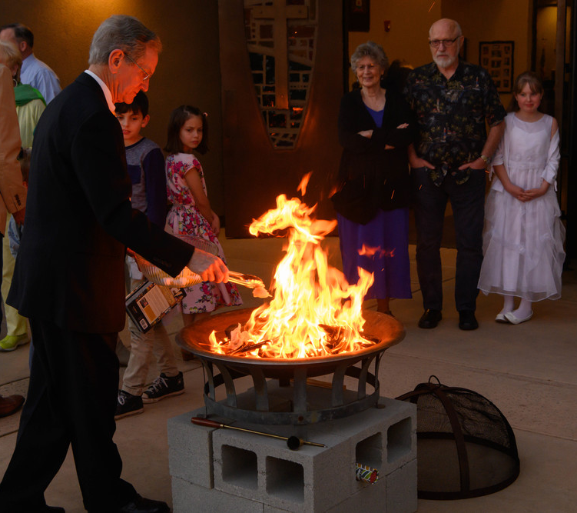
My mission of being
in the heart of the people
is not just a part of my life or a badge I can take off; it is not an “extra” or just another moment in life. Instead, it is something I cannot uproot from my being without destroying my very self.
I am a mission on this earth; that is the reason why I am here in this world. We have to regard ourselves as sealed, even branded, by this mission of bringing light, blessing, enlivening, raising up, healing and freeing.
Evangelii Gaudium, 273

Slide 36
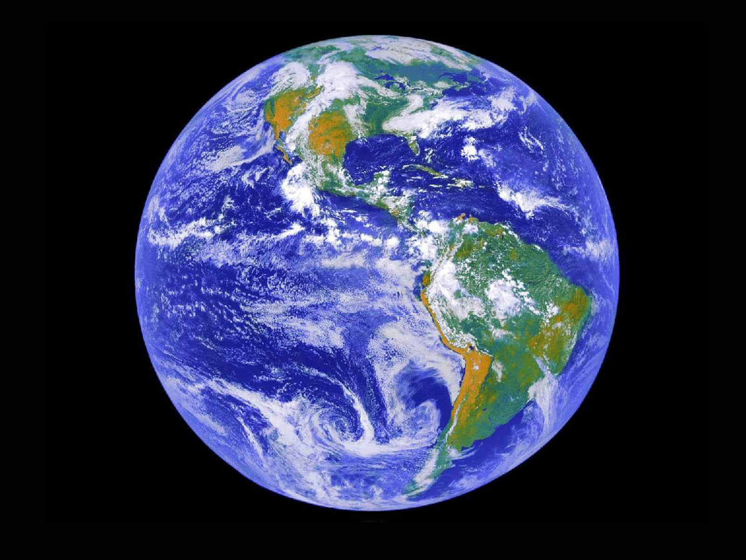
‘I am a mission on this earth’

Slide 37
Glory to God whose power, working in us, can do infinitely more than we can ask or imagine:
Glory to him from generation to generation in the Church, and in Christ Jesus for ever and ever. Amen.

