Slide 1
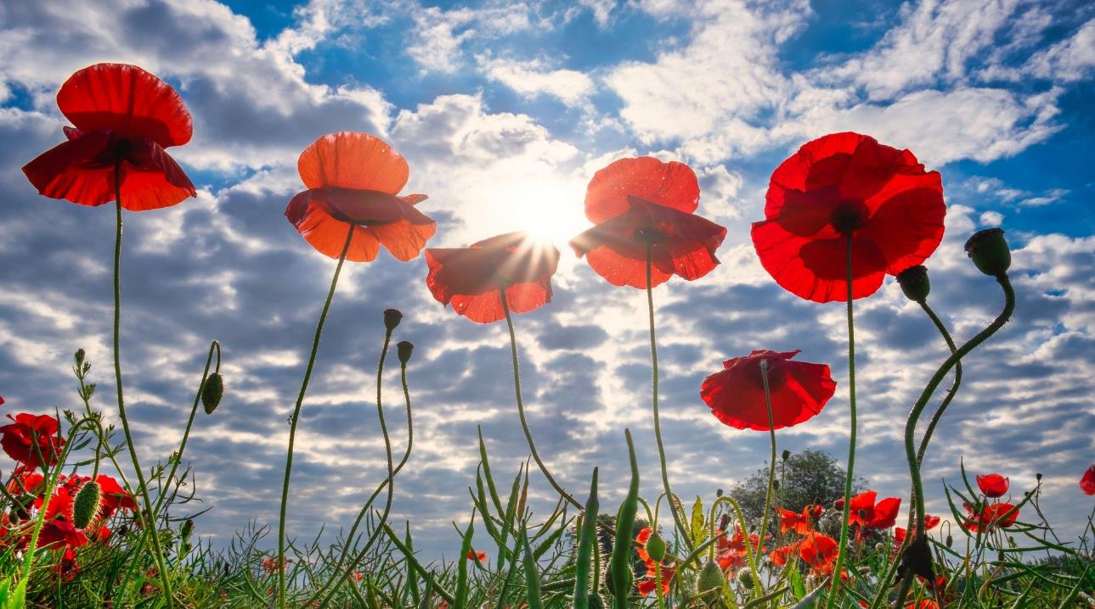
A season of Remembrance
Five Collective Worships on the theme of Remembrance for November 2021

Slide 2
Worship 1 – THE meaning of the POPPY

Slide 3
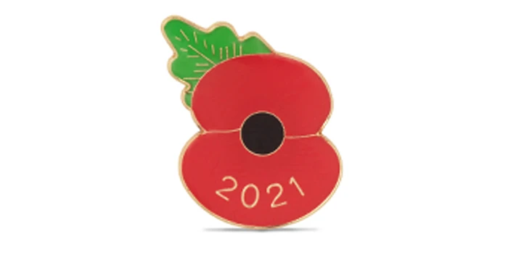
What does the poppy help us remember?

Slide 4
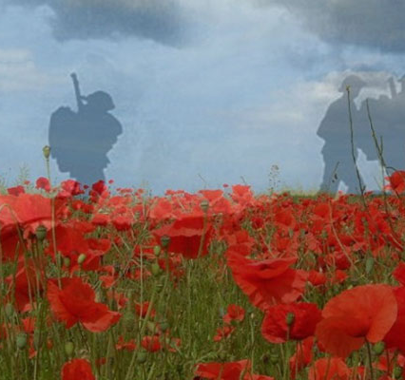
It helps us remember something that happened a long, long time ago: the First World War. Many of the soldiers who fought in this war never came home.
It was decided that there would be a special day every year for remembering. This was 11th November, the day when the Armistice was signed (an armistice is an agreement to end fighting).This day was called Armistice Day or Remembrance Day. It was also decided that everyone should wear a red poppy on that day. This was because many hundreds of red poppies were growing in the battlefields where many of our soldiers lost their lives in this war.

Slide 5
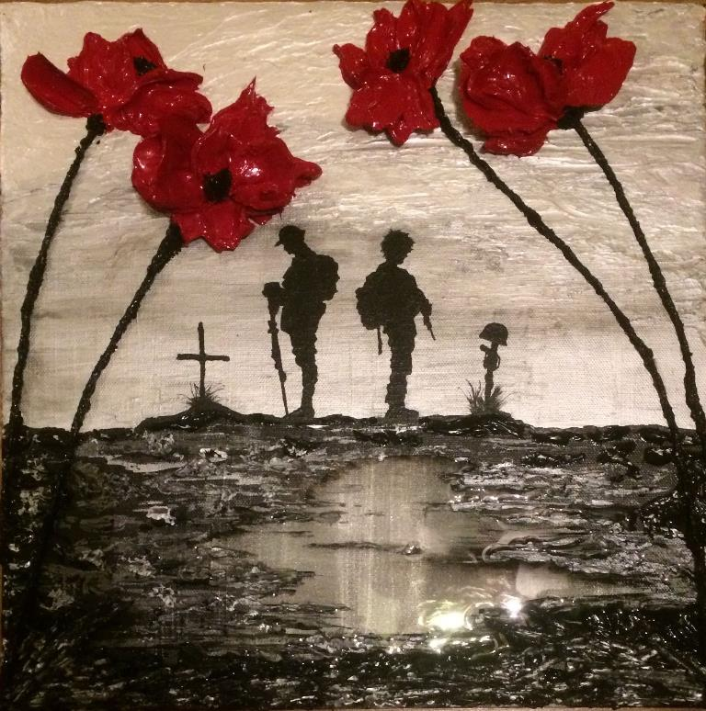
From 1939 to 1945 there was another terrible world war: the Second World War. After this, it was decided to move Remembrance Day from November 11 to the second Sunday in November. This Sunday is called Remembrance Sunday. On Remembrance Sunday we remember the British and Commonwealth servicemen and women who died in two world wars. We also remember the men and women in the armed forces who have given their lives in all the wars that have taken place since the ending of the Second World War. Wearing a red poppy will mean, ‘We are remembering together.’

Slide 6
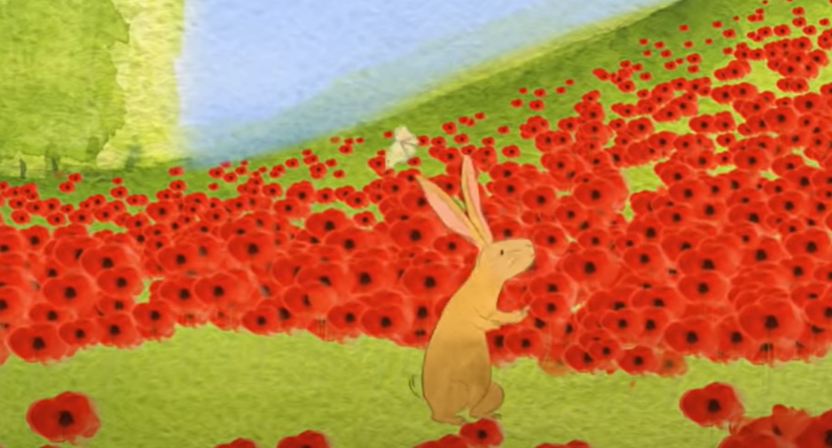
This week we will be remembering all those who have died in wars, their families and those who are still fighting for us and others today. Many families have had to go through terrible suffering and sadness and this is the time to remember them and their loved ones.
Watch the clip and spend time thinking about the different feelings involved in remembrance.
Watch me

Slide 7
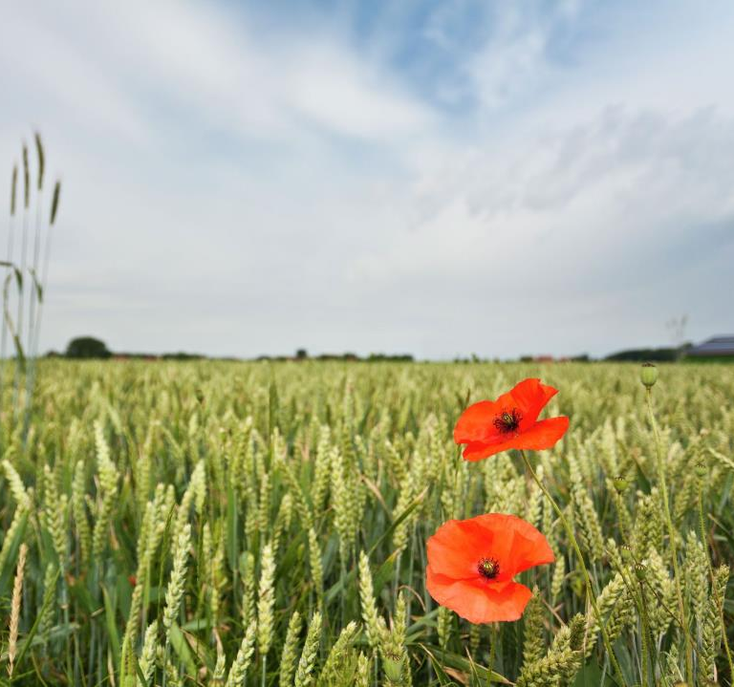
Reflection
Remembering the past, whether it is good or bad, can help us to make good choices in the future. If we know how good friends make us feel, then we should try to be good friends to others.
What have you done in the past that you can learn from?
Think about a time when you did something you knew you shouldn’t, how did it make you feel? Think about when you have done something well, how did that make you feel?
Try to use both of these times to help you make the right choice today.

Slide 8
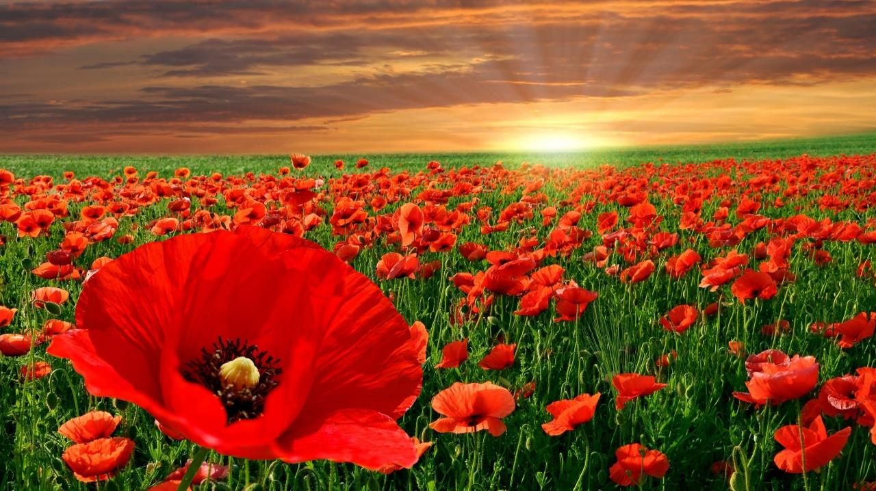
Time to think or time to pray
Father God,
On this Remembrance day, we remember all those who have and are serving in our armed forces. We thank you God for all those who sacrificed their lives for us.
We pray for all those who have been and are still affected by war, bring them your comfort and peace.
For those families who have lost loved ones, bring them your comfort and peace.
We pray for all those who have had to flee their homes because of war or persecution, bring them your comfort and peace.
We pray for protection and strength for all those who are currently serving as part of our armed forces, bring them your comfort and peace.
We pray for all our world leaders that they will make wise decisions, bring them your comfort and peace.
We thank you God, that you know and love each of your children, bring them all your comfort and peace today.
Amen

Slide 9
Worship 2 –we must remember

Slide 10
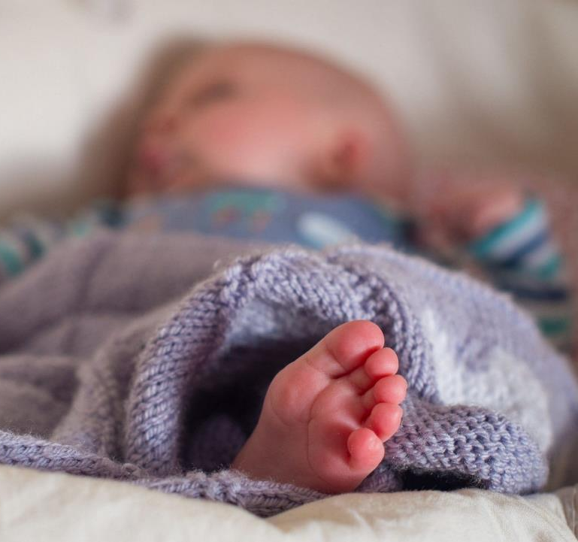
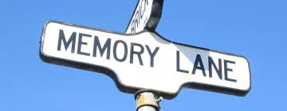
What is your earliest memory?
Why do we remember some things and forget others?
Why is it important to remember?

Slide 11
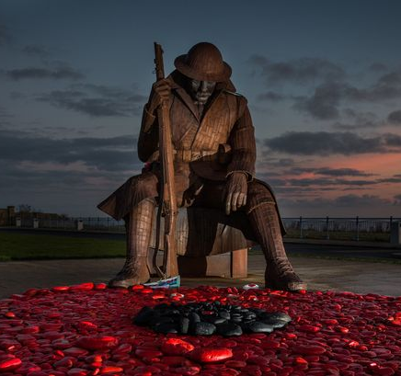
They shall grow not old, as we that are left grow old:
Age shall not weary them, nor the years condemn.
At the going down of the sun and in the morning
We will remember them.
We have chosen to remember the wars of the present and the past. Because we have chosen to remember it means that we think it is something that we shouldn't forget. We remember the battles that took place and the men who died fighting. In choosing to remember the battles and the men who have given their lives we are also choosing to remember that peace should never be taken for granted.

Slide 12
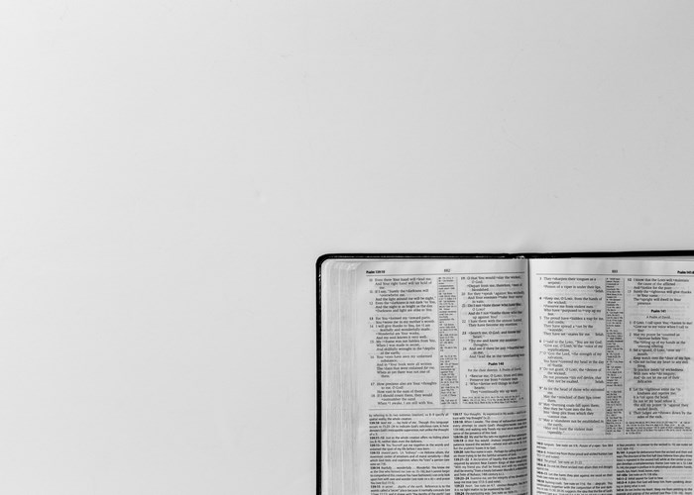
What does the bible say?
God stops wars all over the world;
he breaks bows, destroys spears,
and sets shields on fire.
“Stop fighting,” he says, “and know that I am God,
supreme among the nations,
supreme over the world.”
The Lord Almighty is with us;
the God of Jacob is our refuge.
Psalm 46:8-11
What is the important message for Christians to remember?

Slide 13
Time to think or time to pray
Time to think or time to pray
Dear God
We take time this remembrance week to be thankful. May we never take it for granted. Help us to choose to remember those who were and are not as fortunate as to live in peaceful times. May our remembrance be seen in our actions as we seek to learn the lessons from our past.
Amen

Slide 14
Worship 3 – the peace poppy

Slide 15
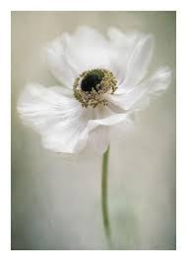
What do you think is the meaning of a white poppy?
Notes:
(These are traditionally used to represent victims away from the frontline and a commitment to a peaceful future).

Slide 16
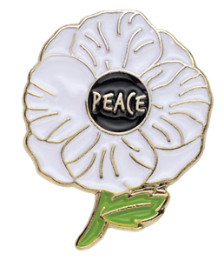
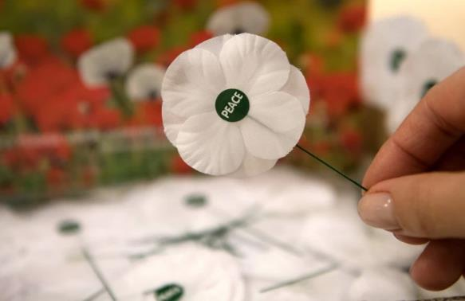
A white poppy represents peace.
Notes:
(These are traditionally used to represent victims away from the frontline and a commitment to a peaceful future).

Slide 17
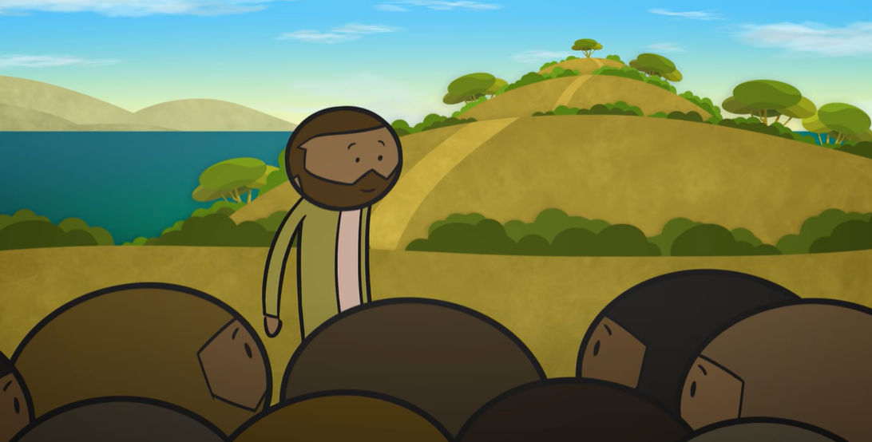
What did jesus teach about peace?
Click here

Slide 18
What does the bible say?
Jesus said - I leave you peace. My peace I give to you. I do not give it to you as the world does. So don’t let your hearts be troubled. Don’t be afraid.
John 14:27
Christians have God’s peace available to them, a peace that is greater than anything the world offers. Being worried, anxious and scared can stop us from living peaceful lives. God promises to leave his peace with his people so they don’t need to be afraid or worried

Slide 19
The Gift of peace
The peace at the end of the Second World War must have seemed like a gift. The war lasted five years. It not only affected the soldiers fighting, but planes bombed towns and cities across Europe. All of those affected by the war must have felt peace was never going to come. The eventual peace at the end of the Second World War cost the lives of an estimated 20-70 million people as well as the cost of rebuilding towns and cities due to the bombing.
In Europe and across much of the World, the majority of families would have known someone who had died in the conflict, someone they thought important who died as a result of the war. Some gifts are lasting reminders of what we hold to be important.

Slide 20
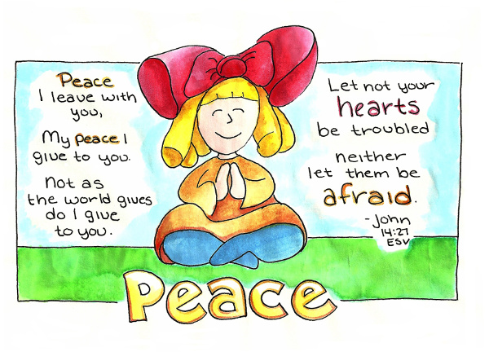
Time to think or time to pray
Dear God
We know that Remembrance Day is the day we set aside to think of those who died in war. We are thankful for the relative peace we have enjoyed in the UK in the years since the world wars. We pray for peace in places around the world that are at war now. Help us all to learn the lessons from the actions of the past. Help us to change the bad and repeat that which is good.
Amen

Slide 21
Worship 4 – William Coltman

Slide 22
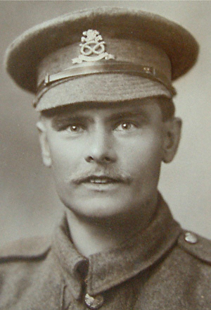
Lance Corporal William Coltman
(1891-1974)
Like so many other young men, William Coltman joined up in January 1915, aged 26, initially as a rifleman in the North Staffordshire Regiment, but he never fired a shot. He was a Christian, and early on in the war, he made the decision that he wanted to be a ‘peacemaker’. He determined that he should not end lives, but try to save them.

Slide 23
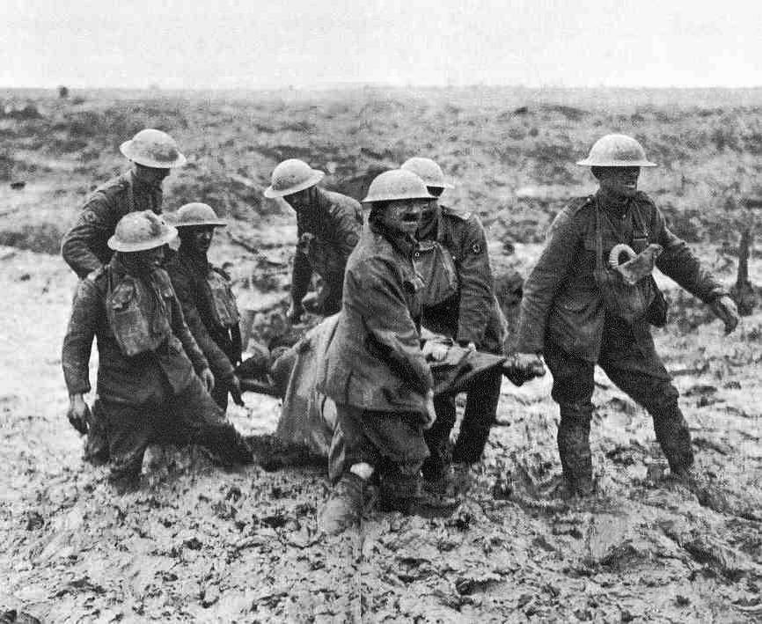
And so, instead of fighting, he became a stretcher-bearer. The job of a stretcher-bearer was to rescue the injured men from where they fell, often trudging through the mud in ‘No-Man’s Land’ – through enemy fire from all sides. William was only 5’4” tall, but he didn’t let his size stop him, and he was well-known for carrying the wounded off the battlefield on his back! Most nights, he would venture out into enemy lines to see if any of his regiment were left behind.

Slide 24
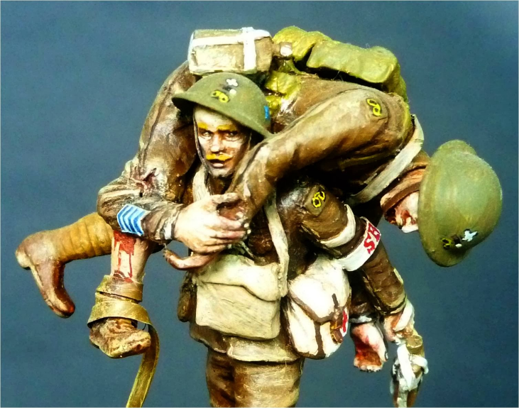
This sculpture is modelled on him, and shows him carrying a wounded soldier away from the battlefield on his shoulders.

Slide 25
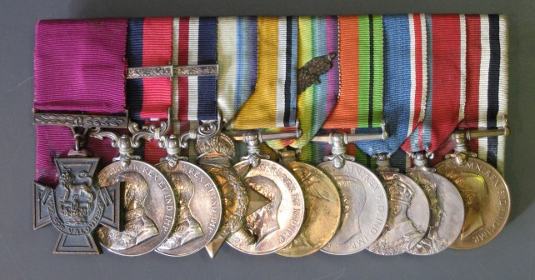
Photo © South Staffordshire Regiment Museum
He did this for three years and was awarded the Victoria Cross for his actions on October 3rd & 4th, 1918. His official letter states that: ‘This very gallant officer tended the wounded unceasingly for 48hours….He won many other medals too, yet never fired a single bullet.’ William Coltman was one of the few who survived WWI.

Slide 26
What can we learn from William Coltman?

Slide 27
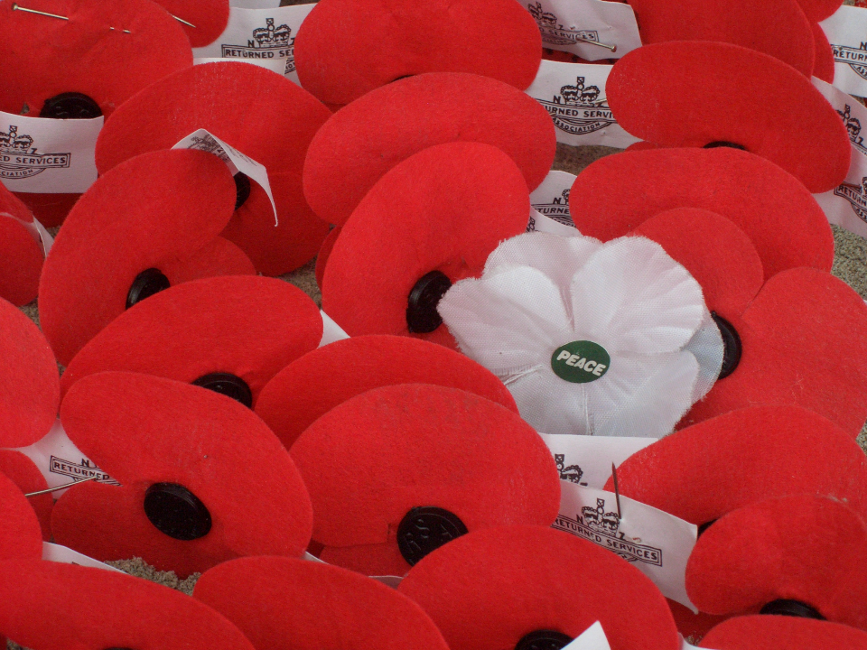
Quiet reflection
‘At the going down of the sun, and in the morning, we will remember them…’

Slide 28
Time to think or time to pray
Today we have heard about one WWI soldier whose life made a difference, and whose bravery and service is especially remembered by us.
His example shows that even in the midst of war, it is possible to live honourably.
Jesus called all who followed him to act in this way…but even if you’re not a follower of Jesus, acting peacefully is still good!

Slide 29
Worship 5 – walter Tull

Slide 30
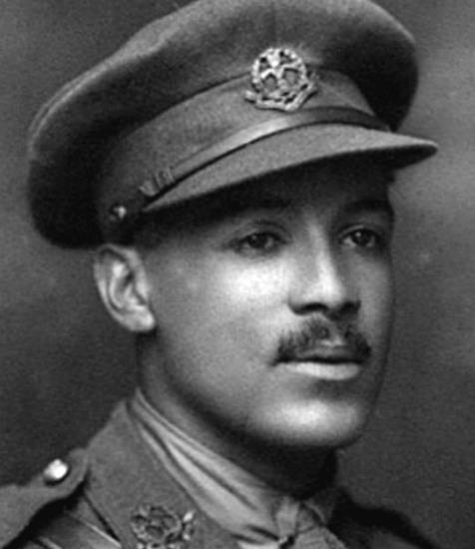
2nd Lieutenant Walter Tull
(1888-1918)
Walter Tull was born in 1888, but his parents died within 2 years of each other, when Walter was just 9 years old. He was sent to an orphanage, a home for children without any parents, and it was here that he started playing football.
Photos © Tull family archives & National Archives

Slide 31
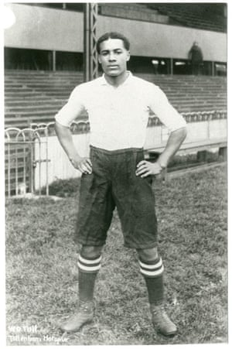
‘Tull is so clean in mind and method as to be a model for all…’
Walter was spotted and signed by Tottenham Hotspur FC and became one of the first black professional football players. He played in front of crowds of many thousands, and although Walter often received racial abuse, he never retaliated. One reporter wrote that: ‘Tull is so clean in mind and method as to be a model for all…’

Slide 32
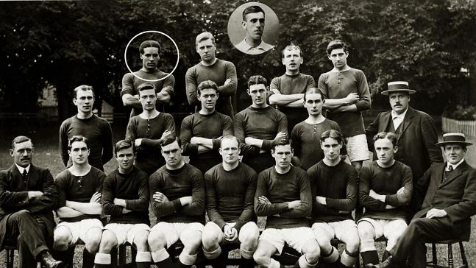
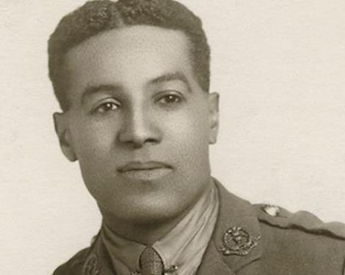
Northampton Town FC
He was then signed by Northampton Town FC in 1911 for a ‘substantial fee’. He played 111 games for the team, playing the final game in the season in 1915, having signed up for a regiment nicknamed the ‘Football Battalion’, the 23rd Middlesex Regiment. In November 1915, Walter shipped out to France to fight.
Notes:
Slide 13: He was then signed by Northampton Town FC in 1911 for a ‘substantial fee’. He played 111 games for the team, playing the final game in the season in 1915, having signed up for a regiment nicknamed the ‘Football Battalion’, the 23rd Middlesex Regiment. In November 1915, Walter shipped out to France to fight.

Slide 33
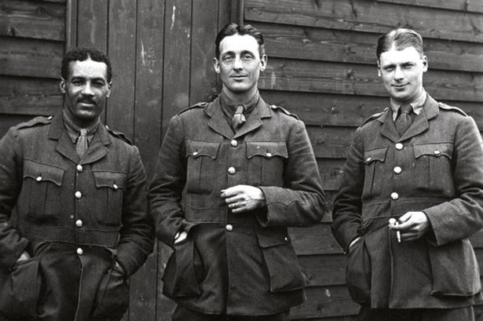
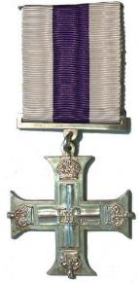
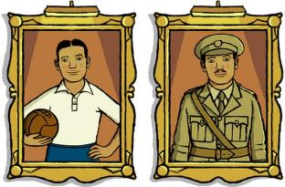
Walter had been highly regarded as a football player – respected for his integrity on the football field – and became equally popular with his battalion. He was the first black soldier to be promoted to officer status, very much against what was ‘normal’ at the time. It would be 23 years before this would be done again!
He was praised for his actions following a night-time raid into enemy territory and was recommended for the Military Cross because of his "gallantry and coolness". Walter sadly died in the final few months of the war, on March 25th 1918. His Commanding Officer wrote to Walter’s elder brother Edward, saying “how popular he was throughout the battalion. He was brave and conscientious…the battalion and company have lost a faithful officer, and personally I have lost a friend.”
Photo © BBC

Slide 34
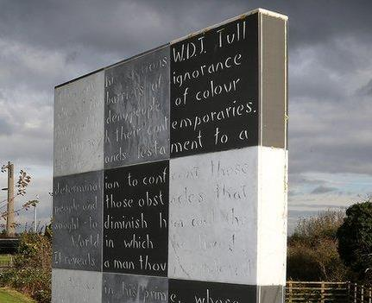
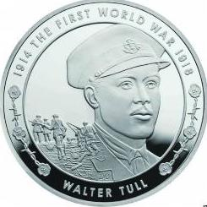
This memorial stands outside the Northampton FC ground, commemorating his life, and marking the significance of his quiet fight against racism.
His family are still waiting for his Military Cross medal….but his face did appear on a commemorative £5 coin in 2014!
Photo © BBC

Slide 35
What can we learn from Walter Tull?
Photos © Tull family archives & National Archives

Slide 36
‘be a peacemaker’
Jesus once talked about being a ‘peacemaker’ – and that our world would need people who would be prepared to act in ways that would bring peace.
I wonder what it might be like for us to try to live as peacemakers?
How could we do this today?

