Slide 1
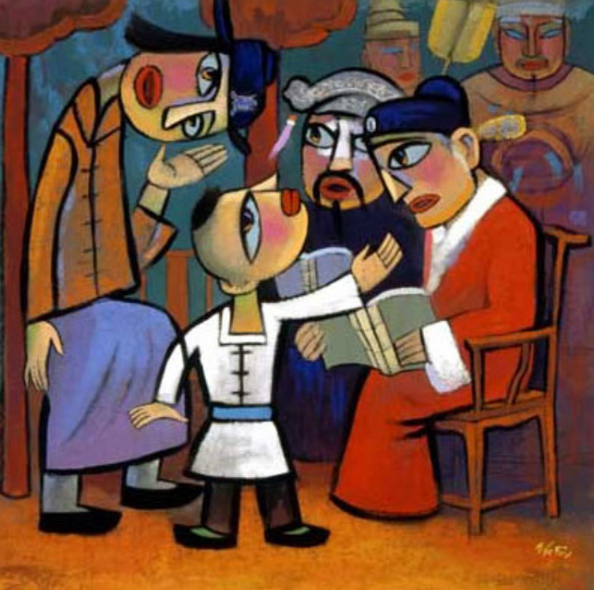
‘Strong in Spirit and Filled with Wisdom’ –Jesus as a child.
Collective Worship planning
for the season of Epiphany
Notes:
"Jesus in The Temple" - He Qi

Slide 2
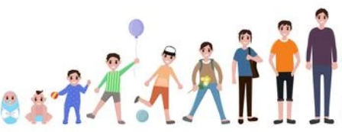
Introduction
The parables, miracles and teachings of Jesus with which we are so familiar took place in a period of only 3½ years.
The Bible says: ‘Jesus did many other things as well. If every one of them were written down, I suppose that even the whole world would not have room for the books that would be written.’ John 21:25
The gospel of John tells us that there were many remarkable incidents in the life of Jesus but not all of them are recorded. Some of them we are more familiar with than others. This resource looks at what is known about Jesus as a child.

Slide 3
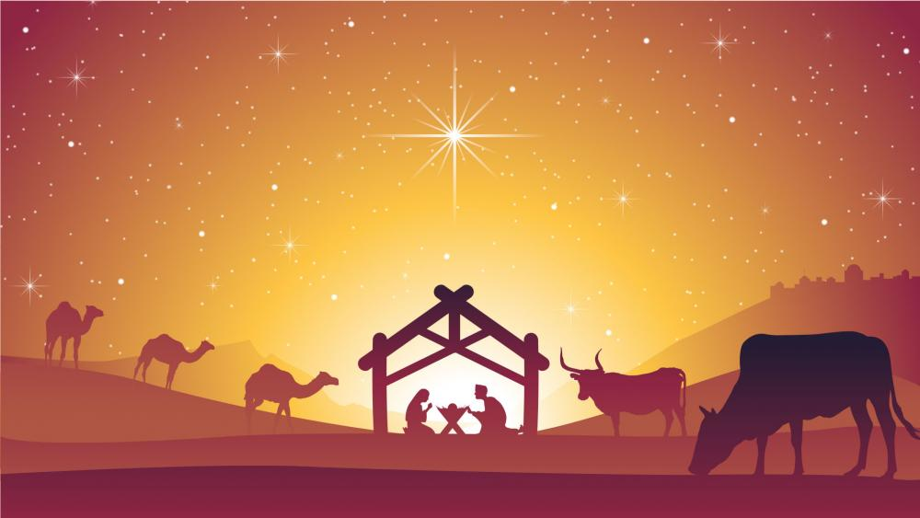
Worship 1: Epiphany

Slide 4
How does it feel to open a gift?

Slide 5
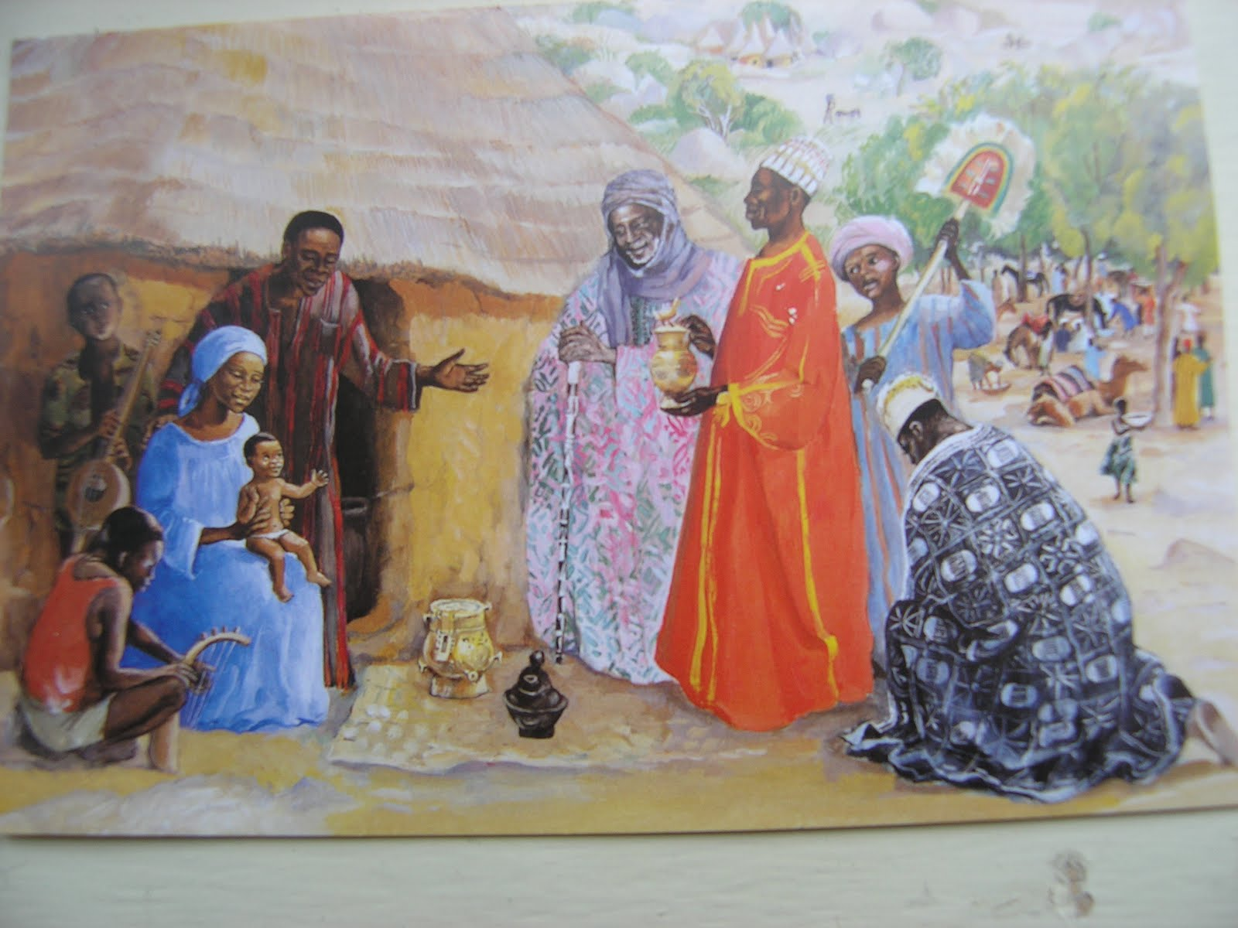
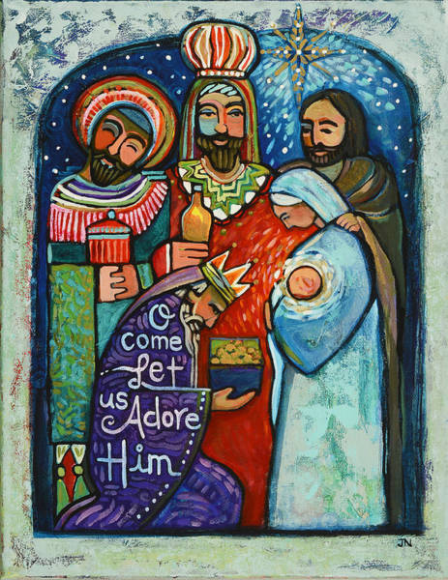
What do you know about this gift story?

Slide 6
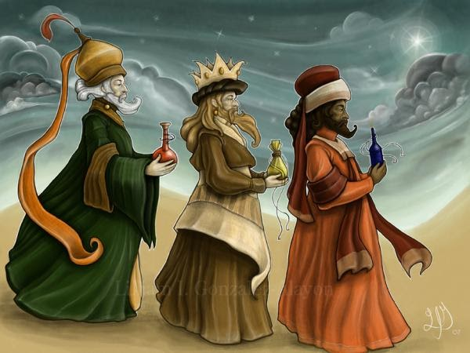
The gifts are clues as to who Jesus was.
watch this

Slide 7
Time to think or time to pray
Thought for all:
The Wise Men journeyed for many, many miles. They left behind everything important to them to face unknown dangers and hardships. All of this was done with the hope of giving their gifts to one called to great things.
All of us, no matter what we believe, are called to the journey which is life and face unknown dangers as we grow.
What matters is how we respond to the challenges we face as we keep our minds focussed on our goal whatever that may be.
Invitational prayer:
O Lord Jesus, we think of you at the crib, we remember that you were born as a tiny baby as we also were born.
The wise men worshipped you as the king of kings, greater than any earthly king. They knew you had come to rescue our world and show us what God is like. Thank you.
Give us the strength and love to follow you through our lives so that we may come at last to your heavenly kingdom, Amen.
Reflection for all:
Think of those family and friends who have helped and supported you through difficult times and challenges.
Quietly in your head say thank you to each one.

Slide 8
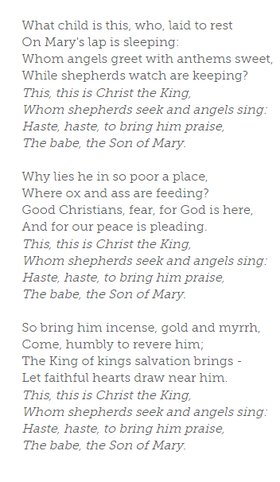
Song
What chid is this is a traditional carol sung to the well-known English folktune, 'Greensleeves’.
It is a clever example of a question and answer song - in this case about the Christmas story.

Slide 9
Worship 2: Refugee

Slide 10
Why do people move house?
How do they prepare?

Slide 11
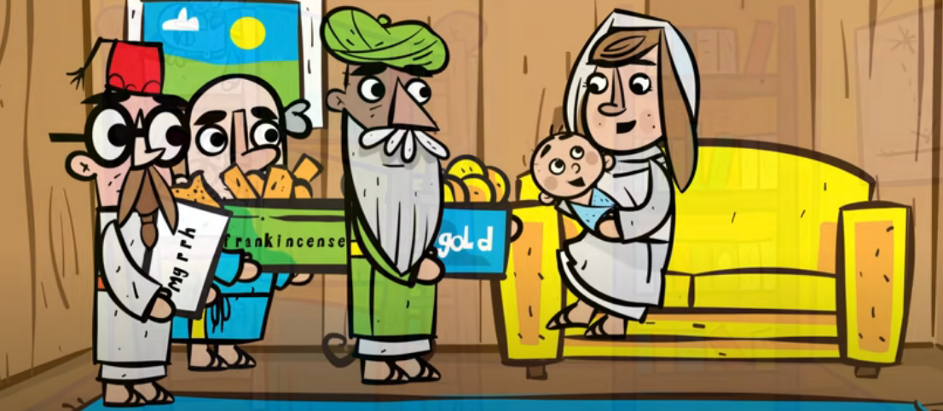
How about moving country?
After the wise men left, Joseph and Mary moved to Egypt to keep Jesus safe. It wasn’t a story that ended happy ever after…
watch this

Slide 12
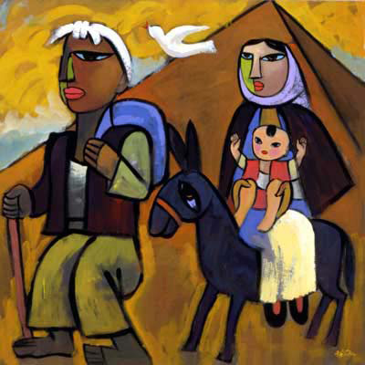
Time to think or time to pray
Thought for all:
How do you think they felt living in a place so different to where they had come from? I wonder what their journey was like? I wonder how they felt having to leave their home and possessions behind? I wonder how they felt leaving friends and family? I wonder if they ever felt welcomed and loved in Egypt? It must have been hard, scary and difficult for them to get used to another culture and another language.
Sadly, thousands of people in the world today share the experience of Mary and Joseph. They are ‘refugees.’ A refugee is a person driven from their home by war and violence. Sometimes a lack of food and water also forces people to become refugees.
Invitational prayer:
Dear God, We are thankful for the peace we experience in this country. We are thankful for our school, our friends and who keep us safe and help us learn. Please help us to consider those who have had to leave their homes due to war. May we be kind to any we meet. Amen.
Reflection for all:
What could we do as a community to support, love and include everyone?
Reflect on the ways you could help any refugee child feel welcome at school.

Slide 13
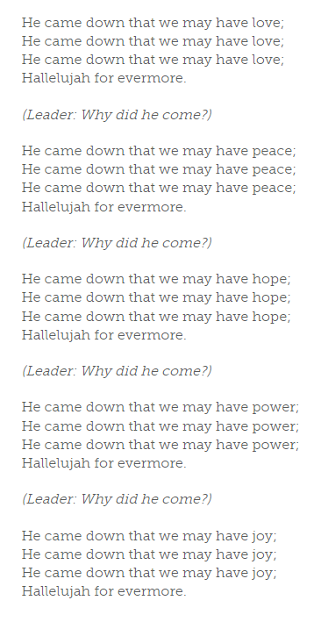
Song
He came down is a song from the Cameroon that can be sung at any time of the year but is particularly suitable at Christmas. It can be sung with actions: start with both hands in the air, sweep them downwards across the body on the words 'he came down'. On 'love' cross your hands over your chest. For 'peace' make a dove with your thumbs overlapping and your fingers as wings. For 'hope' open your arms with palms upwards. On 'power' make both hands into fists and raise your arms. For 'joy' lift both hands and shake them. You could add other values of your own - and some actions!

Slide 14
Worship 3: Growing up

Slide 15
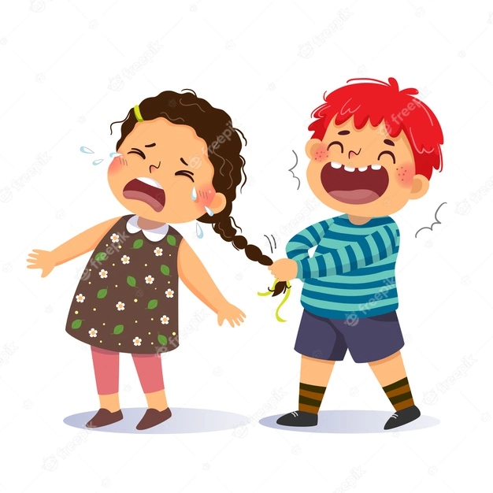
What is it like being the eldest sibling?
What is it like being the only child?
What are some of the wise ways to help you get on with your siblings?
What is it like being the youngest?

Slide 16
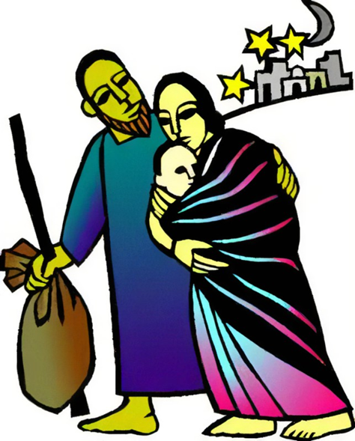
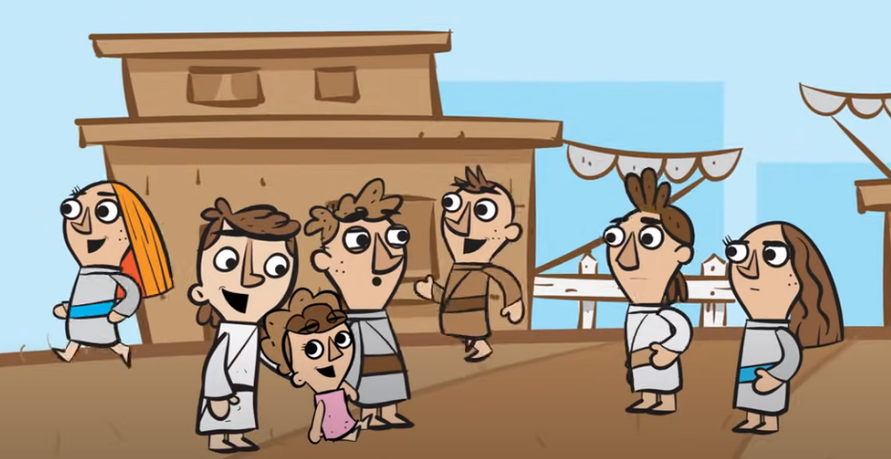
In the end Jesus didn’t grow up in Egypt. Instead he was between two and five years old when his mum and dad journeyed north to Nazareth in Galilee. They were too afraid to return home to Bethlehem in Judaea because one of Herod's son was now ruling. Instead Jesus was brought up in Galilee (ruled by another of Herod’s sons) and later became known as ‘Jesus of Nazareth’.
The Bible tells us that Jesus had 4 younger brothers and at least 2 younger sisters. This means he was the oldest of seven! His father Joseph was a carpenter. This means he worked with wood. It was a job needing skill, patience and hard work. All of this Jesus would have observed as he grew up, probably at the same time as looking after his younger brothers and sisters. But Jesus would have been a perfect child which would have made him different from everyone around him.
click here

Slide 17
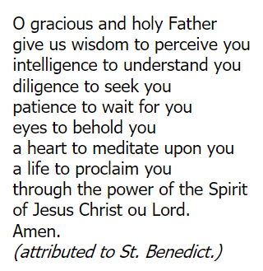
Time to think or time to pray
Thought for all:
The Bible says in Luke 2:40 that Jesus as he grew up became ‘strong in spirit and filled with wisdom’.
I wonder… what do you think this means?
Are there times when you have made wise choices? Or unwise choices?
What helps us become wise as we grow up?
Invitational prayer:
Reflection:
Who or what helps you make wise choices?

Slide 18
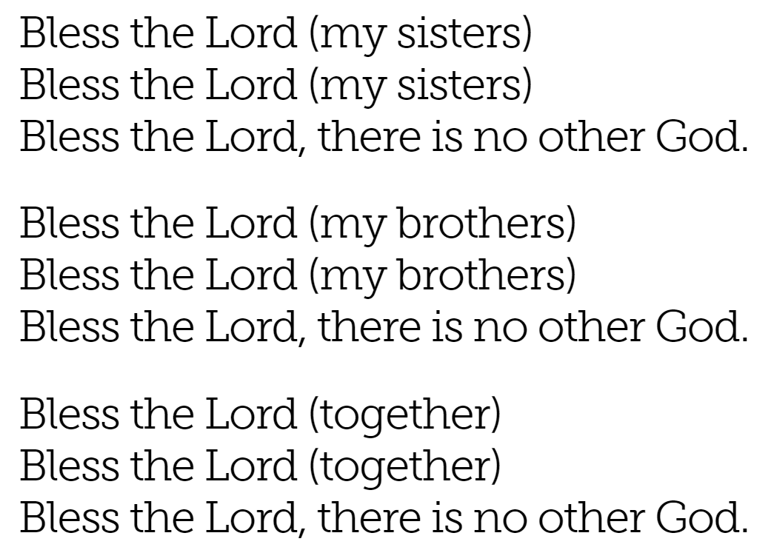
Song
Bless the Lord - Worship Workshop This simple song is from Kenya. The words in brackets can be sung by a leader or a small group. You could also make up your own verses. How about: 'Bless the Lord (our teachers)' or 'Bless the Lord (us children)'.

Slide 19
Worship 4: Jesus at 12 years old

Slide 20
Have you ever lost anything important?
Have you ever been lost? What happened? How did you feel?

Slide 21
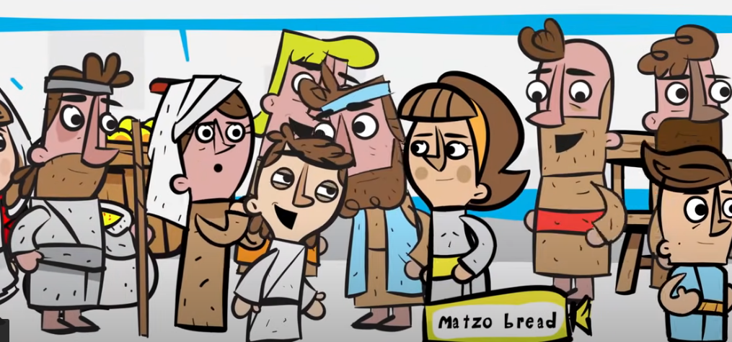
Jesus in the temple
Jesus was lost by his parents once. Where do you think they found him? What do you think he got up to while he was on how own? Let’s find out what happened.
click here
Notes:
Jesus grew up in the home of Mary and Joseph. Joseph was a carpenter and it is likely that Jesus would have helped him sometimes, so he would have learned how to use different tools and how to make things out of wood.
Jesus also spent some time at school. The sort of school he would have attended would have been run in the local temple or synagogue, which is a Jewish church building, and the teachers would have explained about reading, writing and God to the children who were there. Jesus would have gone to this sort of school, like many other children, and made the most of his chance to learn.
Once a year, all the people in Jesus’ village went to Jerusalem for a few days for a special celebration. Mary and Joseph took Jesus and they all had a good time. As they were on their way home, however, Mary suddenly realized that Jesus was not with her, so she asked Joseph if he had seen the boy. Joseph couldn’t see him anywhere and suggested that they should go back to Jerusalem to find him.
Mary and Joseph worried about Jesus as they rushed back to the city. Where could Jesus be? They started to search the rooms where they had stayed and the roads nearby.
Eventually, they decided to look in the temple, the huge synagogue at the heart of the city. As they entered the building, they spotted Jesus there, sitting on the floor talking to the priests.
As they went closer, they heard him asking questions, finding out as much as he could, listening and learning all the time. The priests were really impressed with all that Jesus knew and his eagerness to learn more.
As Mary and Joseph set off back home with Jesus, they asked him why he had been there. ‘Didn’t you realize that I would be there, in ‘My Father’s House’?
And from this time Jesus kept growing in wisdom.

Slide 22
I wonder…
Why did it take so long for his parents to notice Jesus was missing?
Jesus must have been a very sensible child. His parents probably thought he was with other family members travelling back and trusted him to behave well.
Jesus said he was in his father’s house. He knew that God was his father and the temple was his special house where he could learn more about him. He was growing up and part of growing up is asking questions about who we are and where we belong.
Notes:
Jesus must have been a mature and sensible child. His parents probably thought he was with other family members travelling back and trusted him to behave well. it was on the third day after the festival that they found him in the temple area. He was not playing with other boys, lost or even scared to be on his own. He was instead involved in discussions with some teachers of the law in Jerusalem, “both listening to them and asking them questions” (Luke 2:46).
Rather than being annoyed by one so youthful, these intelligent men were astounded by Jesus’ questions and responses and, most importantly, by his grasp of deep theological topics. Luke’s account says, “All who heard Him were astonished at His understanding and answers” (verse 47). Truly they were in the presence of a very divinely gifted young man.
Once He was located, Joseph and Mary were relieved to find Jesus safe. Yet at the same time they were bewildered by their Son’s surprising behavior and seeming lack of appreciation for the anxiousness He had caused.
Mary took the lead in asking what it all meant. It seems Joseph remained quiet for the moment and allowed her to speak for them both. Perhaps it was because Jesus was conceived in her womb or because, being a concerned mother, she was the one more emotionally distraught after the days of searching, but Mary now sought an answer from her Son.
Jesus’ mother showed wisdom and self-control in that she first inquired about her Son’s intent. She asked in verse 48, “Son, why have You done this to us? Look, Your father and I have sought You anxiously.”
Many parents would automatically allow their frustration or anger to dictate their action and might lash out at their child for causing such distress, but she apparently knew her Son had never been irresponsible or rebellious and so she sought an honest understanding of what He was doing.

Slide 23
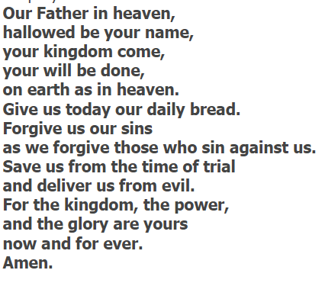
Time to think or time to pray
Thought for all: Jesus was growing up but at 12 he wasn’t yet ready to start teaching about God and who he really was so he went home with his parents and became a carpenter just like his dad Joseph. This must have made his parents really happy. In fact he didn’t start teaching about God for another 18 years.
In that time he grew up like we all do. He changed physically, became wiser, learnt how to make friends, learnt a profession all while being a part of a busy family and following the rules. But with one important difference. Christians believe Jesus was perfect - both as a child and an adult. He never made a single mistake. Not ever.
Do you think you could follow all of the rules all of the time and never make a mistake?
Invitational prayer:
Reflection for all:
Do you think you could follow all the rules all the time and never make a mistake?

Slide 24
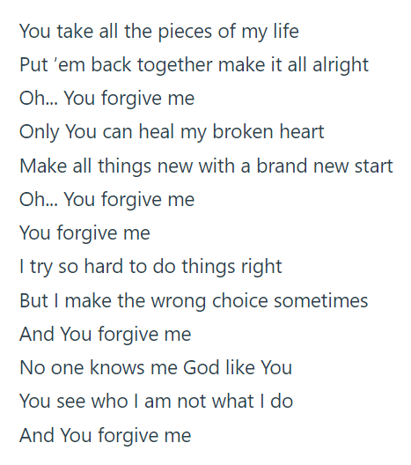
Song
(5) You Forgive Me | Maker Fun Factory Music Video | Group Publishing – YouTube
Listen or join in with the words.

Slide 25
Worship 5: Baptism

Slide 26
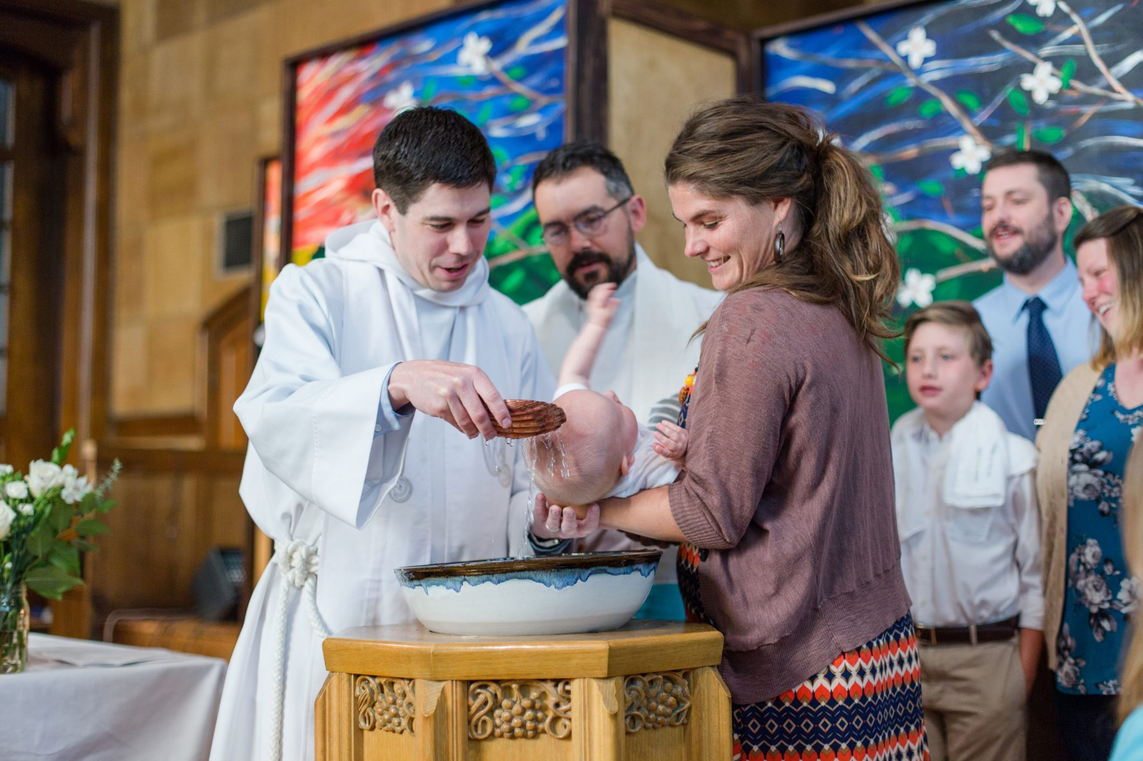
I wonder, have you ever seen a baptism or christening where water is poured over someone’s head as a sign of God’s love?

Slide 27
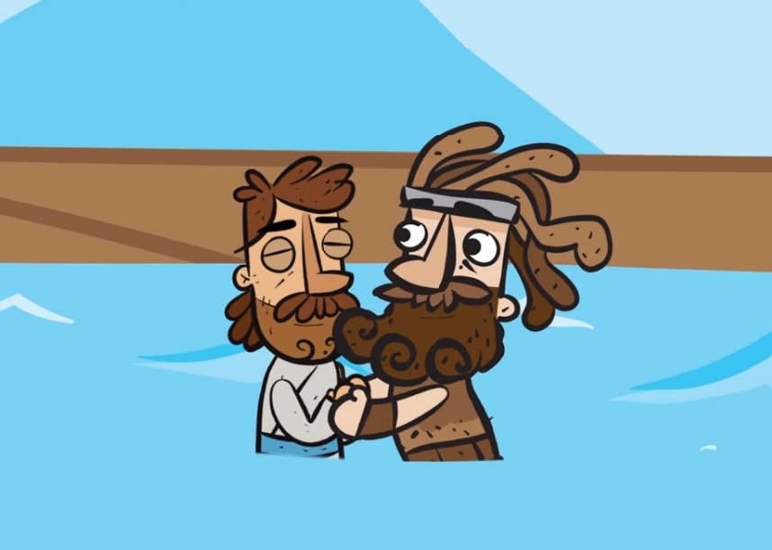
When Christians join the church they are baptised. This can happen as an adult or as a child. Maybe you were christened as a baby or know someone who was?
watch this
Jesus was baptised around the age of 30 just before he started teaching about God. At his baptism something special happened…

Slide 28
Time to think or time to pray
Christians believe being baptised is like a new beginning and one which brings them closer to God. They also believe that it doesn’t matter if you have been baptised or not, God still loves you. The Bible says ‘You have called us by our name, we belong to you’ (Isaiah 43:1-7).
The Lord says, I created you, I formed you, do not fear, for I have saved you; I have called you by your name, you are mine. When you pass through rivers, I will be with you and I will keep you safe. When you walk through fire, I will not let you be burned. For I am your God, the Holy One. You are precious in my sight and I love you. Do not be afraid, I am always with you.
Isaiah 43:1-7
Invitational prayer:
Dear God,
Thank you for sending Jesus to be baptised. Thank you that you looked down on him and saw he was an amazing person. Thank you for thinking that about us too.
Amen
Reflection for all:
Who do you belong to? And who belongs to you?

Slide 29
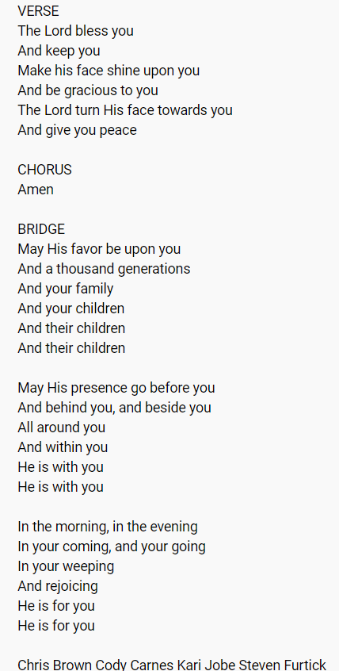
Song
(5) THE BLESSING [KIDS] - featuring kids from different nations - YouTube

