Slide 1
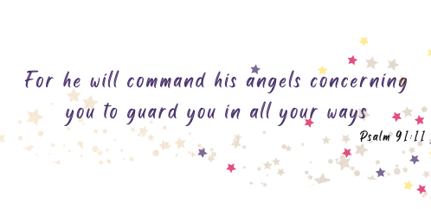

Slide 3
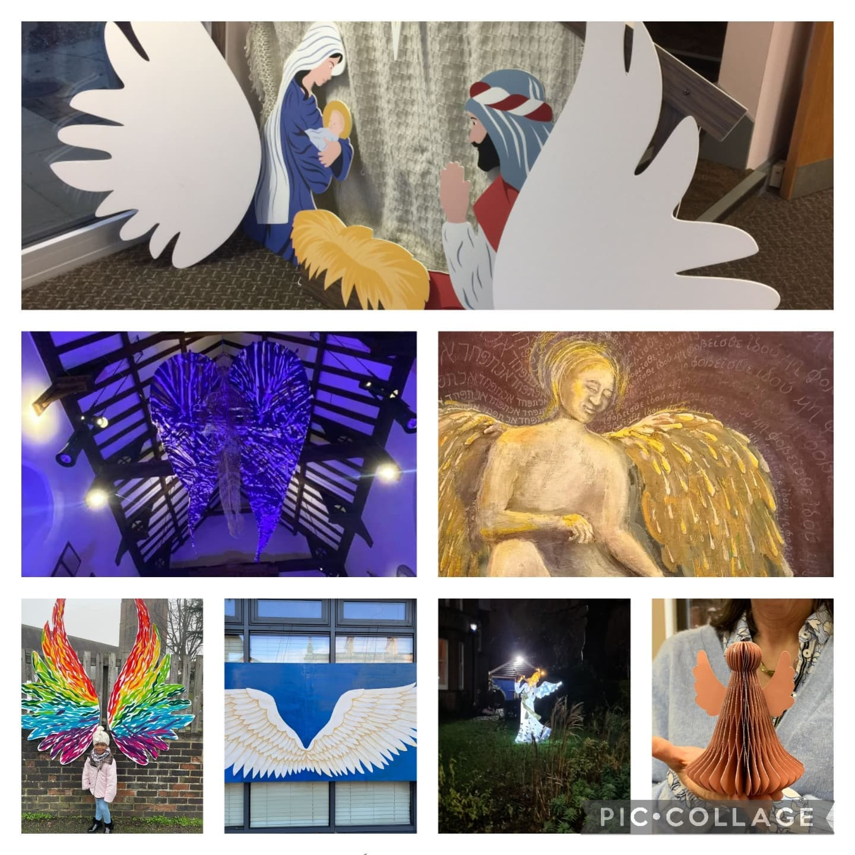
Last year Ipswich churches launched a Christmas campaign called Inspiring Angels and this year we would like to offer you the opportunity to roll this out across the diocese.
Angels are a symbol of love, of presence, pointing the way to the moment it all changed, when God came in the person of Jesus to be with us in the world, to share in love and pain alongside us. Angels appeared to tell us about the birth of a baby in a manger.
Angels sang, bursting with joy, to some shepherds, and told them, ‘Go and see!'

Slide 4
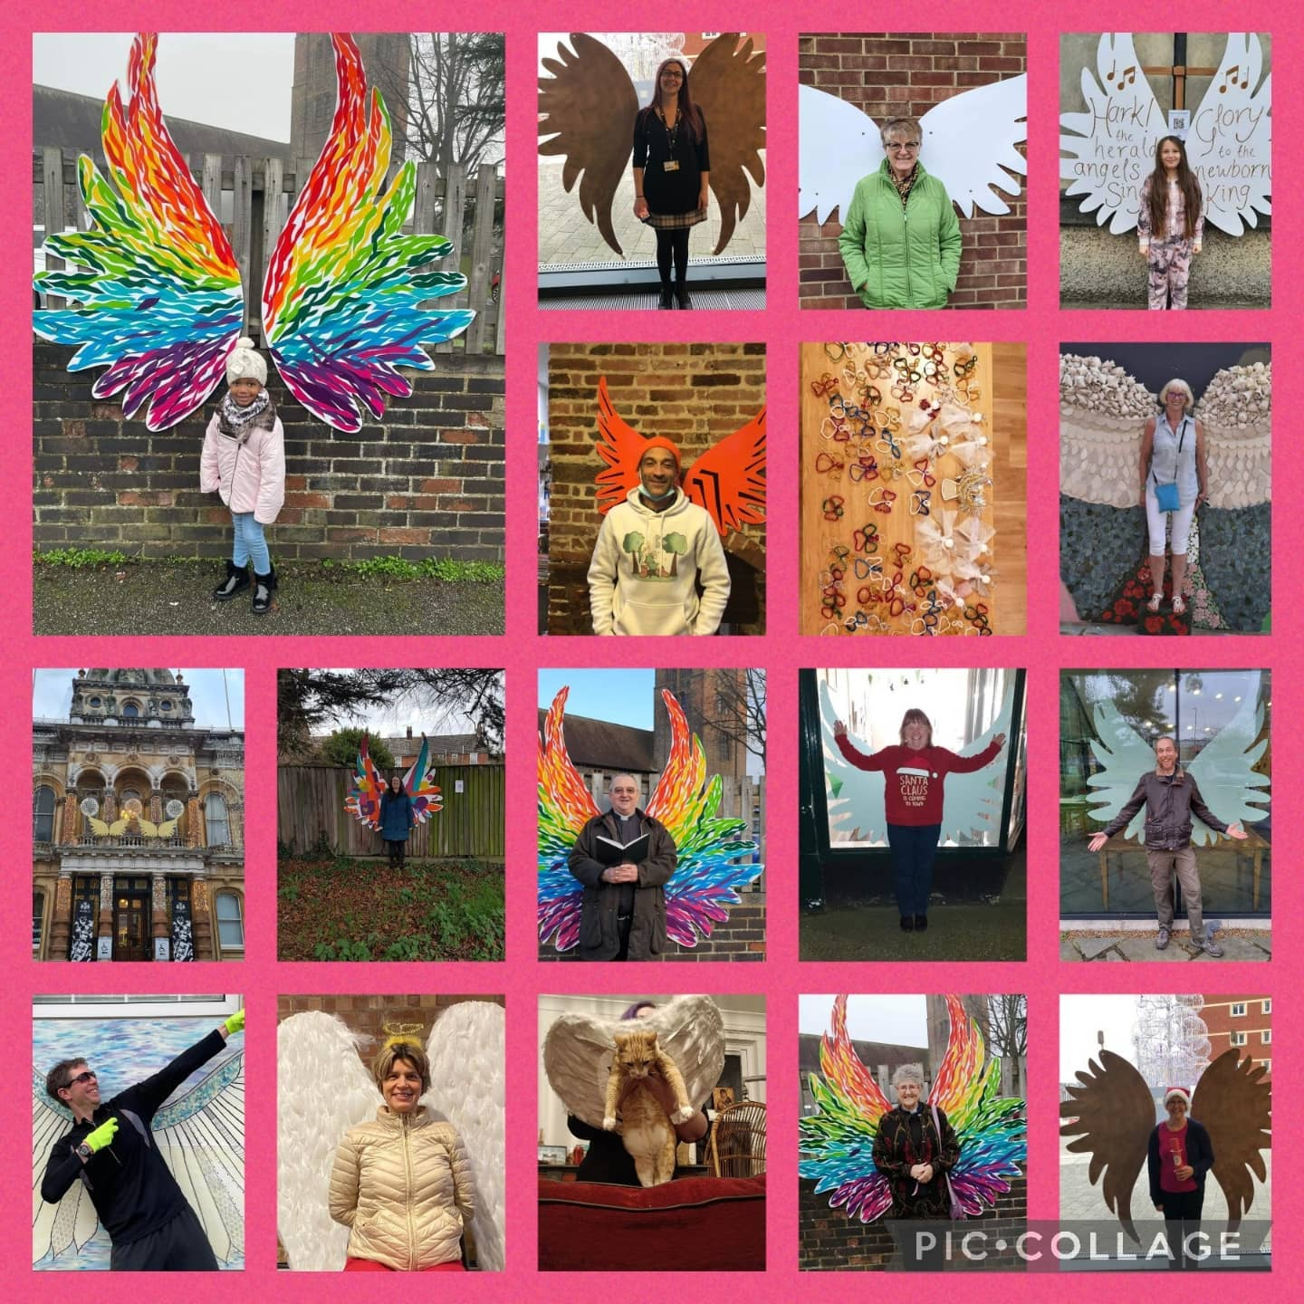
We are bursting with ideas to make angels as visible as possible. We are hoping that angels in a variety of shapes and sizes will appear all over Suffolk - in schools, shops, on public buildings, on the pavements, in bedroom windows, wherever people's imagination takes them!
This is a great opportunity to fill Suffolk with joy this Christmas!

Slide 5
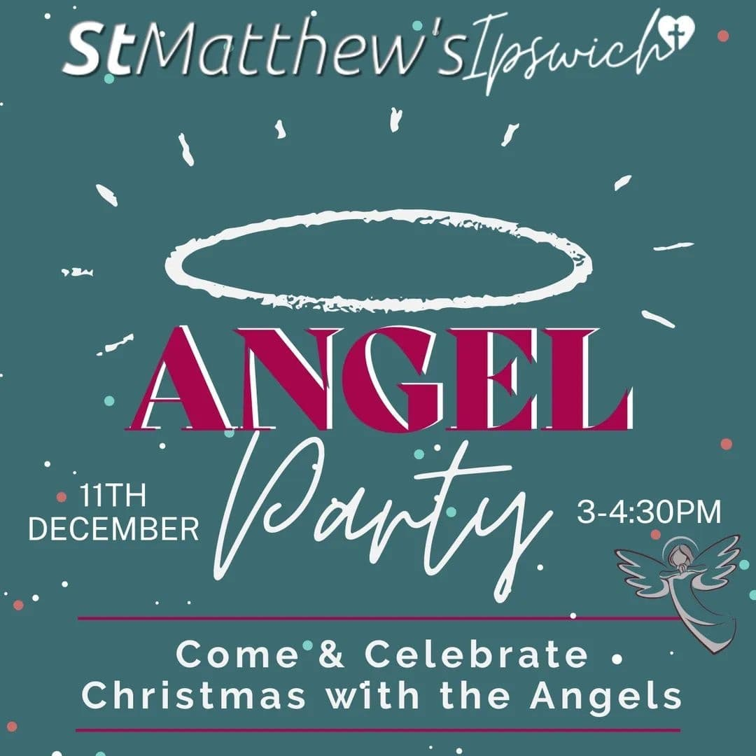
Why not have a 'Be an angel' advent
We are hoping you may choose to donate to a food bank, cook for people, make a charity shop donation or another small act each day during Advent. You could post your activities on Facebook to let others know what you are doing. This is a fantastic opportunity for people to offer a service or event to help others over the advent period.

Slide 6
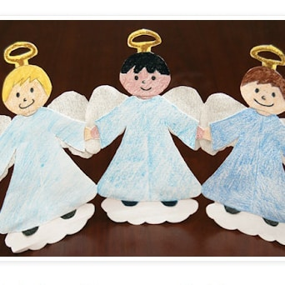
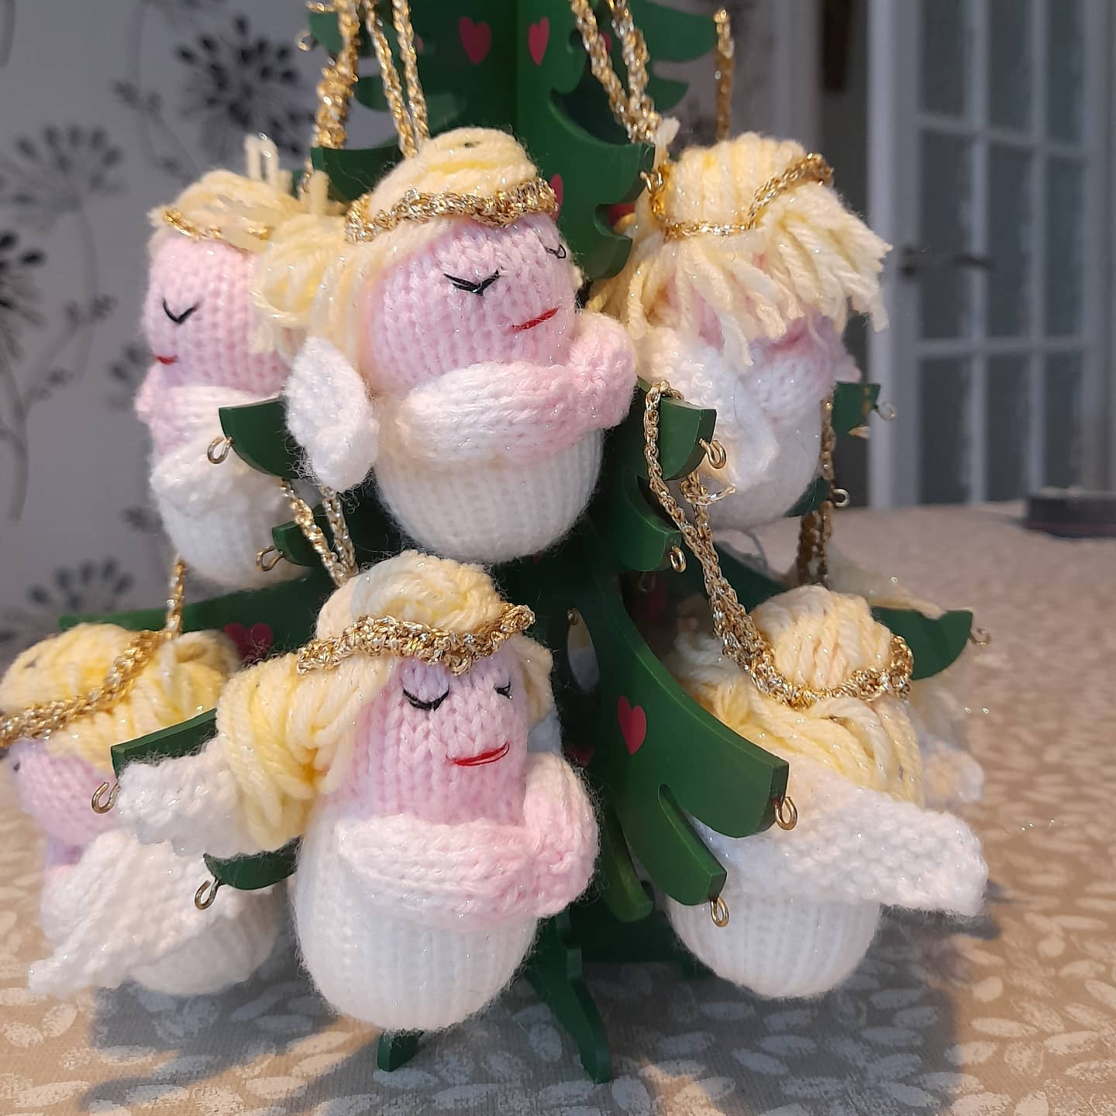
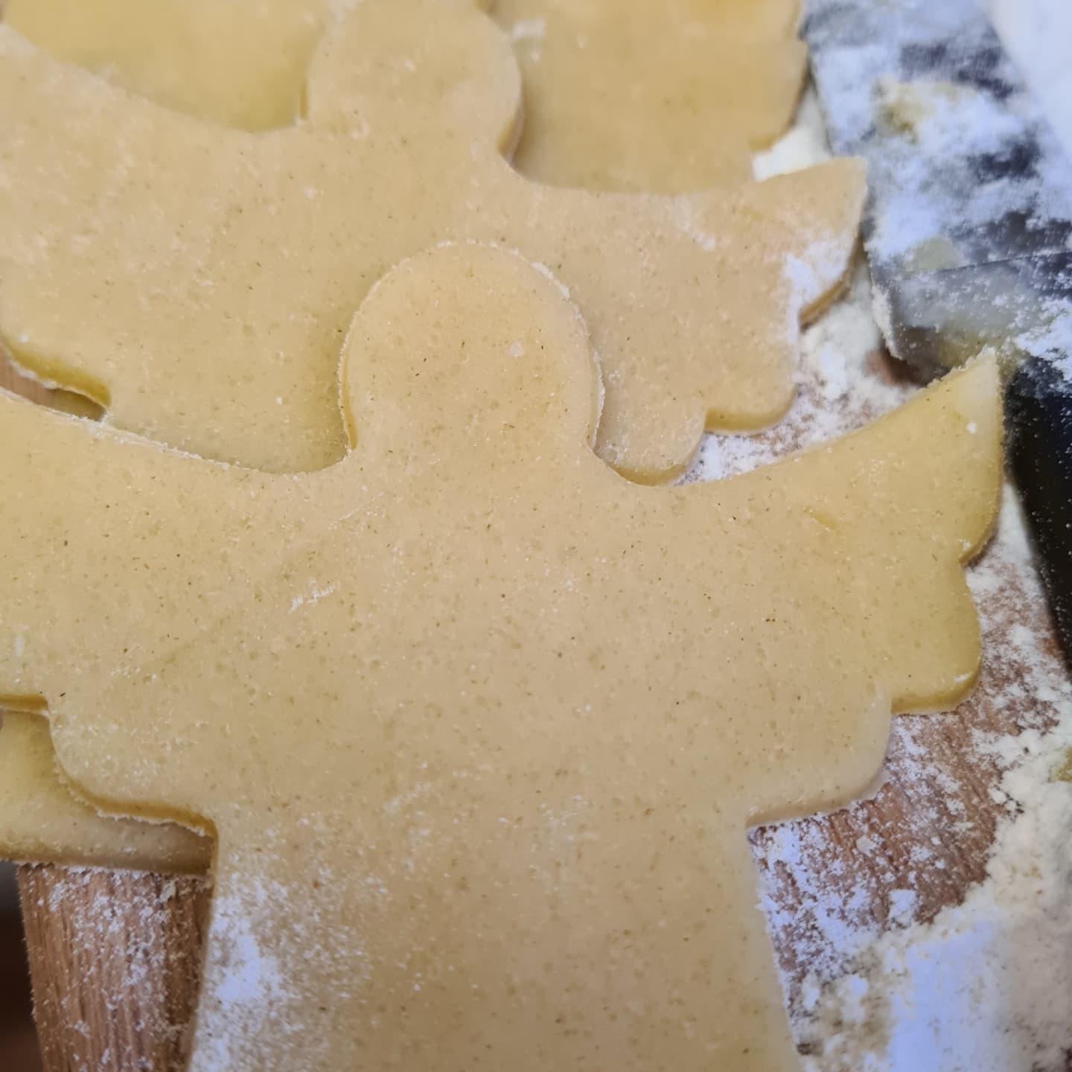
Get creative
We have pulled together a series of resources to make Inspiring Angels as easy as possible You could try knitting angels, angels paper crafts, angel jars, angel prayers, and more. These resources will be great for use in Messy Church activities, for schools and other family projects in the home.

Slide 7
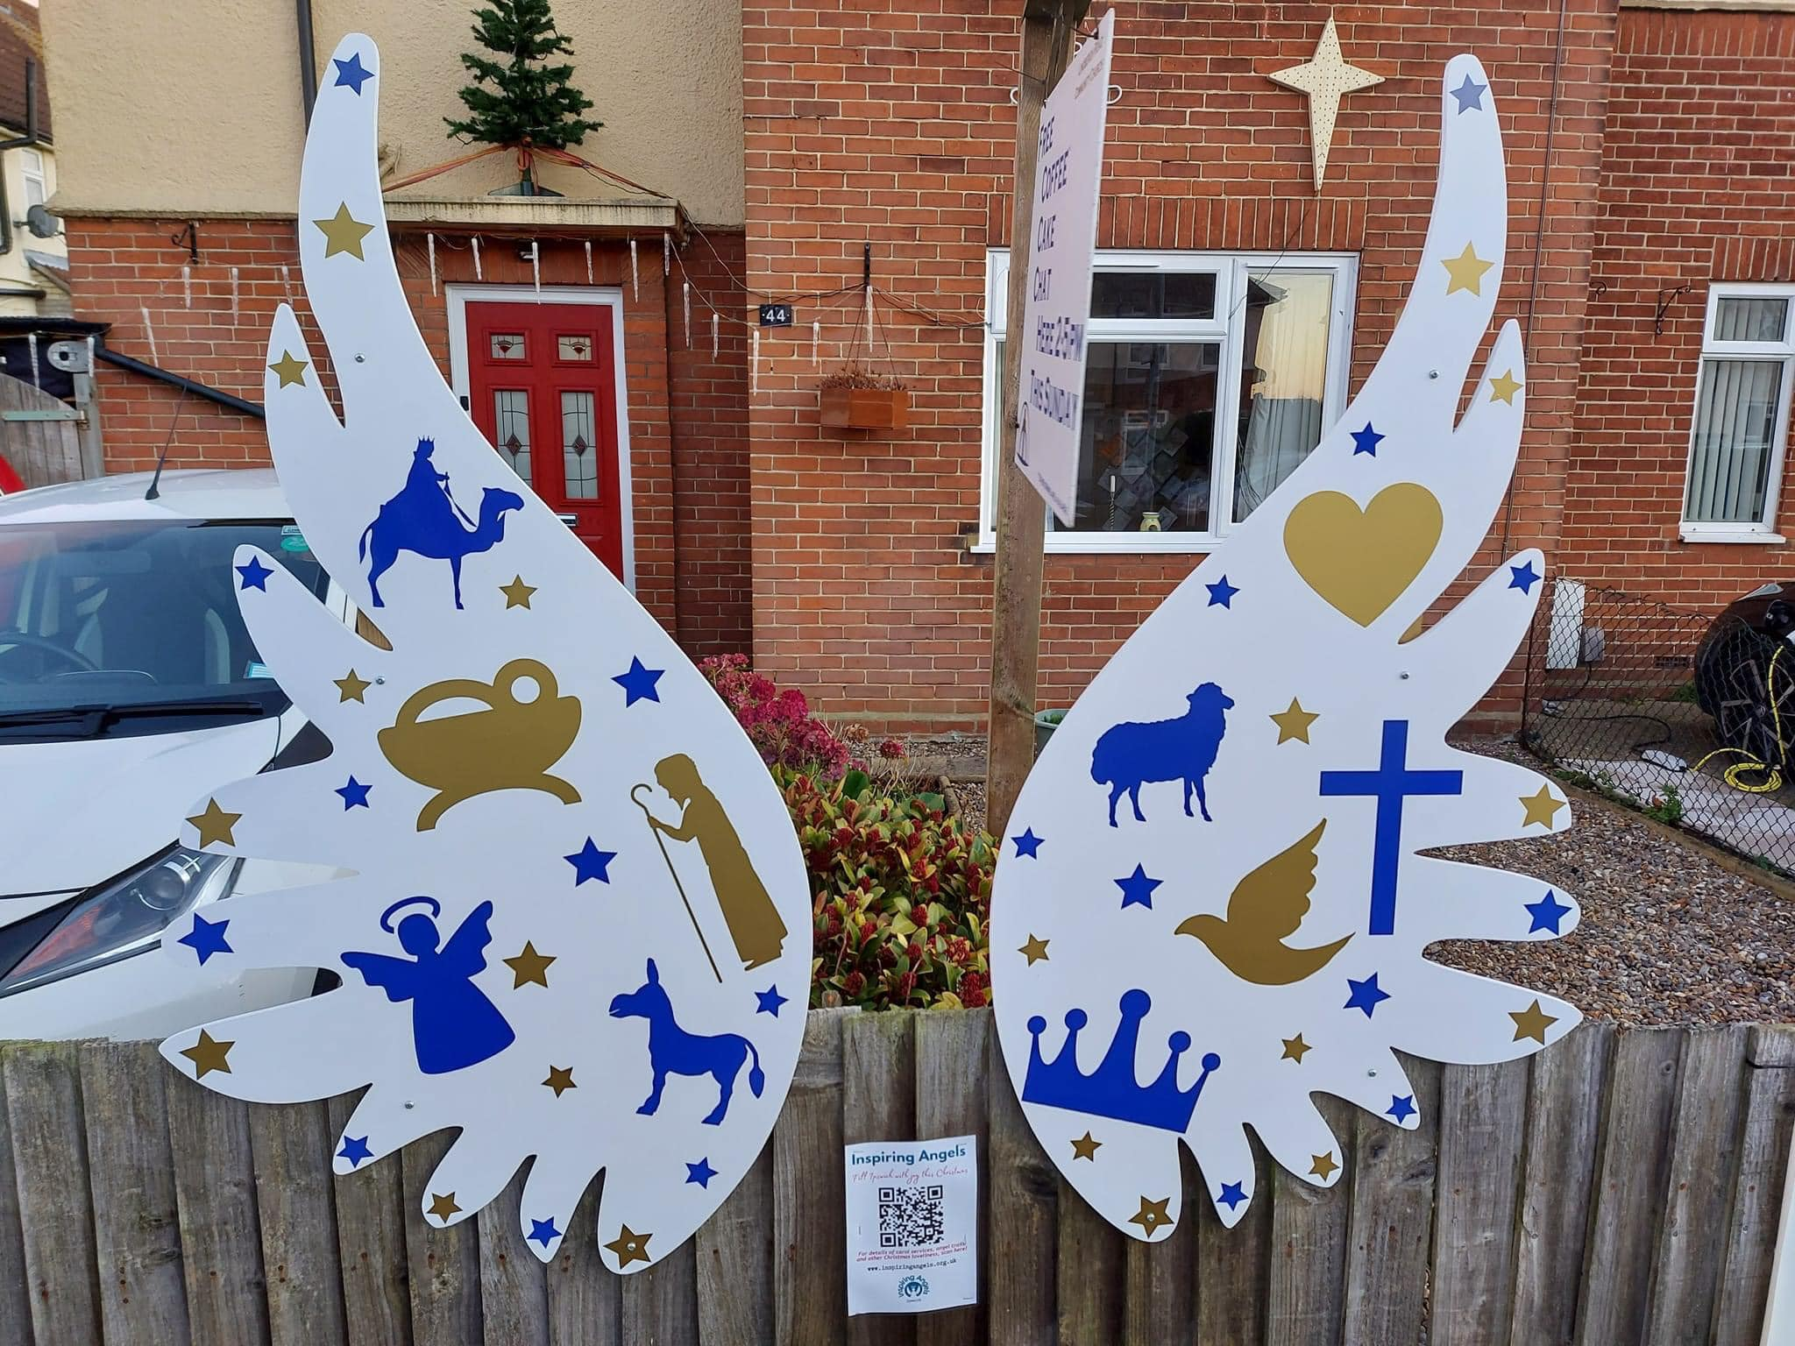
Instagram moments
Last year a number of churches positioned large wings in public spaces to enable people to take photographs for social media. This is a fantastic idea to encourage engagement with everyone in your community.
We have sourced a company to make the wings and if you would like to purchase a large set of wings for use in your parish, church or school please email Helen.prior-townsend for all the cost and production details.

Slide 8
For more information please visit our website:
www.cofesuffolk.org/for-ministers/worship-resources/resources-for-ministers/

