Slide 1
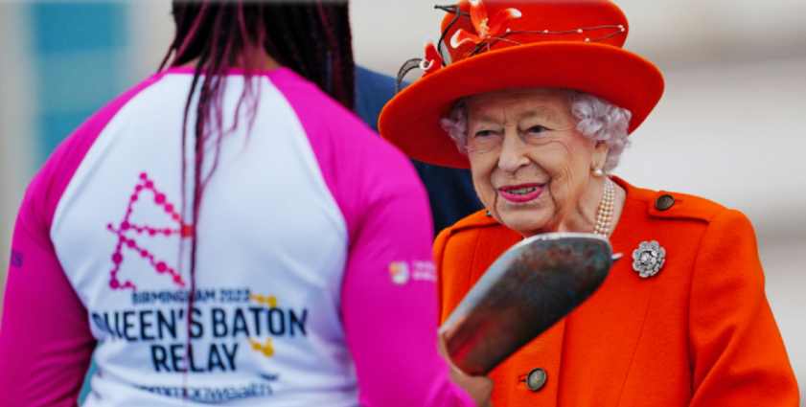
The launch of The Queen's Baton Relay | The Royal Family
The Queen’s Baton Relay
Commonwealth Games 2022
image from https://www.birmingham2022.com/queens-baton-relay/route
Notes:
Slide 1: This picture (with the official photo also being linked here: The launch of The Queen's Baton Relay | The Royal Family) shows the Queen sending the ‘Queen’s Baton’ on its way as it started the Baton Relay across Commonwealth in October 2021, before the Commonwealth Games in 2022. As you may remember from our assemblies last term (if you used them), the baton contained a message from the Queen to each country in the Commonwealth. Here are a few words from that message to start our time together:

Slide 2

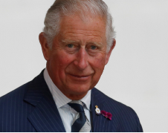
It [the baton] carried not only my message to you, but also the shared hopes and dreams of each nation and territory through which it has passed as it made its way to Birmingham….[a reminder] of our connection with each other, wherever we may be in our world, as part of the Commonwealth family of nations.
The King | The Royal Family
Notes:
Slide 2: ‘It [the baton] carried not only my message to you, but also the shared hopes and dreams of each nation and territory through which it has passed as it made its way to Birmingham….[a reminder] of our connection with each other, wherever we may be in our world, as part of the Commonwealth family of nations.’ How appropriate, now, that the Queen passed the baton to athletes at Buckingham Palace, but it was opened and read by her son, now King Charles III, in Birmingham at the start of the Games.

Slide 3

Photo by Braden Collum on Unsplash
Notes:
Slide 3: The image of ‘passing the baton’ is going to help us as we continue to mourn the loss of our Queen, Elizabeth II, and also, as she would have wanted, to reflect on our own lives. Like handing over a baton in a relay race, this is what is happening in the Royal Family now – the Queen has handed on the baton of her work, of her role, of the Crown, to her son.

Slide 4
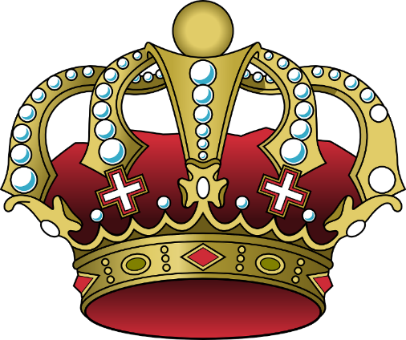
The Queen is dead! Long live the King!
Notes:
Slide 4: These words would have been spoken moments after she died. It perhaps seem a little bit unfeeling, to be welcoming the new King so soon! But they are ancient words, first spoken in 1422 (that’s 600 years ago!) and spoken to show that the royal line lives on in Charles, our next King – who became King Charles III the moment his mother died. His coronation won’t take place for a while [if known, insert official date], but his reign has already started, and he will have to begin his duties – just as his mother did when she became Queen – even although he will be mourning her death.

Slide 5
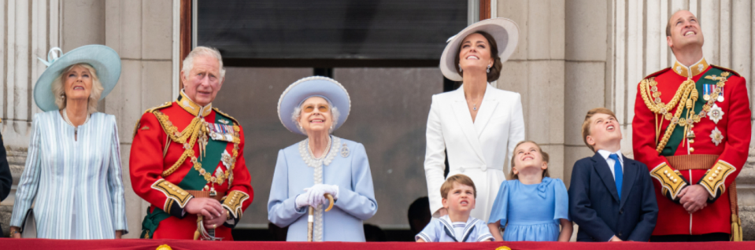
©royal.uk
The Platinum Jubilee weekend | The Royal Family
Notes:
Slide 5: The Royal Family will have been preparing for this moment for quite some time, but will be helped by the knowledge that across our land, and indeed the nations of the world, people are thinking about them and praying for them. Her duties, all the good that the Queen did, her acts of service, her many responsibilities – all these things will continue, as Prince Charles takes the throne and begins his reign, as King Charles III. He may not do these things in the same way that she did, and might have different interests and ideas than her, but he has been preparing for this moment all of his life.

Slide 6






reign
service
faith
responsibility
wisdom
integrity
What will the Queen pass on?
Notes:
Slide 6: In the same way that our school values are passed on from year to year as children come and go, much of the Queen’s values have been and will be passed on through her family. [Go through the words in the hearts:]
Reign: we’ve already talked about how this happened the moment she died, and Charles became King. This is both the start of something new, and the continuation of an ancient Royal family line.
Faith: one of the Queen’s titles was ‘Defender of the Faith’. As a Christian, the Queen took her faith very seriously and considered that her role as Queen meant that she should be the best example that she could be of a follower of Jesus. How King Charles will take on this role remains to be seen…and whether he might be called ‘Defender of Faith’, to include faiths other than Christianity.
Service: despite being one of the most famous women in the world, the Queen saw her role as an act of service. She brought up her children and grandchildren to do the same.
Integrity: the Queen’s values were clear for all to see. She was honest, obedient, kind and honourable – and we hope that this part of her legacy will continue in the reign of King Charles.
Wisdom: more than anything else, the Queen was wise. As a follower of Jesus, she believed that her wisdom came from God. We hope (and pray) that Charles will be as wise and fair in his reign as his mother was before him.
Responsibility: the Queen has already handed over the responsibility of being monarch to her son, Charles – and indeed, he was already sharing some of those responsibilities before her death. We all have responsibilities, both individually and as part of our communities – and we share responsibility with others. We will each be responsible as subjects under King Charles’ reign, and need to work out what this means for each of us. I wonder what we each might be responsible for? [you might wish to pause here, to talk and to think or to pray]

Slide 7
She is strong and is respected by the people. She speaks wise words and she teaches others to be kind. She watches over her family and is always busy…..
Proverbs 31: v25-27
Notes:
Slide 7: We’re going to end this time together today with some words, from Proverbs, one of the books of wisdom, which could’ve been written about Queen Elizabeth II, but were actually written many thousands of years before. They might be good words to inspire us as we live our own lives….[read words on screen]

Slide 8
What are we ‘passing on’?
Photo by Braden Collum on Unsplash
Notes:
Responding (and words for worship):
Slide 8: And so as we come to the end of our time together, some things to think about.
Let’s be still and quiet together now…
….let’s pause to think about ourselves and our school….
….I wonder what we are ‘passing on’?...
…or what our responsibilities are?...
….what qualities do people see in us that might make them want to live better lives?....
….thankfully, we can do this every day – not just at the end of our lives!!....
…living out our school values is one way that we can ‘pass it on’ within our own school community, and our own families…. [insert slide here]
…we’ve also thought today about how our Queen’s reign has passed on to her son, Charles III….
…we are sure that many of the qualities that we have so admired in her will also have been passed on….
….we hope that his reign will be full of wisdom and integrity, and that he will faithfully serve the people of our nation and the Commonwealth, as his mother did…
I’m going to turn my thoughts into a prayer now, as I talk to God about some of these things. Make the prayer your own if you’d like to…or if you’d prefer not to pray, then just sit quietly with your own thoughts.

Slide 9
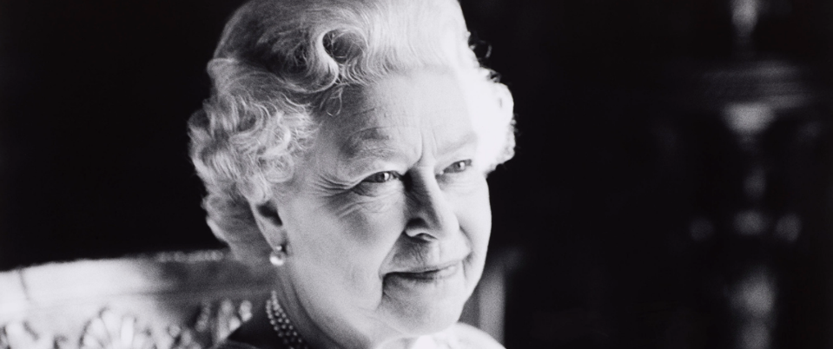

HM Queen Elizabeth II
1926 - 2022
‘I declare before you all that my whole life whether it be long or short shall be devoted to your service…’
From the 21st birthday speech of the then Princess Elizabeth
Notes:
Slide 9: [Image to display whilst you pray]
Dear God
Thank you for the remarkable life of our Queen, whose life was such an example to us all. Help us as we live our lives to serve others, following your example. As her reign passes to King Charles III, we pray that he too would serve with wisdom, integrity and faith. May he know that the prayers of your people, the Church, with him at this time.
We ask all these things in the name of Jesus.
Amen

