Slide 1
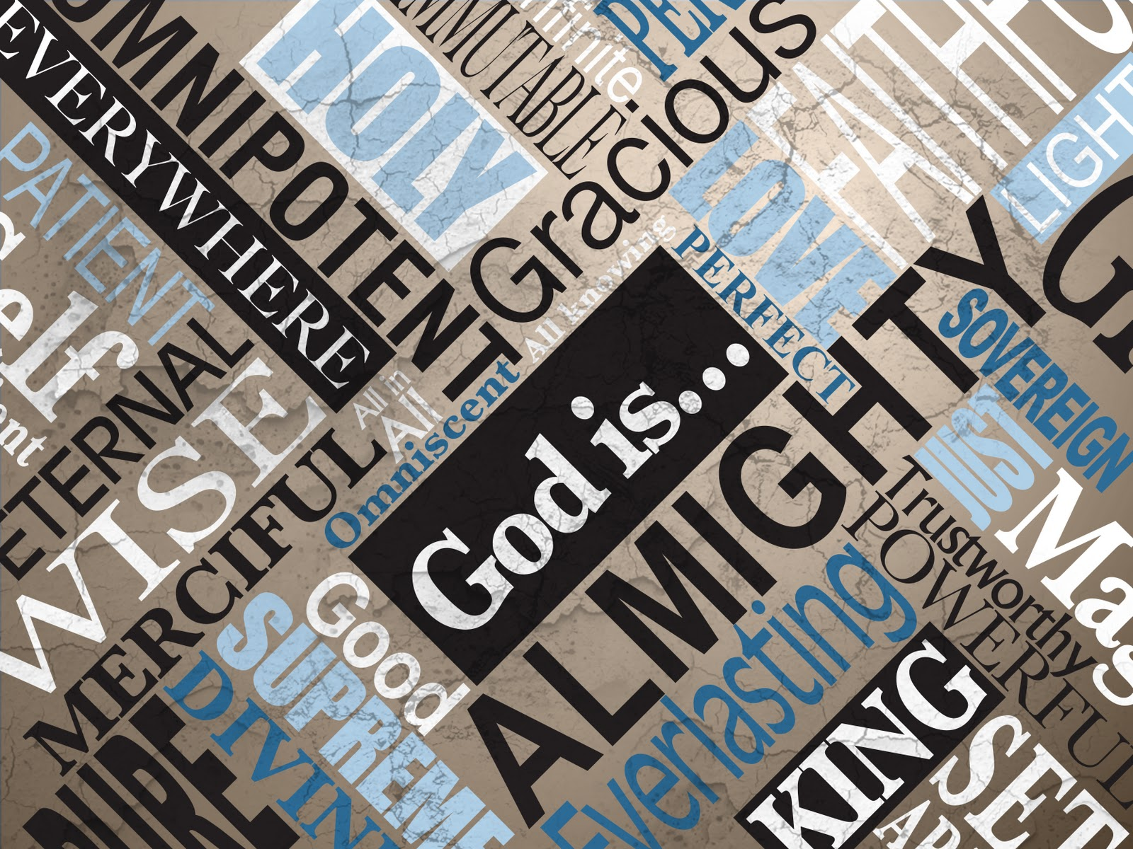
God is...
Exploring Christian ideas about God during collective worship
5 Collective Worship plans

Slide 2
Introduction
The Bible uses different names for God to convey specific, personal meaning and identity. This resource explores some of these names:
God … the perfect father.
God … the creator.
God … a strong tower.
God … the Almighty.
God … the one who sees me.
These collective worship resources are designed for use in Church of England Primary schools. They can be used at any time of year.
Suggestions and links for songs are included but schools may find more suitable alternatives amongst their own song banks.
Some slides have notes with additional advice and video links.
Please share with colleagues. More available from https://www.cofesuffolk.org/collective-worship

Slide 3
Worship 1
Christian belief: God as the perfect Father

Slide 4
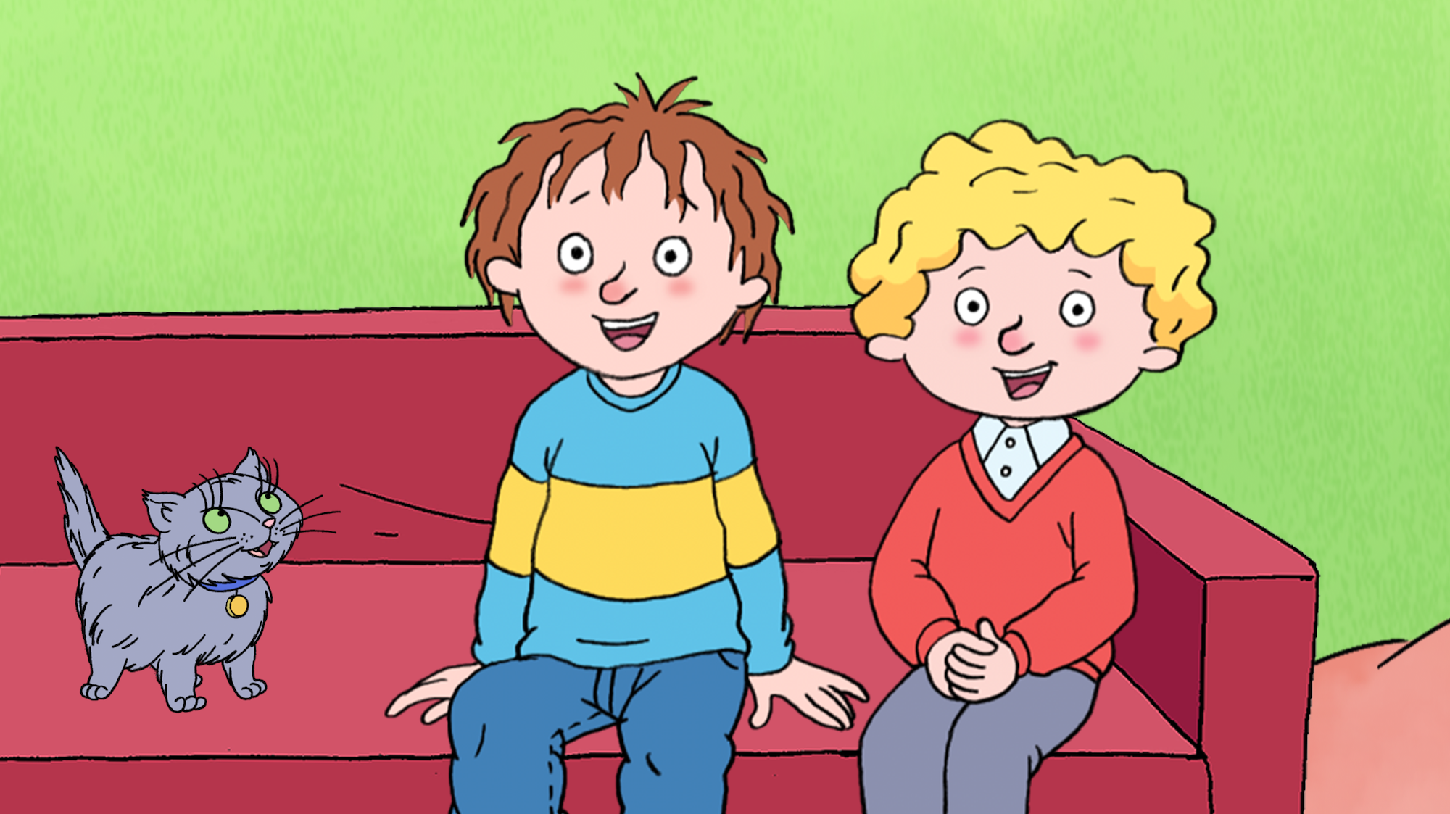
What do you know about these two characters?
Notes:
Horrid Henry and Perfect Peter. How are they different in the choices they make? Can you remember any stories about them from books, film or TV?
Is Henry always horrid? Is Peter always perfect? Aren’t we all a bit more complicated than that?
What would it be like to have a perfect sibling? Or a perfect parent?

Slide 5
What would the perfect parent be like?
You might think…
Happy all the time
Always makes the right decision
Lets you have whatever you want
Never burns the tea!
Notes:
Perfect parent or you could use a perfect child example

Slide 6
But none of us are perfect. Not even our parents. And that’s ok. It is all part of being human.
Notes:
Let the children reflect on this.

Slide 7
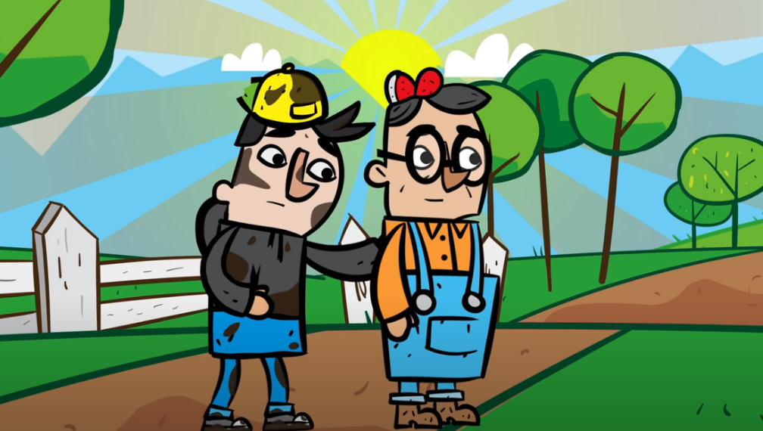
Christians believe that God is perfect. He is the perfect father.
In this story, Jesus teaches that God loves and forgives. He is not controlling or full of anger when we mess up. Instead God loves us and knows us. He is the perfect father.
What else do you think the story teaches about God?
click here
Notes:
Throughout the Gospels, Jesus makes more than 150 references to God as a father (more like Daddy). For the Jews of that time, this was a new way of addressing God. While Old Testament writers sometimes described God using qualities of earthly fathers and mothers, Jesus referred to God using more informal, intimate language.
https://www.youtube.com/watch?v=DJgROx4wFKM – the video link

Slide 8
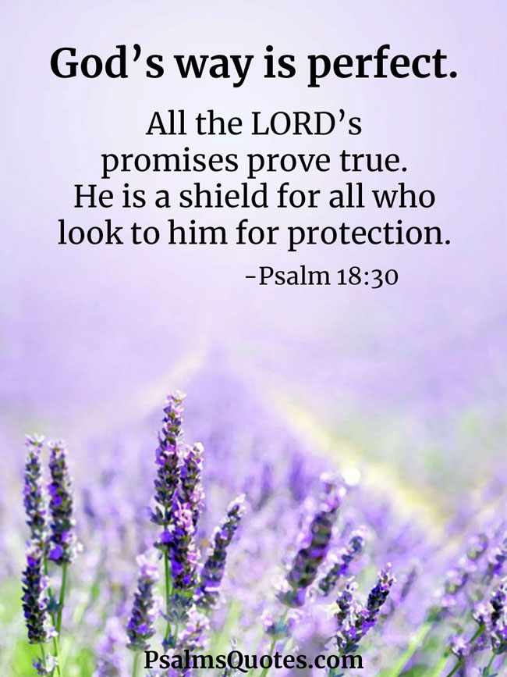
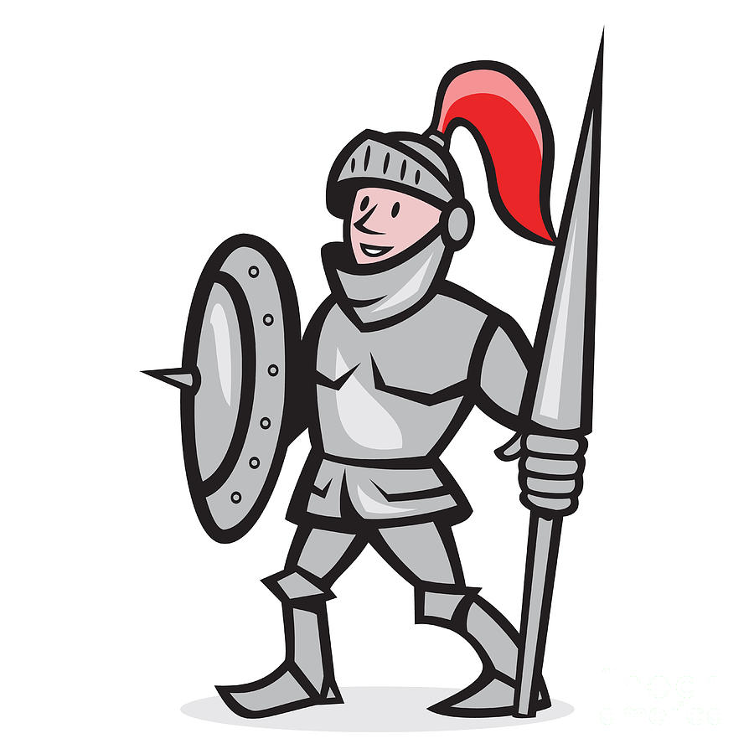
Time to reflect
or time to pray….
Reflect
Who is your shield when life gets difficult? Someone who helps and protects you?
Think about that person and ways you can be thankful for their help and support.
Pray
Dear God,
Thank you for being a perfect parent and loving us just as we are.
Amen

Slide 9
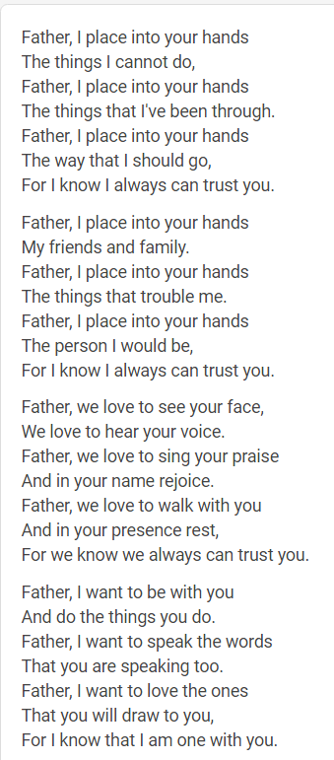
Song
Father I Place into Your Hands - Worship Workshop – This song reminds Christians that they can place all their problems into God's hands as he cares for us. Christians believe that we can't do everything in our own strength and that we must rely on God as the perfect parent to help us through when things get tough.
You can listen to the song or join in if you want to. When you hear or sing ‘Father’ you could think about God if you want to or think about someone else who is important to you.
Notes:
Important children understand the song - look at some of the lyrics.

Slide 10
Worship 2
Christian belief: God as creator

Slide 11
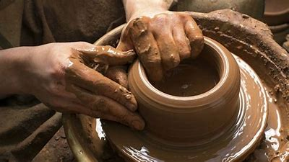
Have you ever watched a potter at work?
Notes:
Make a link to the pottery throwdown on channel 4?
Watch this https://www.youtube.com/watch?time_continue=10&v=u3_CAVv8gDI&feature=emb_logo

Slide 12
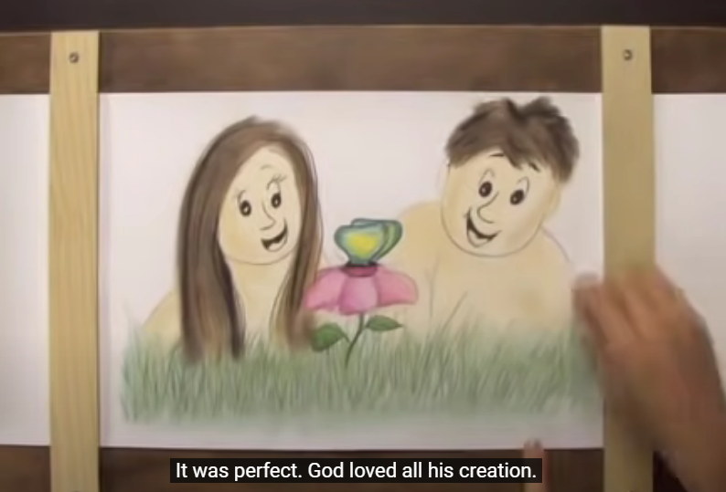
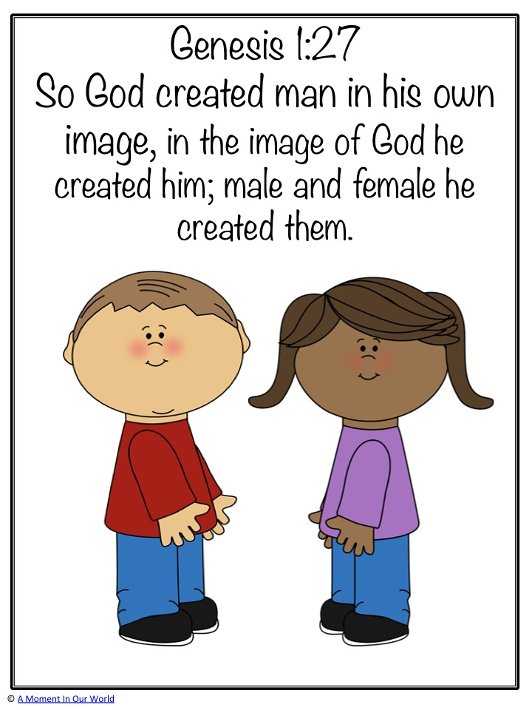
click here
What else do you think the story teaches about God?
The Bible says God took clay, formed it into a person, and breathed life into it. God said that the rest of the Creation was good, but that we are the best thing he made. For Christians he is the creator God.

Slide 13
Prayer
God of the universe,
We thank You for Your many good gifts -
For the beauty of Creation and its rich and varied fruits,
For clean water and fresh air, for food and shelter, animals and plants.
Forgive us for the times we have taken the earth's resources
for granted
And wasted what You have given us.
Transform our hearts and minds
So that we would learn to care and share,
To touch the earth with gentleness and with love,
Respecting all living things.
Amen
Time to reflect or time to pray….
Christians believe God is the creator of the whole world and that he created humans in his own image. They believe God created you to be as you are because he doesn’t make mistakes. When God created the world and the humans in it, he said that it was good. Therefore Christians believe you are good and perfect.
Reflect
Look at the person next to you, what is similar about both of you? What things are not the same? Being different is ok, being different is good, it would be boring if we were all the same. Look at your fingers. If you look carefully you will see fingerprints. Each of yours are completely individual. No one has the same finger prints!

Slide 14
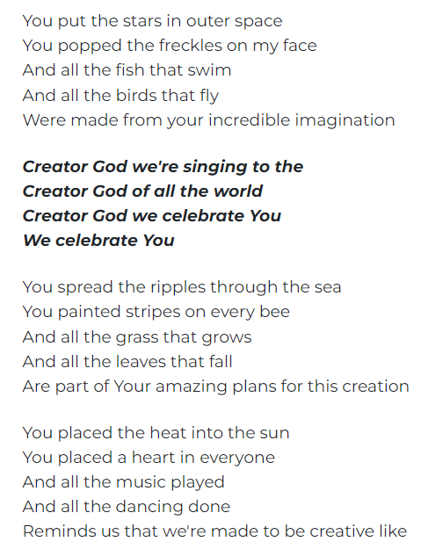
Song
Song Creator God – YouTube This song is sung by Christians during worship. It reminds them that God created everything. You can either listen, think about the words or join in if you want to.

Slide 15
Worship 3
Christian belief: God is my fortress.

Slide 16
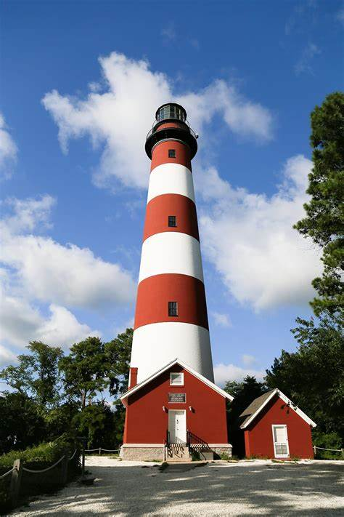
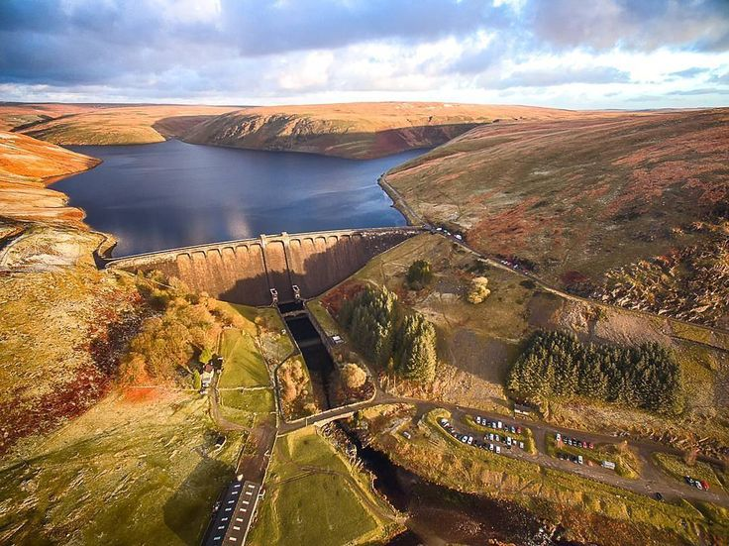
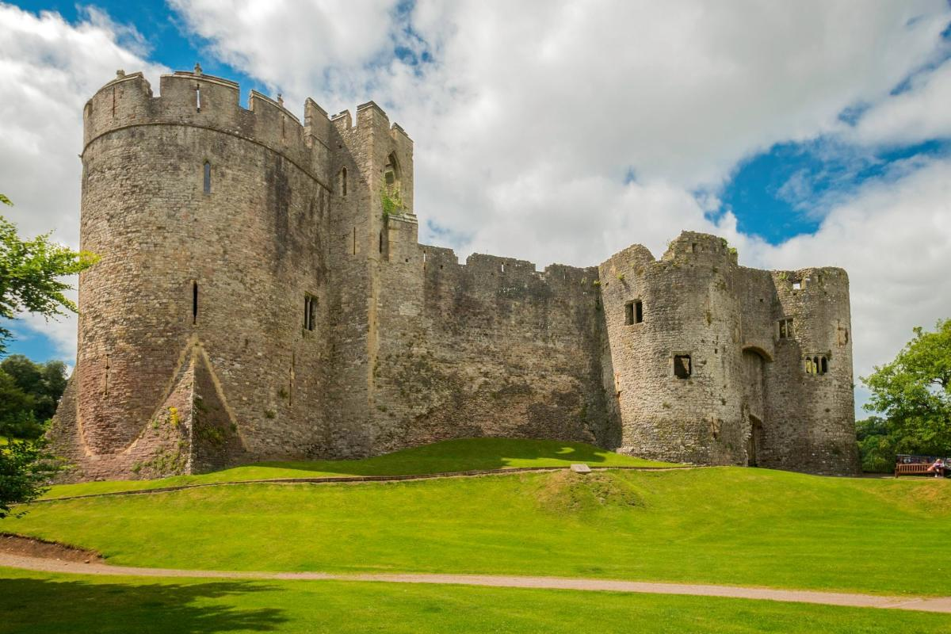
Have you ever visited a strong building?
What do they protect?
Notes:
‘strong building’ as something that stands the test of time because of the climate, environment or conflict so how about a light house, or castle or river dam?
Why do these buildings need to be strong? How do they make you feel?
Draw out the need to protect.

Slide 17
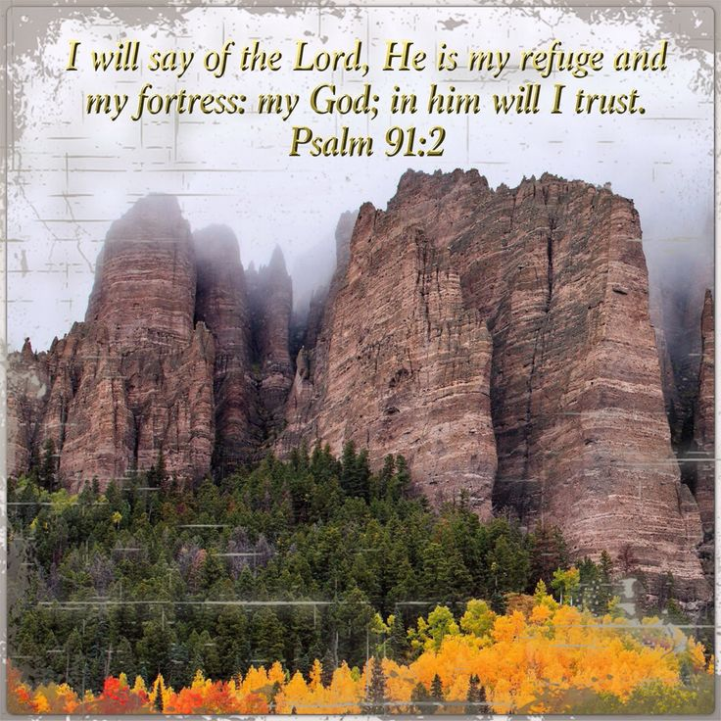
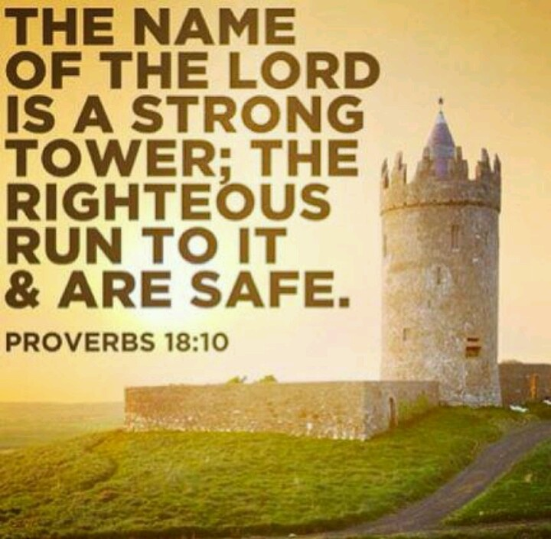
Christians believe that God is like a fortress or a strong tower.
Notes:
Read the bible verses. How can a person be a safe space?

Slide 18
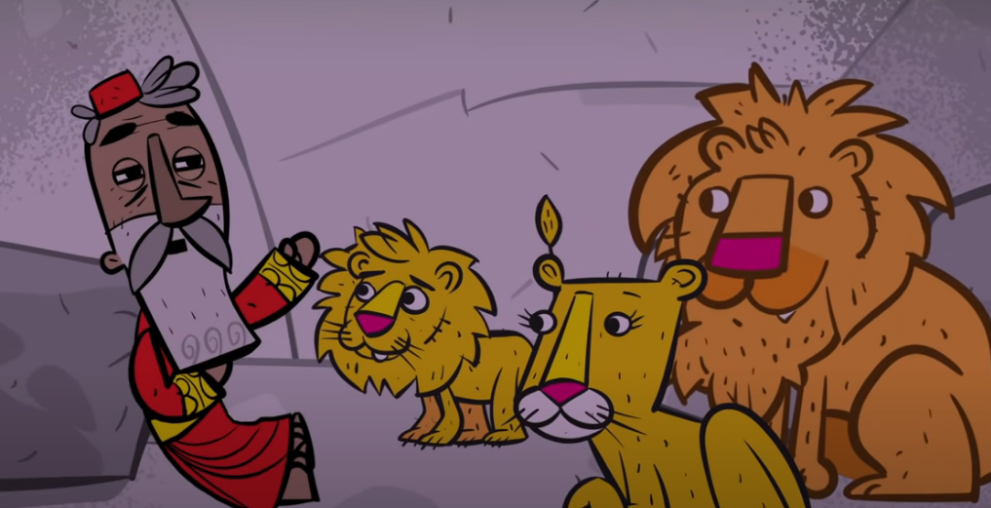
Daniel and the Lion’s Den
What gave Daniel courage was not his own strength or power, but knowing that God was with him and would protect him.
click here
What else do you think the story teaches about God?
Notes:
ory

Slide 19
Time to reflect or time to pray….
Think about some of the things that hurt or upset you. Each one of these things could be described as a weapon attacking us. But Christians believe we can always turn to God for comfort and support. He is like a strong fortress. Our enemy may try and hurt us, but these weapons are useless against the strong walls of God’s love. Christians believe the Bible makes it clear that we are never alone and that God is always with us.
Prayer
Dear God,
Thank you that you are always with us.
That you are here to love and protect us.
Even when we feel like you are not there, help us to trust you.
Help us always to take the time to help others when they are sad or struggling.
Help us to protect one another.
Amen
Reflect
Remember we are never alone even if we sometimes feel like it. We always have other people around us to help and support us when we experience difficult situations. Look at your hand. Can you name a trusted adult to talk
to for each of your fingers?

Slide 20
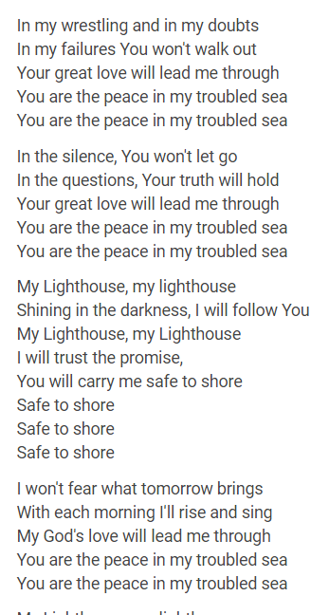
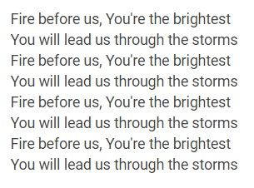
Song
My Lighthouse is a Christian worship song. You can join in with the song if you want to. You could think about God as your lighthouse or someone else in your life who keeps you strong.

Slide 21
Worship 4
Christian belief: God is the Almighty

Slide 22
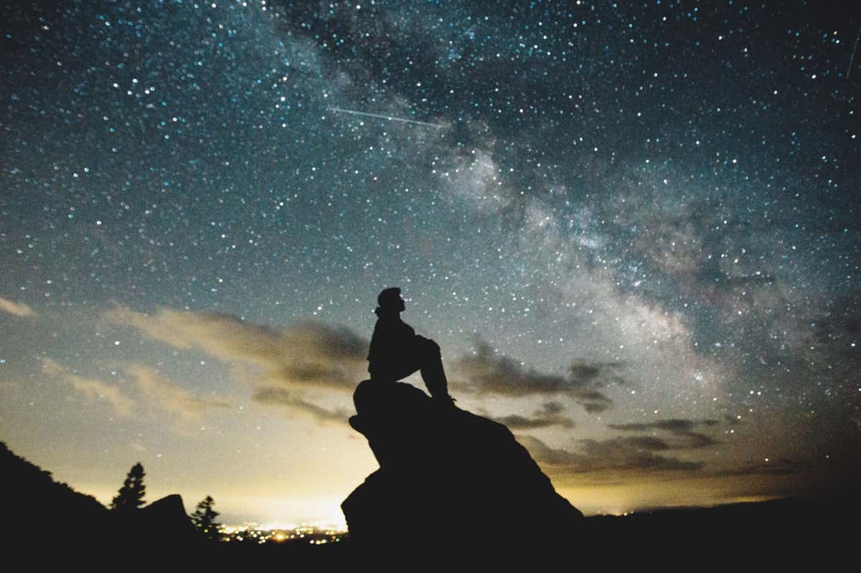
Do you think counting the stars is an impossible task? Have you ever tried to count them all?
Notes:
How many do you think there are? Have you ever looked through telescope at the night sky?
The night sky looks like it has millions of stars. That's because we live in a galaxy that has hundreds of millions of them. However, we can't really see all of them with the naked eye. It turns out that the skies of Earth have, at most, around ten thousand stars that can be spotted with the naked eye.

Slide 23
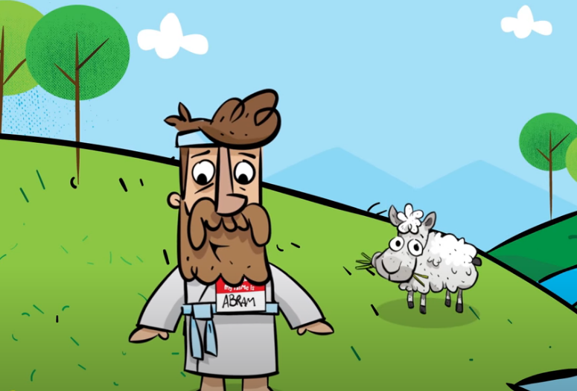
Christians believe that God is the Almighty. This means he can do anything and is all powerful. He knows exactly how many stars are in the sky. He even knows how many hairs are on your head.
This is the story of Abraham and Sarah. God made them a promise which might seem impossible but for God the Almighty nothing is impossible.
click here
What else do you think the story teaches about God?
Notes:
https://www.youtube.com/watch?v=rDz-7OX4C9k
God's Story: Abraham and Sarah – YouTube

Slide 24
Time to reflect or time to pray….
Christians believe that nothing is impossible for God. This means that God can do ANYTHING. He can calm a storm. He can stop the sun. He can make a pathway through the sea.
Christians believe that there is one thing God can never do. One thing that is impossible. To stop loving us.
Prayer
Dear Almighty God
Thank you for everything you have created.
Thank you for the stars in the sky.
Thank you for giving us hope.
Thank you for loving us.
Amen
Reflect
Think about something you have achieved that once felt impossible. Maybe it was learning to read or ride a bike. What helped you?

Slide 25
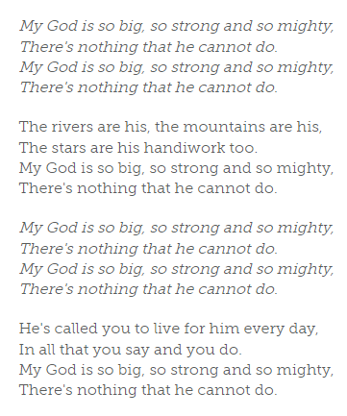
Song
My God is so Big - Worship Workshop
This simple song reminds Christians of God's power and strength - and that he created the world in which we live. Listen or join in if you want to.

Slide 26
Worship 5
Christian belief: God is… the one who sees you.

Slide 27
If you were invisible for a day, where would you go and what would you do?
Notes:
What would the fun things be about being invisible? What about the negatives?

Slide 28
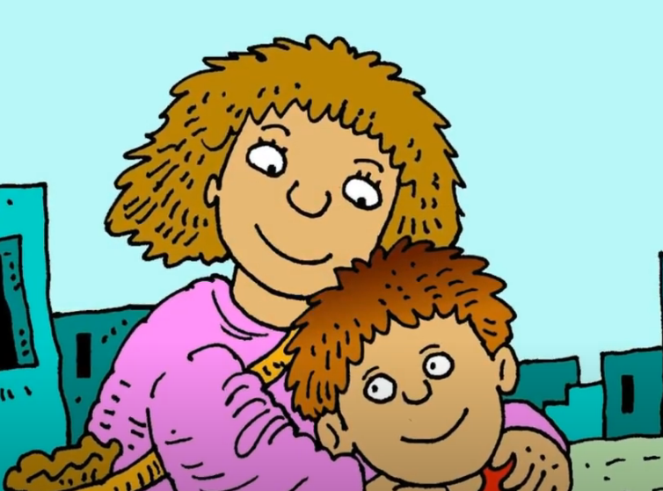
The story of Hagar.
click here
In the Old Testament, there were many times where God’s people went through difficult and challenging times.
But they were reassured by knowing that God was watching over them and would bless their lives and families.
Do you remember the story of Sarah and Abraham? God promised them children despite their old age. Before this, Abraham had a child with a woman called Hagar but Sarah became very jealous…
Notes:
https://www.youtube.com/watch?v=GtM-UXb9ayc

Slide 29
Sarai, Abram’s wife, had no children. Sarai said to Abram, “God has not allowed me to have children. If you marry my servant Hagar and have a child, maybe I can have my own family through her.” Abram did what Sarai said. But when Hagar became pregnant, she and Sarai argued. So Hagar ran away. The angel of the Lord found Hagar beside a spring of water in the desert. The angel said, “Hagar, go home to Sarai and do as she asks you.” The angel also said, “I will give you so many descendants they cannot be counted.” Hagar said to the angel “You are the God who sees me,” for she said, “I have now seen the One who sees me.”
Genesis 16
Christians believe that God always sees you - you are never invisible to God.

Slide 30
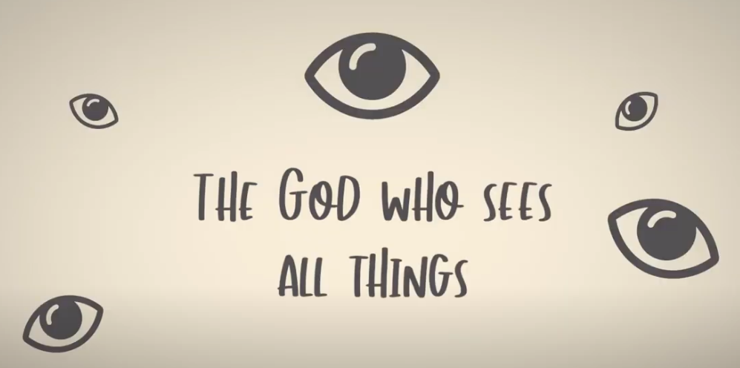
Time to reflect or time to pray….
Christians believe God watches over us because he loves us , like a parent who watches over their children. That he is present in every event in your life. He knows what we are going through and what we need.
Prayer
Dear God,
We thank you that you are the God who sees us. You see everything that happens to us. And you care about us. Help us to remember that you’re always there for us and that you will do good things for us.
Amen.
click here
Reflect
Perhaps there have been times in your life when you have felt invisible, ignored or alone.
A Christian devotional from a Christian point of view
Notes:
https://www.youtube.com/watch?v=GtM-UXb9ayc

Slide 31
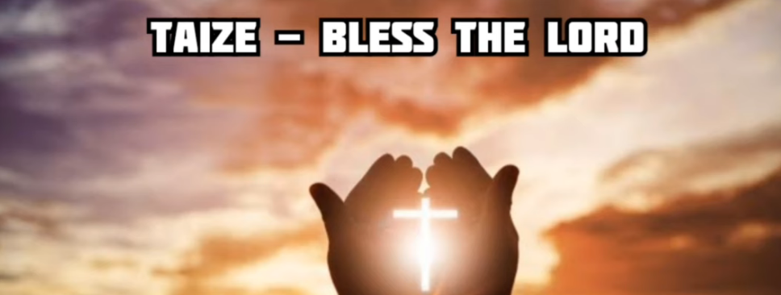
Bless the Lord - Taize music emphasizes simple phrases, usually lines from Psalms or other pieces of the Bible, repeated and sometimes also sung in canon. The repetition is intended to aid meditation and prayer.
Lyrics:
Bless the Lord, my soul, and bless God's holy name.
Bless the Lord, my soul, who leads me into life.
Solo (from Psalm 103): Lobe den Herrn, meine Seele, und vergiß nicht, was er dir Gutes getan.
As the heavens are high above the earth, so is God's way above our ways, so is God's love for us.
Bénissez le Seigneur, toutes ses œuvres, bénissez le Seigneur tous ses anges.
Song
Notes:
https://www.youtube.com/watch?v=t4Svh-9ohg4

