Slide 1
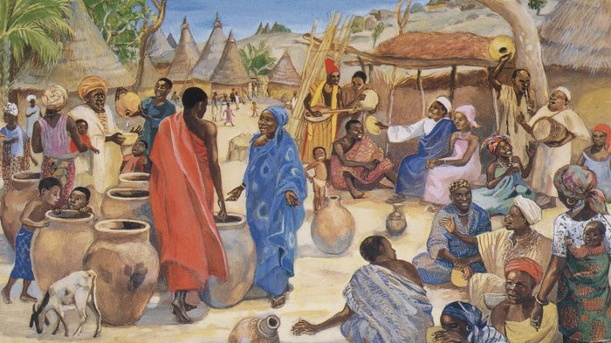
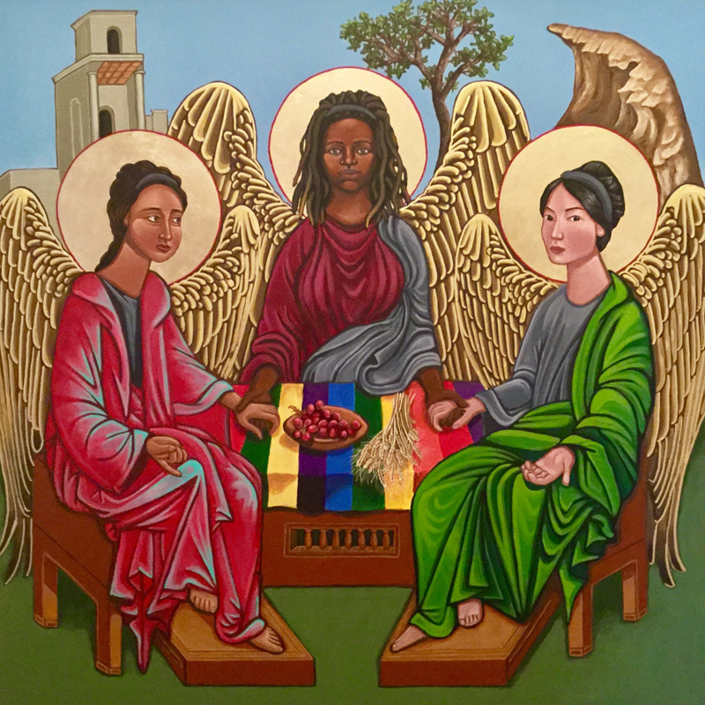
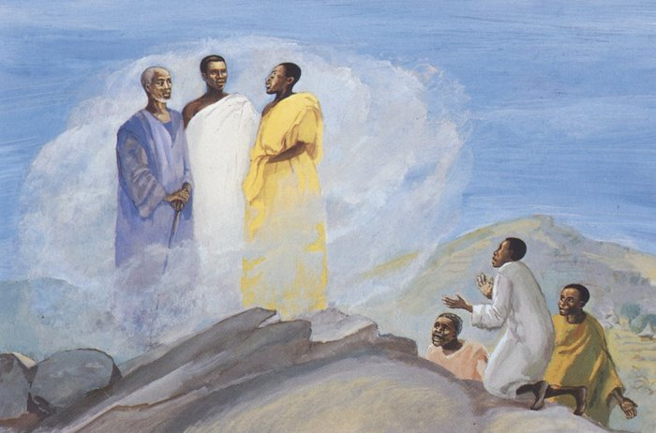
Global Christianity:
Jesus around the world

Slide 2

During these worship times, we will look at pictures of Jesus from around the world and see how he is portrayed in different ways. Each piece of art is linked to a story or passage from the Bible.
Global World map by Nastyasensei Sens is licensed under CC BY-SA 4.0

Slide 3
Worship Number 1
Global World map by Nastyasensei Sens is licensed under CC BY-SA 4.0

Slide 4
Who are the 3 people? Why do they all have halos?
Can you see Jesus?
Look closely again at the picture. What else do you notice about the people and what they are doing?
I wonder what the Bible says?
Latimore, Kelly. Trinity, from Art in the Christian Tradition, a project of the Vanderbilt Divinity Library, Nashville, TN. https://diglib.library.vanderbilt.edu/act-imagelink.pl?RC=57123 [retrieved January 3, 2025]. Original source: Kelly Latimore Icons, https://kellylatimoreicons.com .

Slide 5
The Trinity
The word Trinity means 3 as 1. Christians believe that God has three forms or characters: Father, Son and Holy Spirit. The box below shows that they are all different, and all still are God.
In the first book of the Bible, God was there before the earth was created. In the Gospel books, God comes to earth as a human, Jesus, and we read about His life on earth. After Jesus has left earth to go back to heaven, the Holy Spirit comes to be a friend and helper to Christians.
Who are you? | Father | Son | Holy Spirit
What are you? | God | God | God
Video
What is the Trinity?
Where is it in the Bible?
Father – Genesis, chapter 1
Son – The Gospels: Matthew, Mark, Luke and John
Spirit – The book of Acts, chapter 2.
Latimore, Kelly. Trinity, from Art in the Christian Tradition, a project of the Vanderbilt Divinity Library, Nashville, TN. https://diglib.library.vanderbilt.edu/act-imagelink.pl?RC=57123 [retrieved January 3, 2025]. Original source: Kelly Latimore Icons, https://kellylatimoreicons.com .

Slide 6
Take a closer look.
In the painting, all three of the people (the Trinity) are holding hands. Except you can see there is a gap in their circle.
Why do you think this is? Who could fill the gap?
The artist is from the USA.
Latimore, Kelly. Trinity, from Art in the Christian Tradition, a project of the Vanderbilt Divinity Library, Nashville, TN. https://diglib.library.vanderbilt.edu/act-imagelink.pl?RC=57123 [retrieved January 3, 2025]. Original source: Kelly Latimore Icons, https://kellylatimoreicons.com .

Slide 7
Time to think or time to pray…
The three people in the painting form the three characters or parts of God:
God the Father,
God the Son,
God the Holy Spirit
The painting reminds us that we are invited in to be part of the Trinity, to be part of God’s family. The gap in the circle of hands is for us. What a wonderful invitation. Christians believe through his Spirit, God lives in them and that we can ask God to be part of our lives. Is that something you would like to do?
Dear Father God, You came to earth as Jesus and then sent your spirit to help us. Thank you. Amen.
Latimore, Kelly. Trinity, from Art in the Christian Tradition, a project of the Vanderbilt Divinity Library, Nashville, TN. https://diglib.library.vanderbilt.edu/act-imagelink.pl?RC=57123 [retrieved January 3, 2025]. Original source: Kelly Latimore Icons, https://kellylatimoreicons.com .

Slide 8
Worship Number 2
Global World map by Nastyasensei Sens is licensed under CC BY-SA 4.0

Slide 9
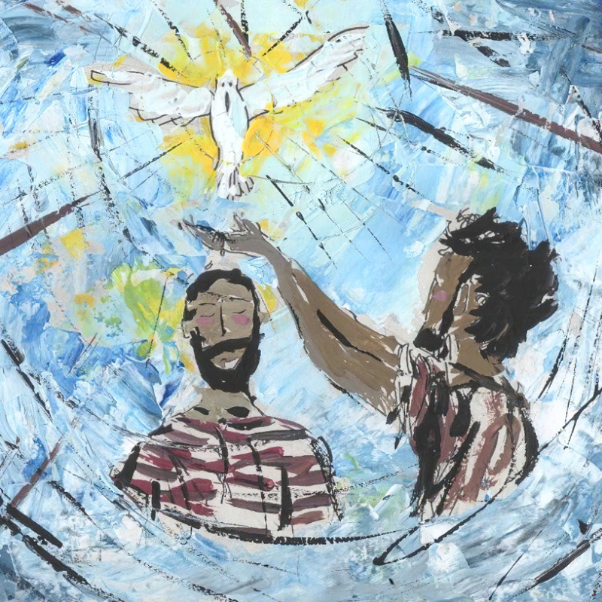
What is happening in the picture?
Can you see Jesus?
Why is there a dove?
Who do you think the other man is? What might he be doing?
I wonder what the Bible says?
Valente, Liz. Baptism of Jesus, from Art in the Christian Tradition, a project of the Vanderbilt Divinity Library, Nashville, TN. https://diglib.library.vanderbilt.edu/act-imagelink.pl?RC=59036 [retrieved January 3, 2025]. Original source: Liz Valente, https://www.instagram.com/donalizvalente/

Slide 10
Jesus’ Baptism
At that time Jesus arrived from Galilee and came to John at the Jordan to be baptised by him. But John tried to make him change his mind. “I ought to be baptised by you,” John said, “and yet you have come to me!”
But Jesus answered him, “Let it be so for now. For in this way we shall do all that God requires.” So, John agreed. As soon as Jesus was baptised, he came up out of the water. Then heaven was opened to him, and he saw the Spirit of God coming down like a dove and lighting on him. Then a voice said from heaven, “This is my own dear Son, with whom I am pleased.”
Saddleback Kids Video
Jesus' Baptism
Where is it in the Bible?
This story is found in the book of Matthew, chapter 3 verses 13-17 and also in the books of Mark and John.
Valente, Liz. Baptism of Jesus, from Art in the Christian Tradition, a project of the Vanderbilt Divinity Library, Nashville, TN. https://diglib.library.vanderbilt.edu/act-imagelink.pl?RC=59036 [retrieved January 3, 2025]. Original source: Liz Valente, https://www.instagram.com/donalizvalente/

Slide 11
Last time in worship, we learnt about the Trinity. In this Bible story, can you recognise the 3 characters of God? Who does the dove represent?
The artist is from Brazil, South America.
How does this painting make you feel? Why?
Valente, Liz. Baptism of Jesus, from Art in the Christian Tradition, a project of the Vanderbilt Divinity Library, Nashville, TN. https://diglib.library.vanderbilt.edu/act-imagelink.pl?RC=59036 [retrieved January 3, 2025]. Original source: Liz Valente, https://www.instagram.com/donalizvalente/

Slide 12
Time to think or time to pray…
Do you know anyone who has been baptised or christened? Perhaps you have been.
Many Christians today follow Jesus’ example and choose to be baptised, either as an adult or parents may choose for their child. Children are sprinkled with water, and adults are fully submerged into a pool of water, or maybe even the sea. They believe that by doing this, they are washed clean from their sins and they are asking the Holy Spirit to be with them always.
Dear God,
We thank you that we can learn so much about Jesus’ life through the Bible. Bless us and help us to follow in his footsteps. Amen.
Valente, Liz. Baptism of Jesus, from Art in the Christian Tradition, a project of the Vanderbilt Divinity Library, Nashville, TN. https://diglib.library.vanderbilt.edu/act-imagelink.pl?RC=59036 [retrieved January 3, 2025]. Original source: Liz Valente, https://www.instagram.com/donalizvalente/

Slide 13
Worship Number 3
Global World map by Nastyasensei Sens is licensed under CC BY-SA 4.0

Slide 14
What is happening in the picture?
Who might this lady in blue be?
Can you see Jesus?
I wonder what the Bible says?
JESUS MAFA. The Wedding at Cana, from Art in the Christian Tradition, a project of the Vanderbilt Divinity Library, Nashville, TN. https://diglib.library.vanderbilt.edu/act-imagelink.pl?RC=48305 [retrieved November 27, 2024]. Original source: http://www.librairie-emmanuel.fr (contact page: https://www.librairie-emmanuel.fr/contact ).

Slide 15
Jesus Turns Water into Wine
Two days later there was a wedding in the town of Cana in Galilee. Jesus' mother was there, and Jesus and his disciples had also been invited to the wedding. When the wine had given out, Jesus' mother said to him, “They are out of wine.”
“You must not tell me what to do,” Jesus replied. “My time has not yet come.”
Jesus' mother then told the servants, “Do whatever he tells you.”
The Jews have rules about ritual washing, and for this purpose six stone water jars were there, each one large enough to hold between twenty and thirty gallons. Jesus said to the servants, “Fill these jars with water.” They filled them to the brim, and then he told them, “Now draw some water out and take it to the man in charge of the feast.” They took him the water, which now had turned into wine, and he tasted it. He did not know where this wine had come from (but, of course, the servants who had drawn out the water knew); so he called the bridegroom and said to him, “Everyone else serves the best wine first, and after the guests have drunk a lot, he serves the ordinary wine. But you have kept the best wine until now!” Jesus performed this first miracle in Cana in Galilee; there he revealed his glory, and his disciples believed in him
Saddleback Kids video
Jesus Turns Water into Wine
Where is it in the Bible?
It’s in the book of John, chapter 2 verses 1-11.
JESUS MAFA. The Wedding at Cana, from Art in the Christian Tradition, a project of the Vanderbilt Divinity Library, Nashville, TN. https://diglib.library.vanderbilt.edu/act-imagelink.pl?RC=48305 [retrieved November 27, 2024]. Original source: http://www.librairie-emmanuel.fr (contact page: https://www.librairie-emmanuel.fr/contact ).

Slide 16
This is an African village celebration. A close look at the details reveals one of the miracles of Jesus.
What are the clues?
How are people celebrating?
The artist visited areas in Cameroon, Africa to tell people about Jesus. The villagers then acted out the stories and the artist painted the scenes.
Why can we see everyone’s face except for Jesus?
Can you spot the bride and groom?
JESUS MAFA. The Wedding at Cana, from Art in the Christian Tradition, a project of the Vanderbilt Divinity Library, Nashville, TN. https://diglib.library.vanderbilt.edu/act-imagelink.pl?RC=48305 [retrieved November 27, 2024]. Original source: http://www.librairie-emmanuel.fr (contact page: https://www.librairie-emmanuel.fr/contact ).

Slide 17
Time to think or time to pray…
The Bible tells us that Jesus performed many miracles, and so people at the time began to realize that he was a very special person.
It seemed to them that God must be at work. When God is at work, everyday things like water can become very special. God can make ordinary things extraordinary.
Though we are all ordinary people, God thinks we are wonderful and loves us very much. Christians believe that if we make time for God in our lives he will help us to change for the better, just as in the story where ordinary water was changed into the best wine.
Dear God, Thank you for being at work in our lives. Thank you for loving us. Help us to learn we can call on you for help when times get tough, and changes happen. Amen
JESUS MAFA. The Wedding at Cana, from Art in the Christian Tradition, a project of the Vanderbilt Divinity Library, Nashville, TN. https://diglib.library.vanderbilt.edu/act-imagelink.pl?RC=48305 [retrieved November 27, 2024]. Original source: http://www.librairie-emmanuel.fr (contact page: https://www.librairie-emmanuel.fr/contact ).

Slide 18
Worship Number 4
Global World map by Nastyasensei Sens is licensed under CC BY-SA 4.0

Slide 19
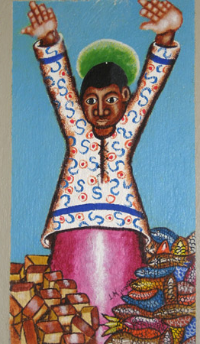
What is happening in the picture?
Which Bible story does it make you think about?
What can you see next to Jesus?
Jesus with Loaves and Fish, from Art in the Christian Tradition, a project of the Vanderbilt Divinity Library, Nashville, TN. https://diglib.library.vanderbilt.edu/act-imagelink.pl?RC=59089 [retrieved January 7, 2025]. Original source: https://www.flickr.com/photos/genvessel/537739978/.

Slide 20
Jesus Feeds Five Thousand
When Jesus heard the news about John, he left there in a boat and went to a lonely place by himself. The people heard about it, and so they left their towns and followed him by land. Jesus got out of the boat, and when he saw the large crowd, his heart was filled with pity for them, and he healed their sick. That evening his disciples came to him and said, “It is already very late, and this is a lonely place. Send the people away and let them go to the villages to buy food for themselves.”
“They don't have to leave,” answered Jesus. “You yourselves give them something to eat!”
“All we have here are five loaves and two fish,” they replied.
“Then bring them here to me,” Jesus said. He ordered the people to sit down on the grass; then he took the five loaves and the two fish, looked up to heaven, and gave thanks to God. He broke the loaves and gave them to the disciples, and the disciples gave them to the people. Everyone ate and had enough. Then the disciples took up twelve baskets full of what was left over. The number of men who ate was about five thousand, not counting the women and children.
Saddleback Kids video
Jesus Feeds 5000
Where is it in the Bible?
It’s in the book of Matthew, chapter 14 verses 13-21. You can also find it in the book of John, chapter 6 verses 5-13.
Jesus with Loaves and Fish, from Art in the Christian Tradition, a project of the Vanderbilt Divinity Library, Nashville, TN. https://diglib.library.vanderbilt.edu/act-imagelink.pl?RC=59089 [retrieved January 7, 2025]. Original source: https://www.flickr.com/photos/genvessel/537739978/.

Slide 21
What has just happened in this painting?
This was painted on a wall. Close your eyes and imagine how large the painting is.
Why do you think Jesus has his hands raised?
Jesus went to a ‘lonely place’. Why did everybody follow Jesus there?
The artist was born in Kenya, Africa.
I wonder how it felt to watch this miracle happen?
Jesus with Loaves and Fish, from Art in the Christian Tradition, a project of the Vanderbilt Divinity Library, Nashville, TN. https://diglib.library.vanderbilt.edu/act-imagelink.pl?RC=59089 [retrieved January 7, 2025]. Original source: https://www.flickr.com/photos/genvessel/537739978/.

Slide 22
Time to think or time to pray…
This is one of Jesus’ miracles that he did whilst he was on earth. All the people were hungry and needed to eat. God blessed them, through Jesus, and they had more than enough food.
Christians believe that Jesus still does miracles today, through God’s power. Is there anyone or anything that you would like to pray for? It could be for a friend or family member who is unwell, you can pray that God will heal them. It could be to pray for people who are hungry, that they will have plenty of food to eat.
Dear God,
We think about those people who need a miracle in their life. We ask that you help them and use your power to bless them. Help them to know your comfort at this time.
Amen.
Jesus with Loaves and Fish, from Art in the Christian Tradition, a project of the Vanderbilt Divinity Library, Nashville, TN. https://diglib.library.vanderbilt.edu/act-imagelink.pl?RC=59089 [retrieved January 7, 2025]. Original source: https://www.flickr.com/photos/genvessel/537739978/.

Slide 23
Worship Number 5
Global World map by Nastyasensei Sens is licensed under CC BY-SA 4.0

Slide 24
What is happening in the picture?
I wonder what the Bible says?
Can you see Jesus?
JESUS MAFA. The Transfiguration, from Art in the Christian Tradition, a project of the Vanderbilt Divinity Library, Nashville, TN. https://diglib.library.vanderbilt.edu/act-imagelink.pl?RC=48307 [retrieved November 27, 2024]. Original source: http://www.librairie-emmanuel.fr (contact page: https://www.librairie-emmanuel.fr/contact ).

Slide 25
The Transfiguration
Six days later Jesus took with him Peter and the brothers James and John and led them up a high mountain where they were alone. As they looked on, a change came over Jesus: his face was shining like the sun, and his clothes were dazzling white. Then the three disciples saw Moses and Elijah talking with Jesus. So Peter spoke up and said to Jesus, “Lord, how good it is that we are here! If you wish, I will make three tents here, one for you, one for Moses, and one for Elijah.” While he was talking, a shining cloud came over them, and a voice from the cloud said, “This is my own dear Son, with whom I am pleased—listen to him!” When the disciples heard the voice, they were so terrified that they threw themselves face downward on the ground. Jesus came to them and touched them. “Get up,” he said. “Don't be afraid!” So they looked up and saw no one there but Jesus. As they came down the mountain, Jesus ordered them, “Don't tell anyone about this vision you have seen until the Son of Man has been raised from death.”
Saddleback Kids video
The Transfiguration
Where is it in the Bible?
It’s in the book of Matthew, chapter 17 verses 1-9.
JESUS MAFA. The Transfiguration, from Art in the Christian Tradition, a project of the Vanderbilt Divinity Library, Nashville, TN. https://diglib.library.vanderbilt.edu/act-imagelink.pl?RC=48307 [retrieved November 27, 2024]. Original source: http://www.librairie-emmanuel.fr (contact page: https://www.librairie-emmanuel.fr/contact ).

Slide 26
Who is in the cloud?
Who is on the mountain?
Whose voice was it, speaking from the cloud?
The artist is from Cameroon, Africa.
I wonder how the disciples felt?
JESUS MAFA. The Transfiguration, from Art in the Christian Tradition, a project of the Vanderbilt Divinity Library, Nashville, TN. https://diglib.library.vanderbilt.edu/act-imagelink.pl?RC=48307 [retrieved November 27, 2024]. Original source: http://www.librairie-emmanuel.fr (contact page: https://www.librairie-emmanuel.fr/contact ).

Slide 27
Time to think or time to pray…
Transfiguration means “transformed” or “changed”. Through God’s power, the disciples saw Jesus change so his face was shining like the sun, and his clothes were dazzling white. God’s power can do anything. Just before this transfiguration, Peter had confessed that Jesus was the son of the Living God. The transfiguration displayed this truth in a magnificent way.
Dear God, we thank you for the joy we can experience in Jesus Christ. Help us reflect that joy in our bright, shining faces. Amen.
JESUS MAFA. The Transfiguration, from Art in the Christian Tradition, a project of the Vanderbilt Divinity Library, Nashville, TN. https://diglib.library.vanderbilt.edu/act-imagelink.pl?RC=48307 [retrieved November 27, 2024]. Original source: http://www.librairie-emmanuel.fr (contact page: https://www.librairie-emmanuel.fr/contact ).

Slide 28
Worship Number 6
Global World map by Nastyasensei Sens is licensed under CC BY-SA 4.0

Slide 29
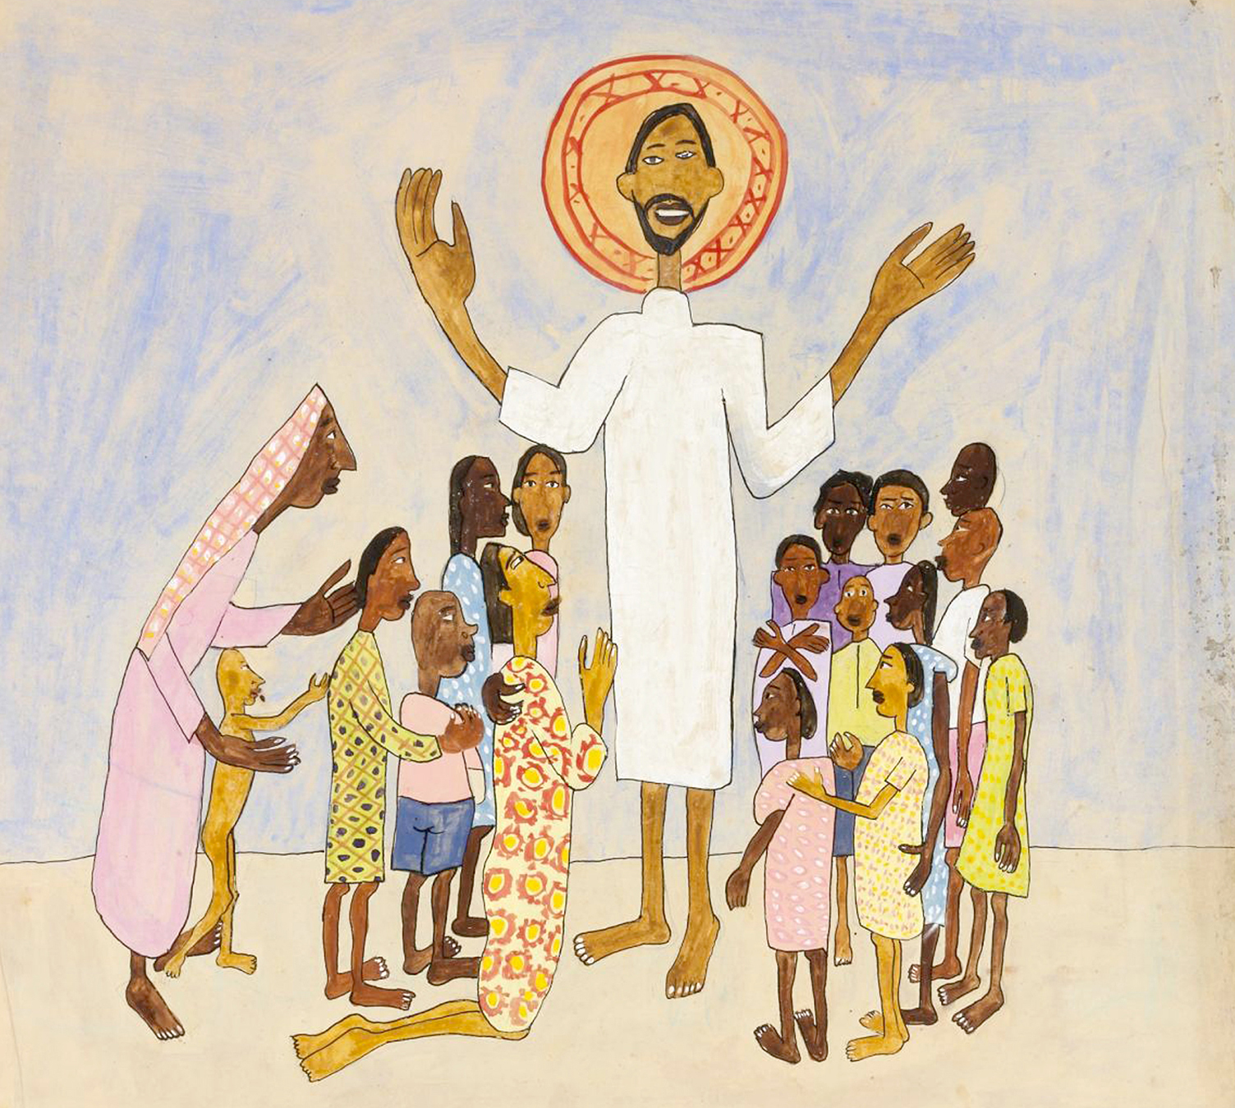
What is happening in the picture?
Can you see Jesus? What makes him easy to spot in this picture?
Who are the other people? What are they doing?
I wonder what the Bible says?
Johnson, William H., 1901-1970. Come Unto Me, Little Children, from Art in the Christian Tradition, a project of the Vanderbilt Divinity Library, Nashville, TN. https://diglib.library.vanderbilt.edu/act-imagelink.pl?RC=56876 [retrieved January 7, 2025]. Original source: https://americanart.si.edu/artwork/come-unto-me-little-children-11621.

Slide 30
Jesus and the Children
Some people brought children to Jesus for him to place his hands on them, but the disciples scolded the people. When Jesus noticed this, he was angry and said to his disciples, “Let the children come to me, and do not stop them, because the Kingdom of God belongs to such as these. I assure you that whoever does not receive the Kingdom of God like a child will never enter it.” Then he took the children in his arms, placed his hands on each of them, and blessed them.
Video
Jesus and the Children
Where is it in the Bible?
This story is found in 3 places in the Bible.
It’s in the book of Matthew, chapter 19 verses 13-15, the book of Mark, chapter 10 verses 13-16, and the book of Luke, chapter 18 verses 15-17.
Johnson, William H., 1901-1970. Come Unto Me, Little Children, from Art in the Christian Tradition, a project of the Vanderbilt Divinity Library, Nashville, TN. https://diglib.library.vanderbilt.edu/act-imagelink.pl?RC=56876 [retrieved January 7, 2025]. Original source: https://americanart.si.edu/artwork/come-unto-me-little-children-11621.

Slide 31
How would you have felt if you were there when Jesus said these words?
Why do you think the artist has chosen to make Jesus so much taller?
I wonder how the adults felt?
The artist wants his pictures to represent “joy, family and friendship”. Do you think this painting does this?
The artist is from a South African family.
Johnson, William H., 1901-1970. Come Unto Me, Little Children, from Art in the Christian Tradition, a project of the Vanderbilt Divinity Library, Nashville, TN. https://diglib.library.vanderbilt.edu/act-imagelink.pl?RC=56876 [retrieved January 7, 2025]. Original source: https://americanart.si.edu/artwork/come-unto-me-little-children-11621.

Slide 32
Time to think or time to pray…
Everybody is important to God. Jesus showed this by saying that the children should come to him. He wants everyone to feel welcome in his family.
Dear God,
Thank you that we are all part of your family. Help us to remember how much you love us. We pray your blessing over all our friends and family. Amen.
Johnson, William H., 1901-1970. Come Unto Me, Little Children, from Art in the Christian Tradition, a project of the Vanderbilt Divinity Library, Nashville, TN. https://diglib.library.vanderbilt.edu/act-imagelink.pl?RC=56876 [retrieved January 7, 2025]. Original source: https://americanart.si.edu/artwork/come-unto-me-little-children-11621.

Slide 33
Worship Number 7
Global World map by Nastyasensei Sens is licensed under CC BY-SA 4.0

Slide 34
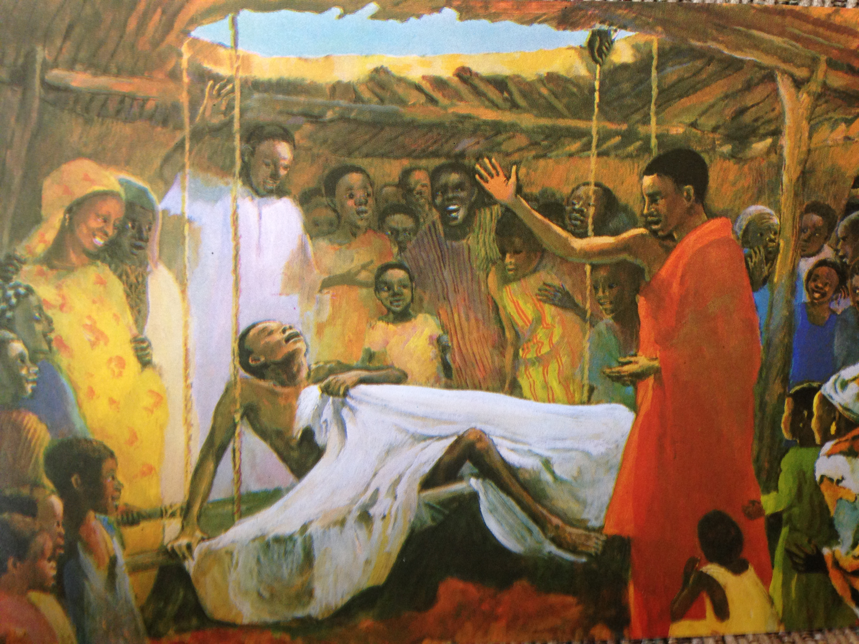
What is happening in the picture?
I wonder what the Bible says?
Can you see Jesus?
JESUS MAFA. Jesus heals a paralyzed man, from Art in the Christian Tradition, a project of the Vanderbilt Divinity Library, Nashville, TN. https://diglib.library.vanderbilt.edu/act-imagelink.pl?RC=48306 [retrieved January 7, 2025]. Original source: http://www.librairie-emmanuel.fr (contact page: https://www.librairie-emmanuel.fr/contact).

Slide 35
Jesus Heals a Paralyzed Man
A few days later Jesus went back to Capernaum, and the news spread that he was at home. So many people came together that there was no room left, not even out in front of the door. Jesus was preaching the message to them when four men arrived, carrying a paralyzed man to Jesus. Because of the crowd, however, they could not get the man to him. So they made a hole in the roof right above the place where Jesus was. When they had made an opening, they let the man down, lying on his mat. Seeing how much faith they had, Jesus said to the paralyzed man, “My son, your sins are forgiven.” Some teachers of the Law who were sitting there thought to themselves, “How does he dare talk like this? This is blasphemy! God is the only one who can forgive sins!” At once Jesus knew what they were thinking, so he said to them, “Why do you think such things? Is it easier to say to this paralyzed man, ‘Your sins are forgiven,’ or to say, ‘Get up, pick up your mat, and walk’? I will prove to you, then, that the Son of Man has authority on earth to forgive sins.” So he said to the paralyzed man, “I tell you, get up, pick up your mat, and go home!” While they all watched, the man got up, picked up his mat, and hurried away. They were all completely amazed and praised God, saying, “We have never seen anything like this!”
Saddleback Kids video
Jesus Heals a Paralysed Man
Where is it in the Bible?
It’s in the book of Mark, chapter 2 verses 1-12.
JESUS MAFA. Jesus heals a paralyzed man, from Art in the Christian Tradition, a project of the Vanderbilt Divinity Library, Nashville, TN. https://diglib.library.vanderbilt.edu/act-imagelink.pl?RC=48306 [retrieved January 7, 2025]. Original source: http://www.librairie-emmanuel.fr (contact page: https://www.librairie-emmanuel.fr/contact).

Slide 36
What is about to happen?
Can you find the four friends who lowered him down to Jesus?
Why were his friends so determined to get their friend to Jesus?
The artist is from Cameroon, Africa.
I wonder how it felt to watch this miracle?
JESUS MAFA. Jesus heals a paralyzed man, from Art in the Christian Tradition, a project of the Vanderbilt Divinity Library, Nashville, TN. https://diglib.library.vanderbilt.edu/act-imagelink.pl?RC=48306 [retrieved January 7, 2025]. Original source: http://www.librairie-emmanuel.fr (contact page: https://www.librairie-emmanuel.fr/contact).

Slide 37
Time to think or time to pray…
At the time of Jesus, Jewish people believed that if your body was sick it was because of all the bad things you had done. But Jesus forgave any sins this man had and healed his body, not because of anything he did but because of the faith of his friends. He had four friends who cut through the roof of the house to get their friend to Jesus. Imagine the care as they walked him around the staircase along the side of the building. Imagine the effort to create a hole in the roof. Imagine how the man must have felt being lowered down. His friends really cared about him.
Our friends will experience times in their lives when they feel a bit stuck and where they need some help from others. Let us be the friend they need and the type of friend we would want.
Dear God, please help me be a good friend and think of others in their time of need. Amen
JESUS MAFA. Jesus heals a paralyzed man, from Art in the Christian Tradition, a project of the Vanderbilt Divinity Library, Nashville, TN. https://diglib.library.vanderbilt.edu/act-imagelink.pl?RC=48306 [retrieved January 7, 2025]. Original source: http://www.librairie-emmanuel.fr (contact page: https://www.librairie-emmanuel.fr/contact).

Slide 38
Worship Number 8
Global World map by Nastyasensei Sens is licensed under CC BY-SA 4.0

Slide 39
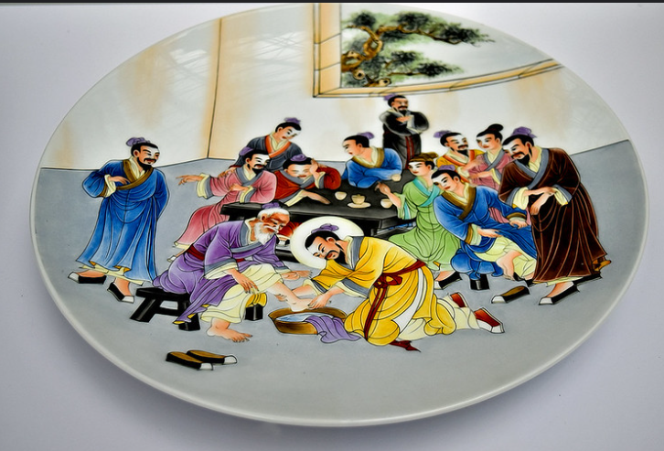
What is happening in the picture?
I wonder what the Bible says?
Can you see Jesus?
Jesus art by Choo Yut Shing is licensed under CC BY-NC-SA 2.0.

Slide 40
Jesus Washes His Disciples Feet
Jesus knew that the Father had given him complete power; he knew that he had come from God and was going to God. So he rose from the table, took off his outer garment, and tied a towel around his waist. Then he poured some water into a washbasin and began to wash the disciples' feet and dry them with the towel around his waist. He came to Simon Peter, who said to him, “Are you going to wash my feet, Lord?” Jesus answered him, “You do not understand now what I am doing, but you will understand later.” Peter declared, “Never at any time will you wash my feet!” “If I do not wash your feet,” Jesus answered, “you will no longer be my disciple.” Simon Peter answered, “Lord, do not wash only my feet, then! Wash my hands and head, too!” Jesus said, “Those who have taken a bath are completely clean and do not have to wash themselves, except for their feet. All of you are clean—all except one.” (Jesus already knew who was going to betray him; that is why he said, “All of you, except one, are clean.”)
After Jesus had washed their feet, he put his outer garment back on and returned to his place at the table. “Do you understand what I have just done to you?” he asked. “You call me Teacher and Lord, and it is right that you do so, because that is what I am. I, your Lord and Teacher, have just washed your feet. You, then, should wash one another's feet. I have set an example for you, so that you will do just what I have done for you.
Saddleback Kids video
Jesus Washes His Disciples Feet
Where is it in the Bible?
It’s in the book of John chapter 13, verses 4-15.
Jesus art by Choo Yut Shing is licensed under CC BY-NC-SA 2.0.

Slide 41
Why has this artist put a halo around Jesus’ head?
Which disciple do you think it is at the back, with his arms folded?
I wonder how it felt to have your feet washed by Jesus? What would you have said to him?
The artist is from China, Asia.
Jesus art by Choo Yut Shing is licensed under CC BY-NC-SA 2.0.

Slide 42
Time to think or time to pray…
This happened near the end of Jesus’ life. He knew that Judas, one of his disciples, would betray Him. Jesus got up at the meal to wash his disciple’s feet. By doing the job of a servant, he was demonstrating that he came to be a servant, to serve and help other people and wash the world of their sins. Only Jesus can offer us forgiveness!
Dear Jesus, Thank you that you came as a servant to lay down your life. We pray that we would learn to be like Jesus and serve one another. Amen.
Jesus art by Choo Yut Shing is licensed under CC BY-NC-SA 2.0.

