Slide 1

SEEKING WISDOM
DISCERNMENT IN A TIME OF UPHEAVAL

Slide 2
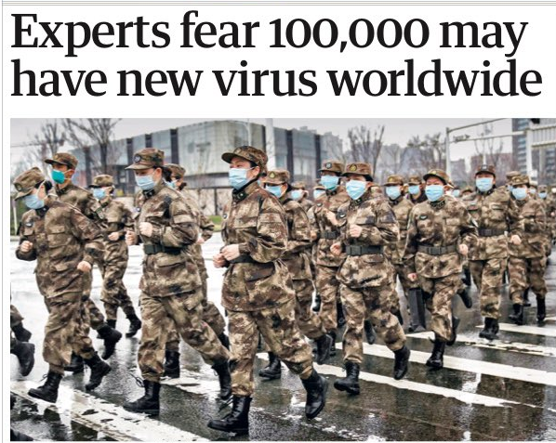

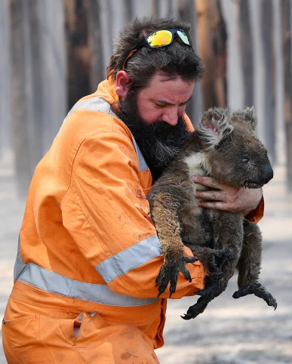
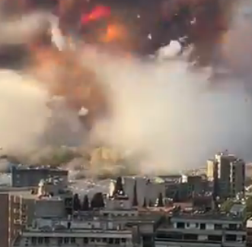

Most high and glorious God, give light to the darkness of our hearts, give us right faith, certain hope and perfect charity. Lord, give us insight and wisdom, that we might always discern your holy and true will.
St. Francis of Assisi

Slide 3
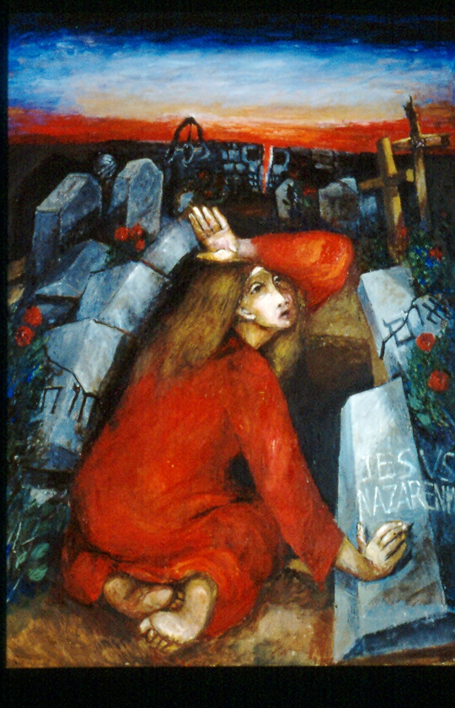
‘Christianity was not only “good news”—the communication of a hitherto unknown content […] the Christian message was not only “informative” but “performative”.
That means: the Gospel is not merely a communication of things that can be known—it is one that makes things happen and is life-changing. The dark door of time, of the future, has been thrown open. The one who has hope lives differently’.
Pope Benedict, Spe Salvi

Slide 4


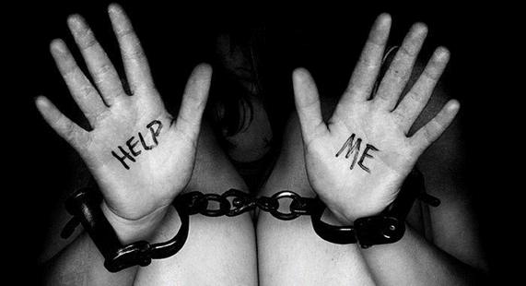
‘The joys and hopes, the grief and anguish, of the people of our time, especially of those who are poor or afflicted, are the joys and hopes, the grief and anguish of the followers of Christ as well. Nothing that is genuinely human fails to find an echo in their hearts.’ [Gaudium et Spes, 1]
Embedded in the Ignatian Exercises and Constitutions is the belief that the Holy Spirit speaks to us in practical circumstances, in the signs of the times and in the depths of our hearts. Ignatius teaches caution in the face of the human capacity for self-deception but also confidence in the Spirit’s power to guide and ours to be guided.

Slide 5
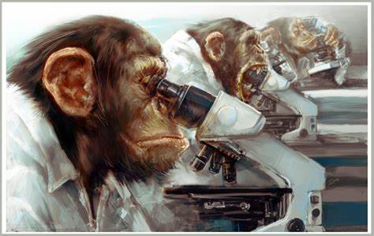
  CONTEMPLATION
  AS ‘A LONG, LOVING LOOK AT THE REAL’
  ‘Finding God in all things’ entails believing
  that there is no human experience or subject
  of focus in which God is not present.

Slide 6
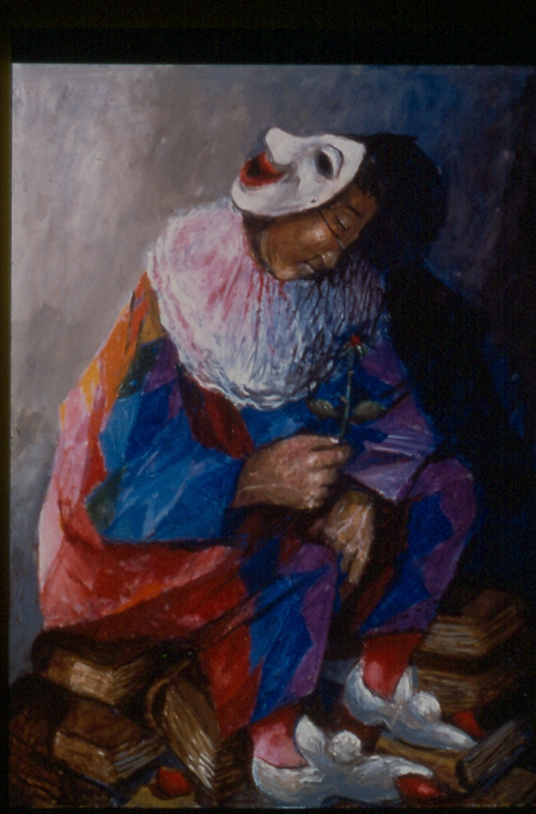
‘Covid has unmasked the other pandemic, the virus of indifference, which is the result of constantly looking away, telling ourselves that because there is no immediate or magic solution, it is better not to feel anything […] This crisis unmasks our vulnerability, exposes the false securities on which we had based
our lives.’
Pope Francis, Let Us Dream

Slide 7
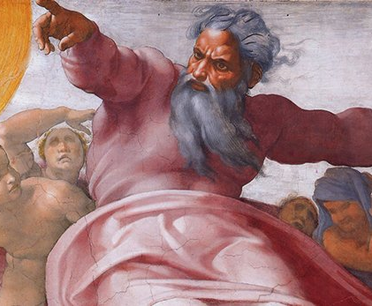
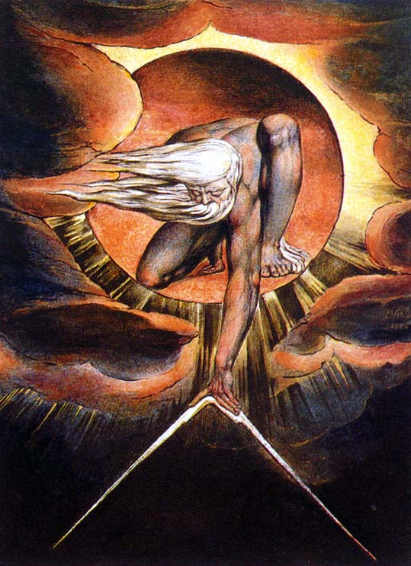

As our image of God, so our prayer and our theology…

Slide 8
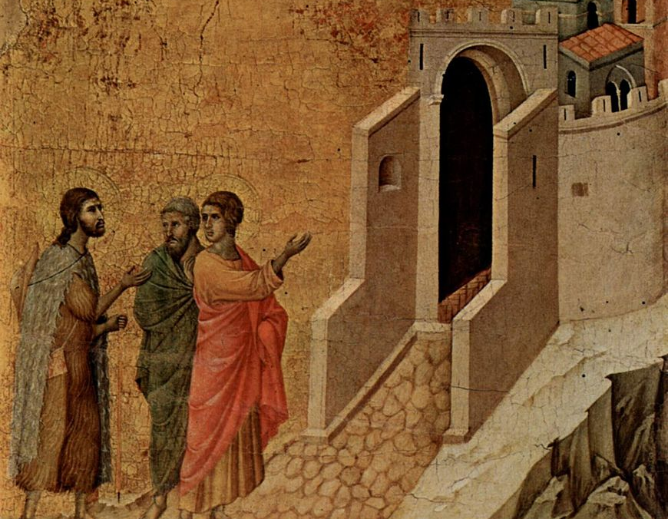
Jesus’ own method of spiritual direction
The disciples are reflecting on their own experience without understanding
Jesus doesn’t give them a long explanation but helps them to reflect on their lived experience in light of Scripture and vice versa
They come to a better understanding of Scripture and of their own experience
They recognize it is him through their affective response ‘our hearts burned within us’…

Slide 9
Normative Theology Formal Theology
Scripture Theology of the Theologians
The Creed Dialogue with other disciplines
Official church teaching
Liturgy
Espoused Theology Operant Theology
Theology embedded Theology embedded in
within a group’s articulation actual practice of a
of its belief. group.
The Four Voices of Theology (Cameron, et al, 2010, p. 54)

Slide 10
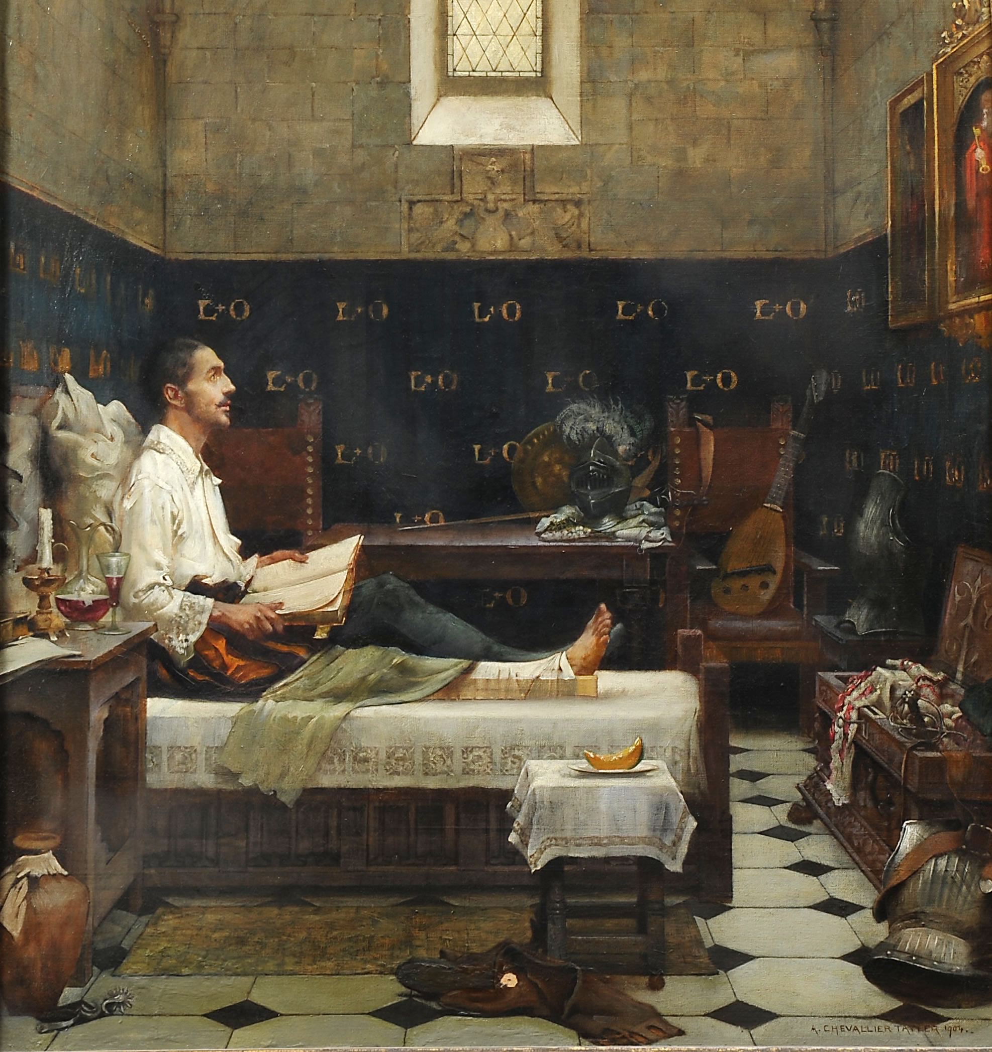
The purpose of discernment
Saint Ignatius wrote his Spiritual Exercises to help us to rid ourselves of ‘disordered attachments’ – practices or beliefs/ideas that hold us captive. The aim is to help us act freely in the world as transformed transformers, being the loving eyes, ears, hands and hearts of Christ to a wounded world.
The aim of discernment is to allow God’s Spirit to lead us daily so that we can develop an instinct for where God is present and active.

Slide 11
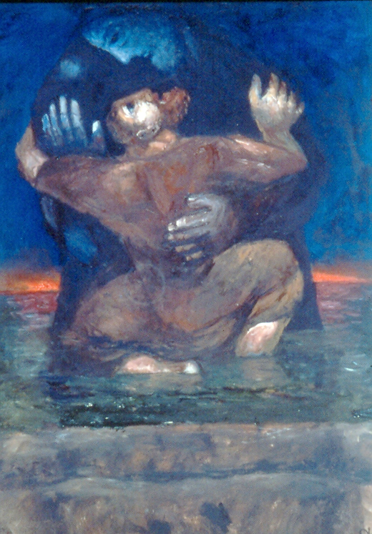
Discernment
is what we see people doing within the Biblical narratives – trying to make sense of their experience, finding clarity through trust and risk-taking, freedom through letting go of regret for the past or anxiety about the future, moving forward without certainty.
In discerning any question, especially those most fundamental to our lives, some key points may help to clarify where and by what inner paths we are being led.

Slide 12
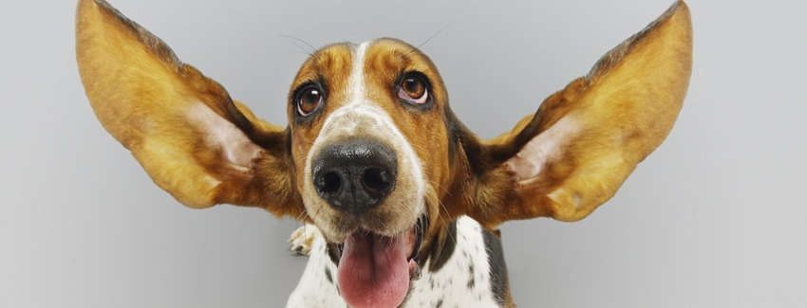
Obedience is above all the
ART OF LISTENING

Slide 13

Trusting our inner feelings
Sensory
Emotional/Relational Intuitive/Instinctive Delusional
Erotic
      I know that I’m forgiven,
      But I don’t know how I know
      I don’t trust my inner feelings –
      Inner feelings come and go.
      (Leonard Cohen, That don’t Make it Junk)

Slide 14
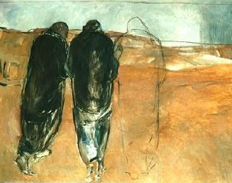
Didn’t our hearts burn within us?
Discernment is not for Lone Rangers. It is never a one-man/woman band. It is always done in companionship with Jesus and with the faith community, both in its entirety and in its individual members. Our feeling and faith responses help us to recognize Jesus, our daily companion, in the Scriptures, in our lived experience and in the breaking of bread.

Slide 15
If a man lies with a male as with a woman, both of them have committed an abomination; they shall surely be put to death; their blood is upon them." Leviticus 20: 13
“Keep my decrees. Do not mate different kinds of animals. Do not plant your field with two kinds of seed. Do not wear clothing woven
of two kinds of material.” Leviticus 19:19
We are already giving ourselves permission to determine what rules are binding under what circumstances… On what premises are we determining some teachings to be essential and others to be contingent on time and space?

Slide 16
Pope Francis encourages us to contextualize our understanding of even such foundational things as our understanding of gender
‘…the configuration of our own mode of being, whether as male or female, is not simply the result of biological or genetic factors, but of multiple elements having to do with temperament, family history, culture, experience, education, the influence of friends, family members and respected persons, as well as other formative situations.
It is true that we cannot separate the masculine and the feminine from God’s work of creation, which is prior to all our decisions and experiences, and where biological elements exist which are impossible to ignore. But it is also true that masculinity and femininity are not rigid categories. […]

Slide 17
A rigid approach turns into an over-accentuation of the masculine or feminine and does not help children and young people to appreciate the genuine reciprocity incarnate in the real conditions of matrimony.
Such rigidity, in turn, can hinder the development of an individual’s abilities, to the point of leading him or her to think, for example, that it is not really masculine to cultivate art or dance, or not very feminine to exercise leadership. This, thank God, has changed, but in some places deficient notions still condition the legitimate freedom and hamper the authentic development of children’s specific identity and potential.
(Pope Francis, Amoris Laetitia, 286, italics added)

Slide 18
Desires matter
Finding out what we truly want, and being willing to engage with those desires. It can be deeply unhelpful to place desires into hierarchies or categories of ‘right’ or ‘wrong’ outside any context of pastoral experience or theological analysis
Equally, we need honesty and clarity to see what is really driving us :
‘The whole life of a good Christian is holy desire. What you desire you cannot see yet. But the desire gives you the capacity, so that when it does happen that you see, you may be fulfilled… this is our life, to be exercised by desire’. (St. Augustine)

Slide 19

Questions matter
A key part of discernment is to know what lies at the heart of our questions – are there fears & anxieties there, an inability to let go & walk forward in trust? Are we imprisoned by the past? Is there something that prevents us from being honest? Or are we in fact not entirely free to make choices just for ourselves?
What is the reality of our context and how does that impact on the choices we can make? Above all, can we trust God to lead us in truth and love, can we trust ourselves & our own instincts and judgement?

Slide 20
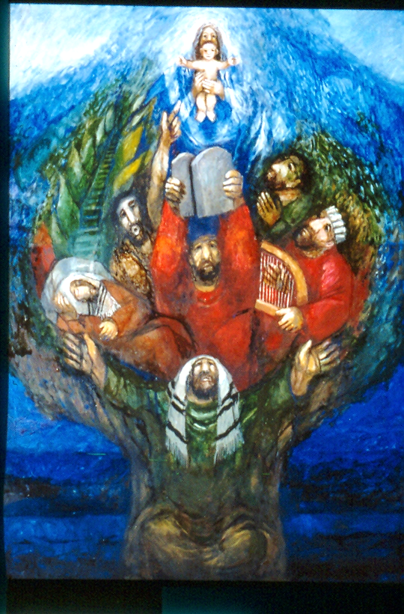
Memories are not neutral
We can be captive to certain memories and the memory of patterns in our lives that have not served us well. Is there some compulsion from which we desire to be freed? This can happen in groups and institutions as well as in individuals.
The memory of our deepest encounters with God can also help us to reconnect with what lies at the root of our heart’s desire and our most authentic self.
What memories from our collective history bind or free us to see, judge and act in particular ways?

Slide 21
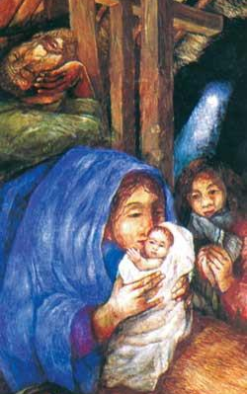
‘I have a dream’: intuition should be taken seriously
The Zeitgeist can be a collective delusion, but it can also be a sign of a collective instinct that new times and circumstances require new perspectives. If we recognize a pattern of orientation towards a particular choice that will not let go of us, it is worth exploring this as potentially the guiding light of God’s Spirit.
It’s also worth taking dreams seriously (or at least checking them out…)

Slide 22
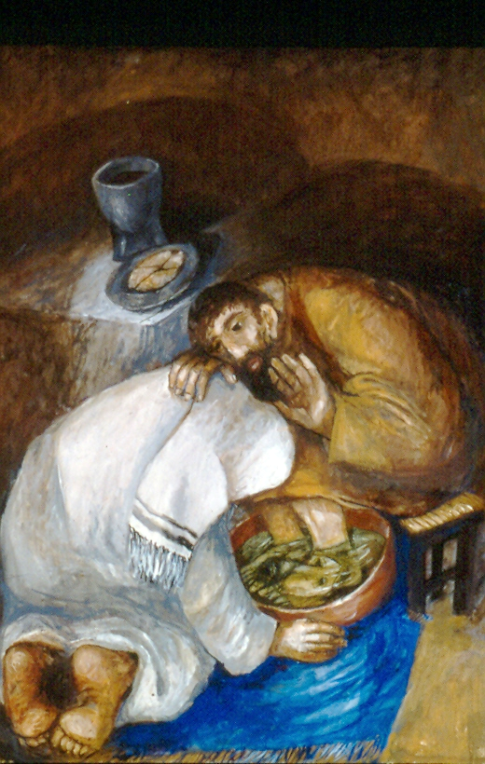
Our body should be taken seriously
Our body is a source of God’s revelation. Our bodies are powerful carriers of wisdom, our senses registering the world, our embodied selves acting in the world in all that we do.
All experience is data for discernment and often comes to us first through our bodies.
When dealing with rules and laws set down in the past, it is worth considering how the body was seen at this time: how its relationship to the mind and soul was understood – whose body was considered as being normative and generally descriptive of all bodies…

Slide 23
Reason and imagination are not opposites
They are different faculties of our mind which enable us to get in touch with responses to God’s grace that are both about our feelings and the fruit of careful consideration.
Imaginative contemplation of the Gospels plays a major role in the Ignatian tradition in terms of helping us prayerfully to come to an understanding of our deepest desires, where the Spirit is at work. Prayer is an essential component of any synodal process.
Balancing the reasons for and against a decision, sifting the data as best we can are both necessary rational activities when it comes to making choices and decisions.

Slide 24
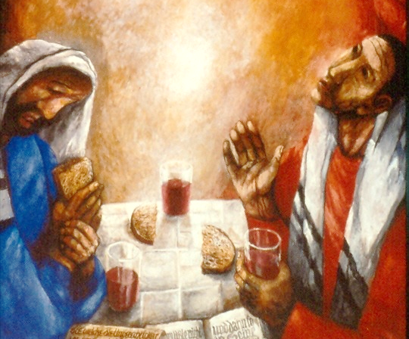
Confirmation
We can seek confirmation through practical exercises like listing reasons why a particular choice and its opposite might be a good or bad idea.
We principally find confirmation in the scriptures, in doctrine, moral teaching, within the faith community which ‘tests the spirit’ against the ‘signs of the times’…

