Slide 1
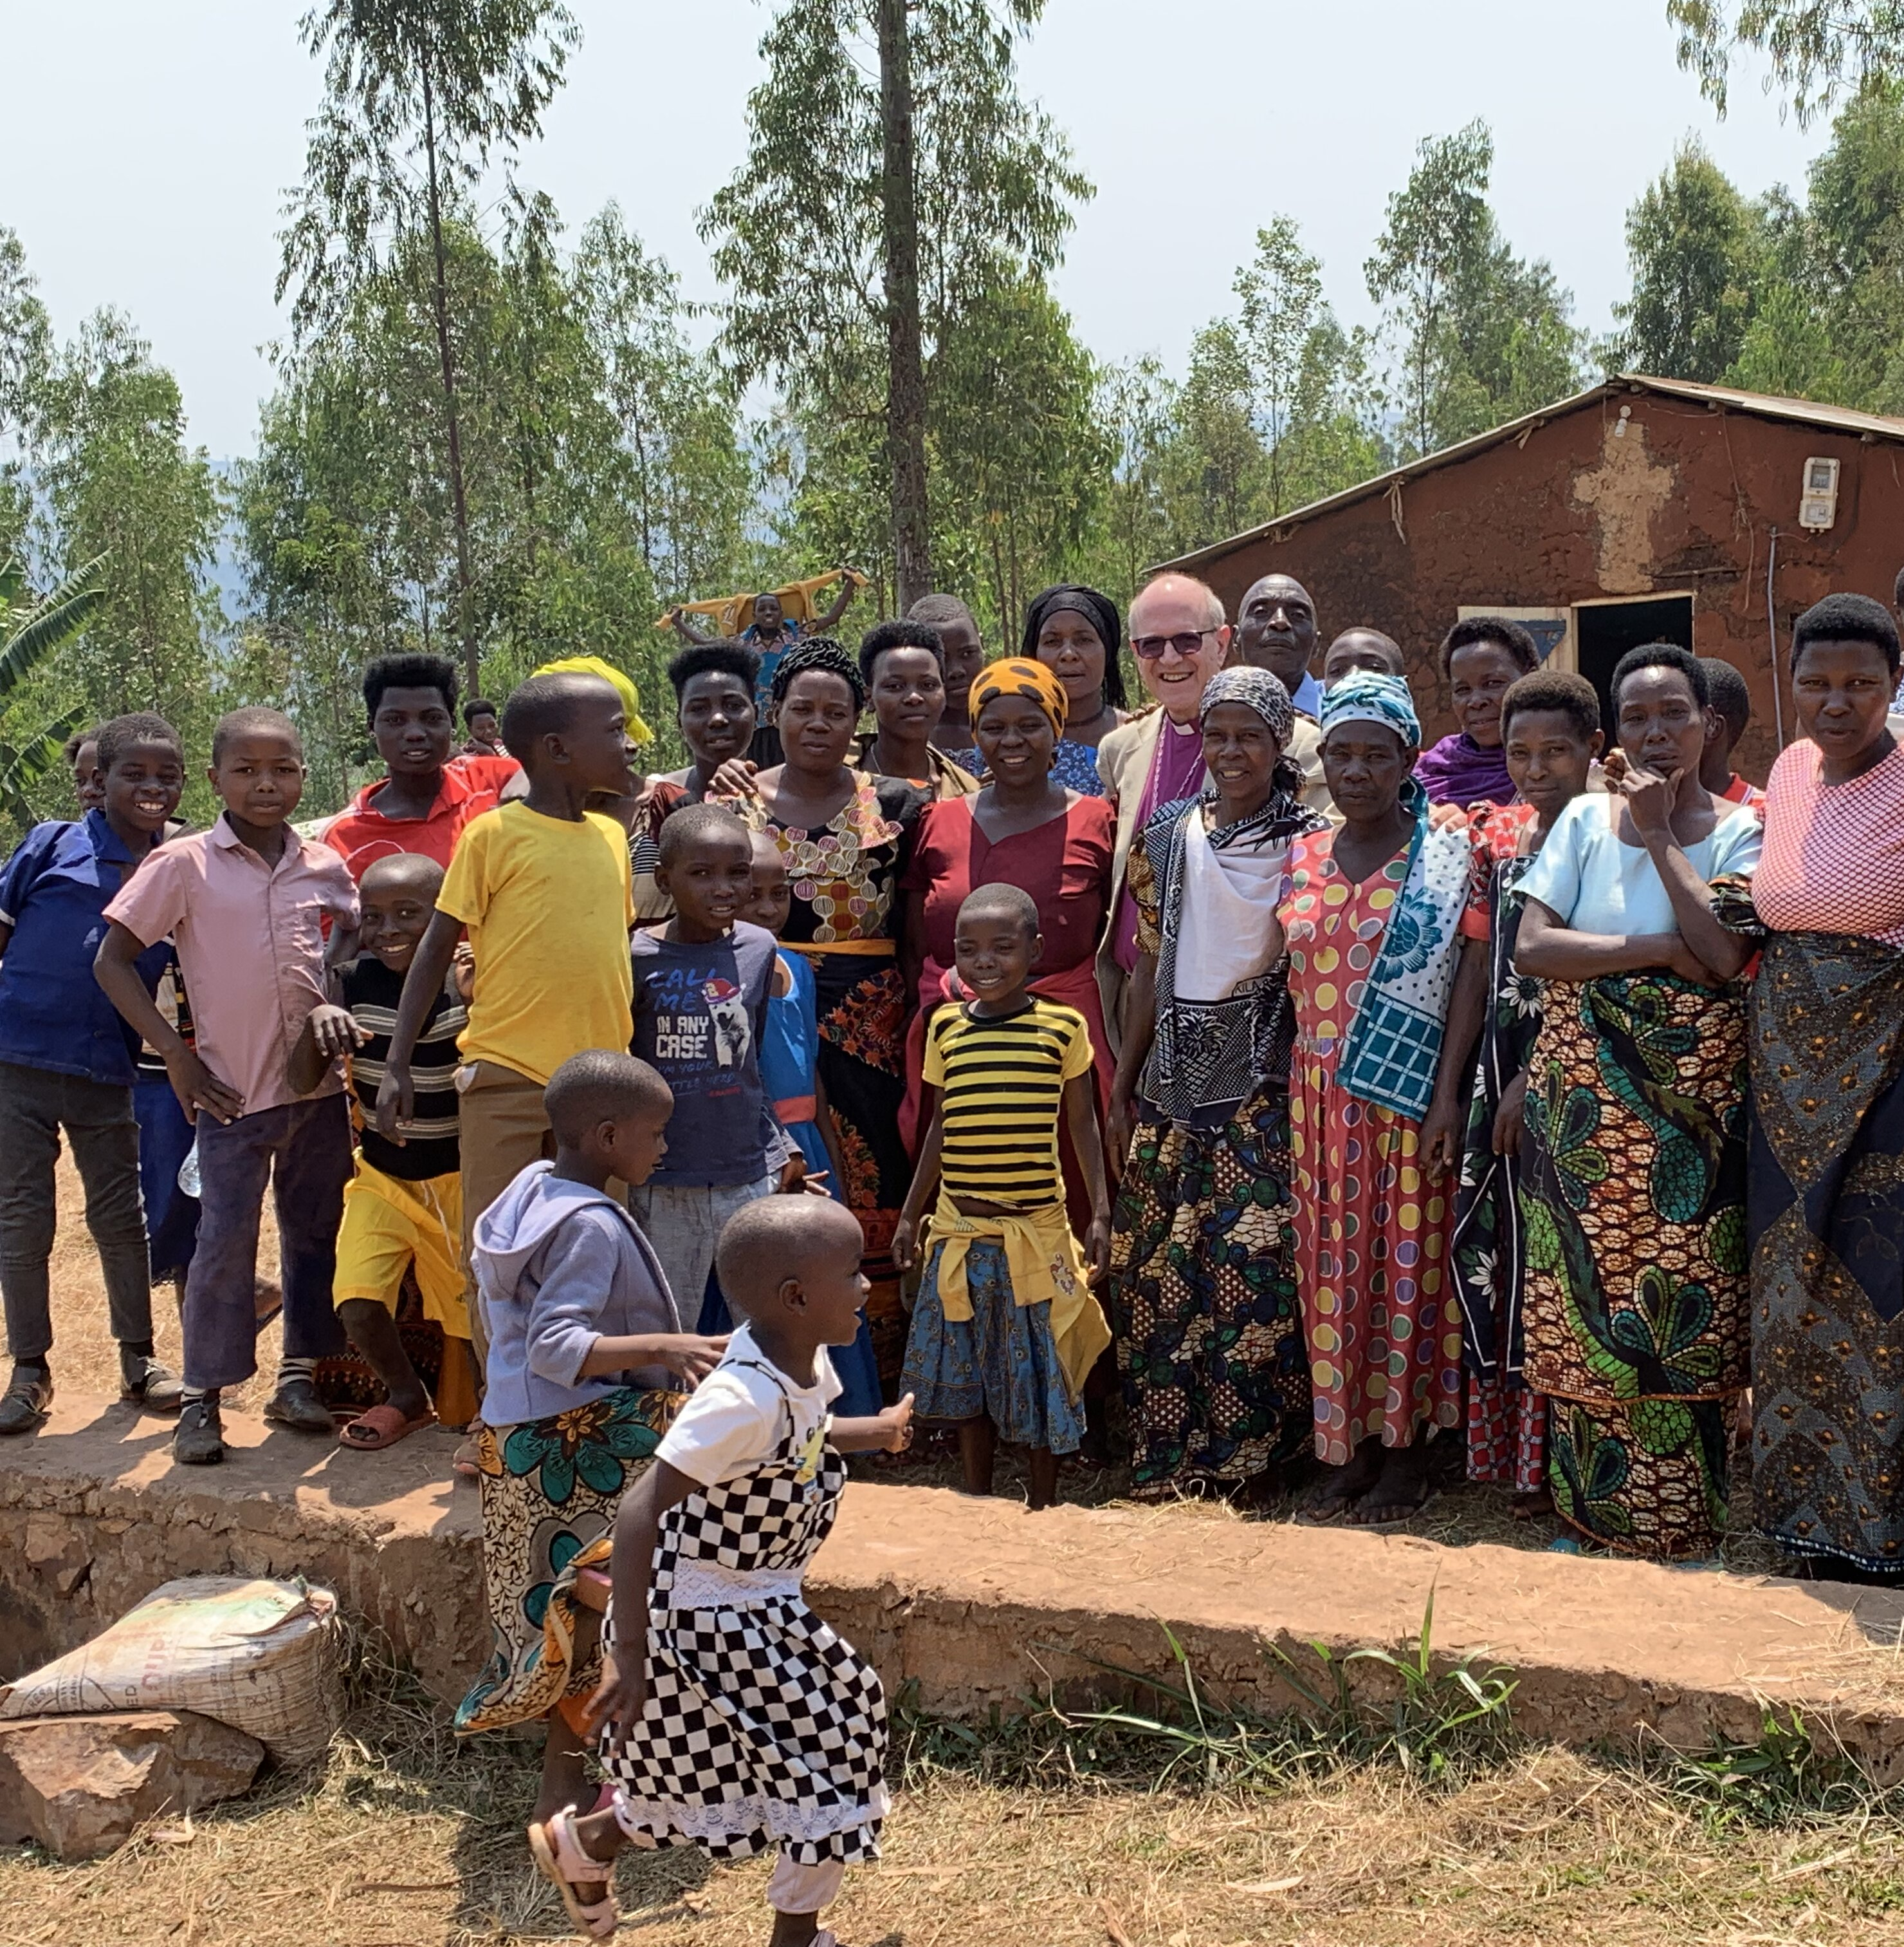

Bishops' Lent Appeal for Kagera
Supporting key workers
in Kagera
Subsistence farmers, doctors, priests and many others in Kagera do vital work in caring for their communities.
This year the Bishops' Lent Appeal is raising funds to support them.
For more information on how you can help, contact your priest, visit cofesuffolk.org/bishops-lent-appeal or email kagera@cofesuffolk.org

