Slide 1
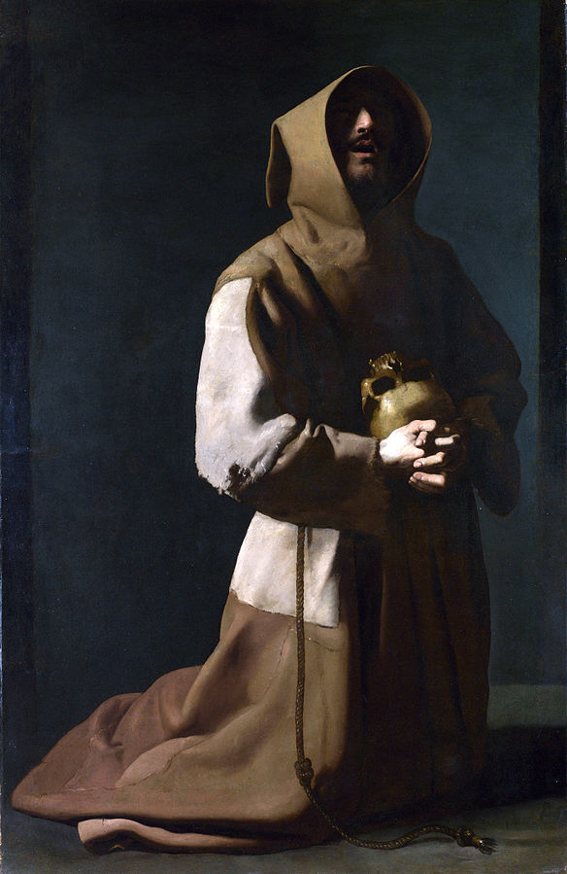
The Last things: death, judgement, heaven and hell
Advent 2020
Notes:
.

Slide 2
Hell

Slide 3
Almighty God,
Give us grace to put away the works of darkness
And to put on the armour of light,
Now in the time of this mortal life,
In which your Son Jesus Christ came to us in great humility;
That on the last day,
When he shall come in his glorious majesty
To judge the living and the dead,
We may rise to life immortal;
Through him who is alive and reigns with you,
In the unity of the Holy Spirit,
One God, now and for ever,
Amen

Slide 4
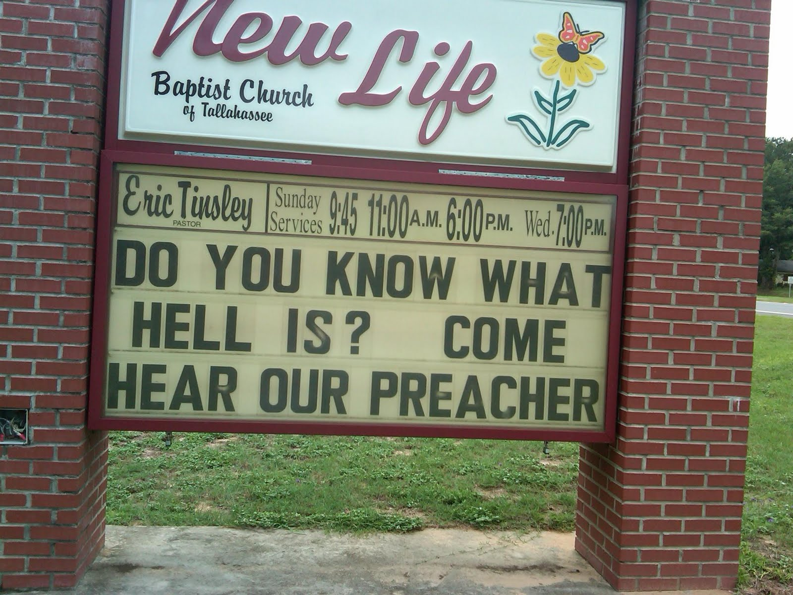

Slide 5

Universalism

Slide 6
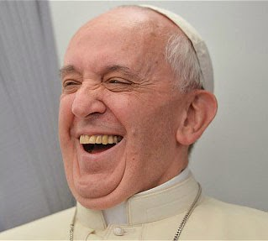
“no one can be condemned for ever, because that is not the logic of the Gospel”.
Pope Francis

Slide 7
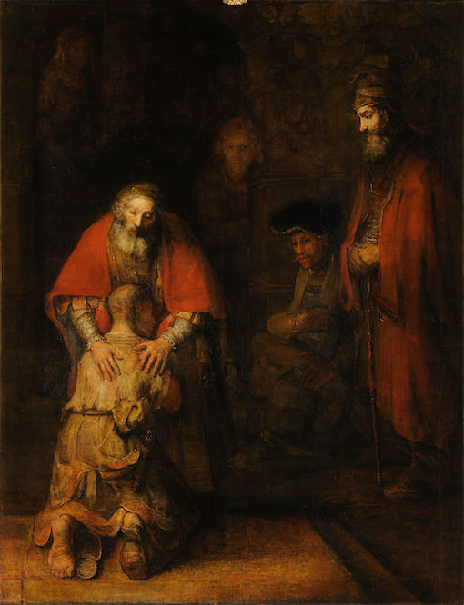
A God of love?
Who would want to
exclude themselves
in the end?

Slide 8
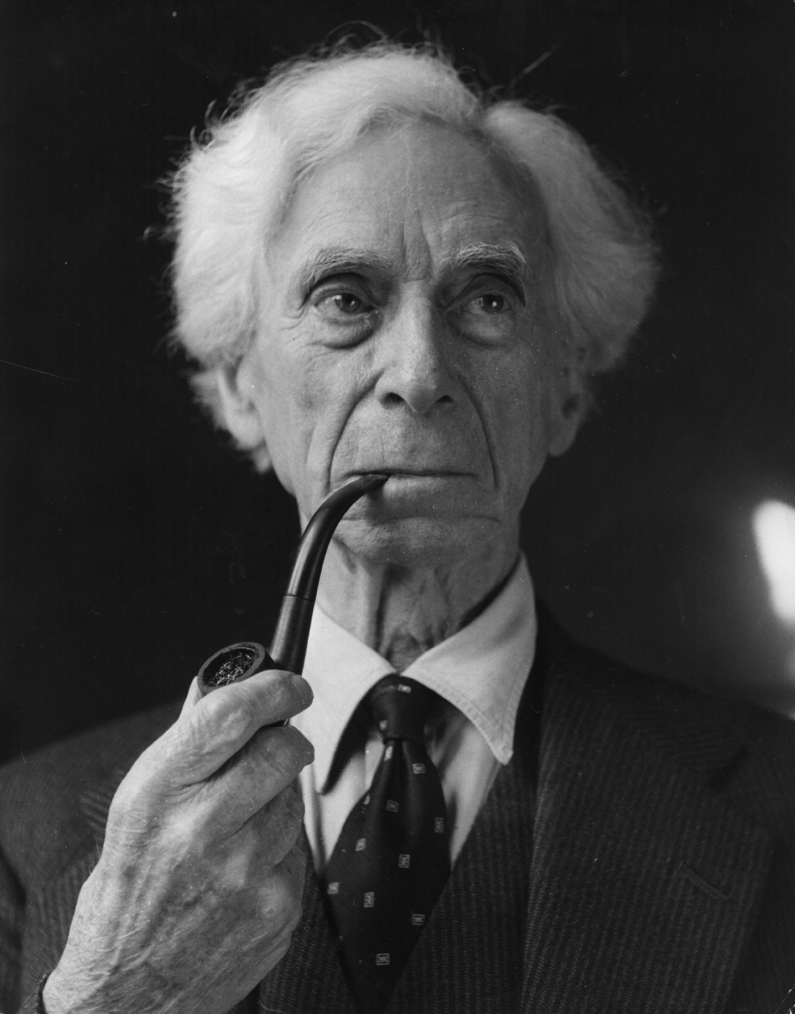
“there is one very serious defect to my mind in Christ’s moral character, and that is that He believed in Hell. I do not myself feel that any person who is really profoundly humane can believe in everlasting punishment”.
Bertrand Russell

Slide 9

Jesus on hell

Slide 10
“Anyone who says “you fool!” will be in danger of the fire of hell” Mt 5.22
“..better for you to lose one part of your body than for your whole body to be thrown into hell” Mt 5.29
“…better for you to enter life maimed…than…to be thrown into eternal fire” Mt 18.8
“Do not be afraid…rather be afraid of the One who can destroy both body and soul in hell” Mt 10.28
“twice as much a son of hell” Mt 23.15
“then they will go away to eternal punishment, but the righteous to eternal life” Mt 25.46

Slide 11
Rich man and Lazarus parable Luke 16.23
“better to enter the kingdom of God with one eye than to have two eyes and be thrown into hell where their worm does not die and the fire is not quenched” Mk 9.47-48
²⁸Do not be astonished at this; for the hour is coming when all who are in their graves will hear his voice ²⁹and will come out—those who have done good, to the resurrection of life, and those who have done evil, to the resurrection of condemnation. Jn 5.28-29
More widely Jesus in John’s Gospel talks of those who will “perish” (3.16, 10.28), will be “condemned” (3.18. 5.24), be subject to death (5.24) and die (6.50)

Slide 12

Exaggeration?

Slide 13

Empty
Threats?

Slide 14
Some texts supporting universalism
“And I when I am lifted up, will draw all people to myself” John 12.32
“Therefore just as one man’s trespass led to condemnation for all, so one man’s act of righteousness leads to justification and life for all” Rom 5.18
“for as all in Adam die, so all will be made alive in Christ” 1 Cor 15.22
“For God has imprisoned all in disobedience, so that he may be merciful to all” Rom 11.32
“For the grace of God has appeared, bringing salvation to all” Titus 2.11

Slide 15
Some texts supporting hell
“But by your hard and impenitent heart you are storing up wrath for yourself on the day of wrath, when God’s righteous judgement will be revealed Rom 2.5
“sudden destruction will come upon them…and there will be no escape” 1 Thess 5.3
“These will suffer the punishment of eternal destruction,. Separated from the presence of the Lord and from the glory of his might” 2 Thess 1.9
“for if we wilfully persist in sin after having received the knowledge of the truth, there no longer remains a sacrifice for sin, but a fearful prospect of judgement, and a fury of fire that will consume the adversaries” Heb 10.26-27
“…and anyone whose name was not found written in the book of life was thrown into the lake of fire Rev 20.15

Slide 16



Slide 17

Hell – some options
Eternal punishment (Augustine)
Annihilation (Ireneaus)
Universalism (Gregory of Nyssa)

Slide 18

The chief punishment of hell is eternal separation from God, in whom alone man (sic) can possess the life and happiness for which he was created and for which he longs
Official Roman Catholic view
and that of most
Pentecostal Churches
Notes:
For RC Church hell exists, is eternal, involves suffering, begins at the moment of death for all those who die in a state of mortal sin

Slide 19
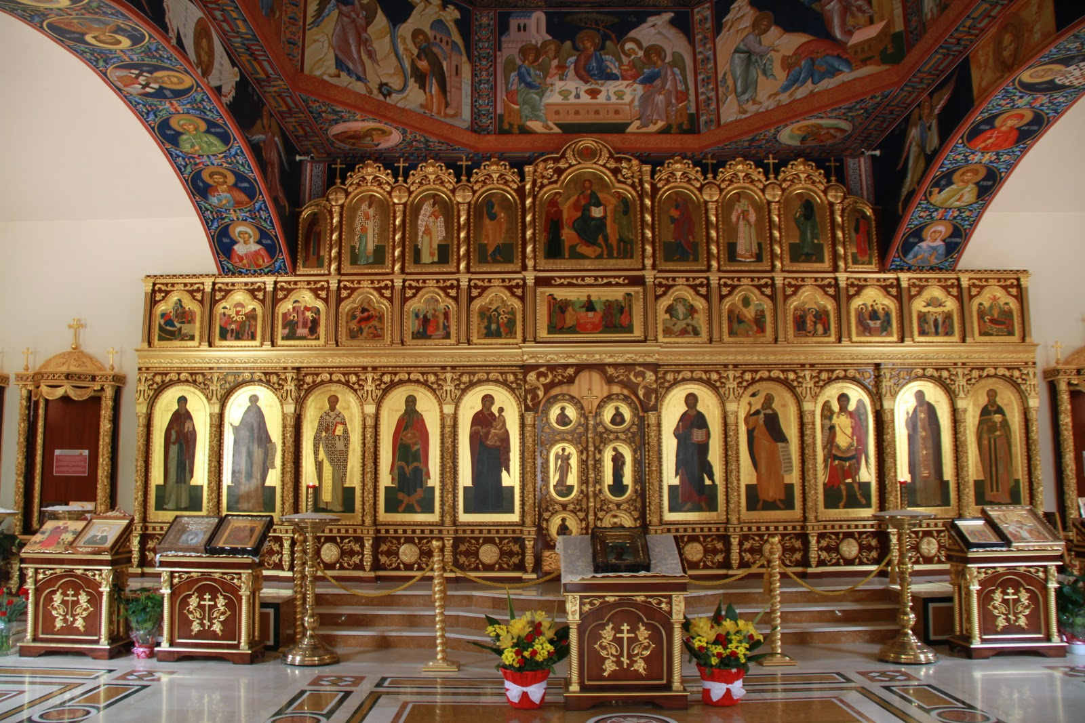
The damned’s experience of God’s light is not like Moses’, whose face was radiant, but rather something perceived as terrifying (Ex 20:19, 33:20). Being that Heaven is dwelling with God (Rev 21:3) where we see His face (Rev 22:4) and He is the only form of light (Rev 21:23), to those who hate God this will be eternal torture. Saint Peter seems to take this for granted when he warns in Acts 3:19, “Repent therefore and be converted, that your sins may be blotted out, so that times of refreshing may come from the face of the Lord.”
Orthodox Church

Slide 20
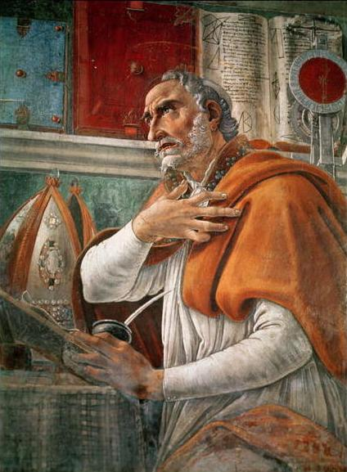
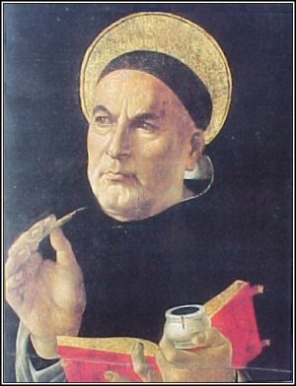
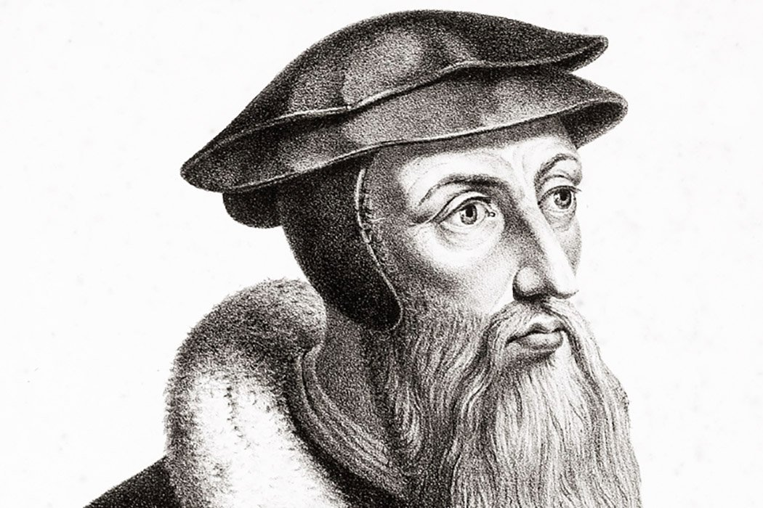

Slide 21
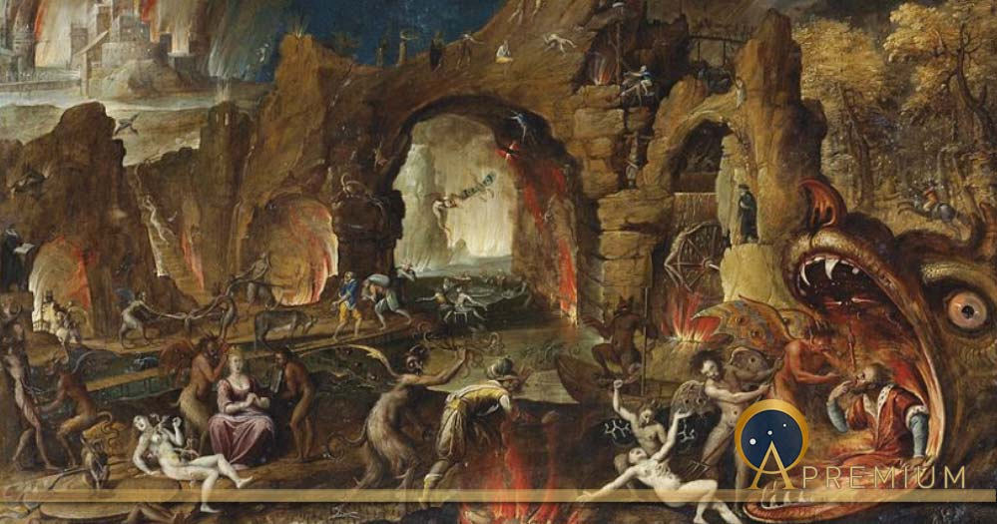

Slide 22
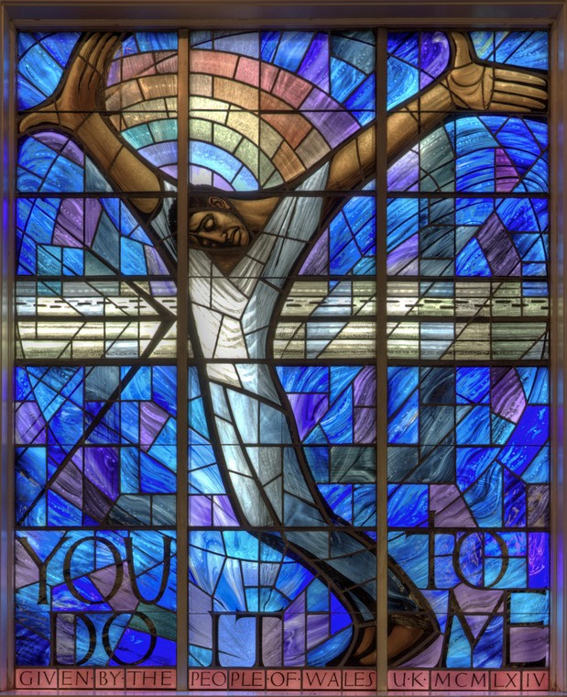
Jesus

Slide 23
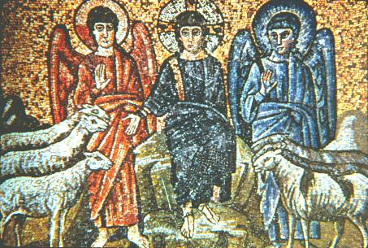
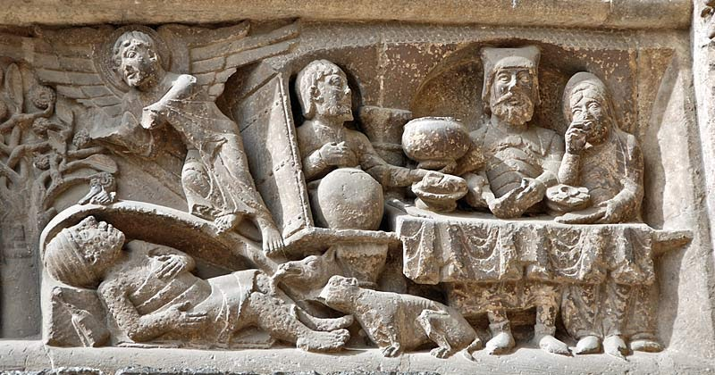
Two parables of Jesus
The sheep and the goats
Mt 25.31-46
Rich Man and Lazarus
Luke 16.19-31

Slide 24

Not everyone who says to me “Lord, Lord” shall enter the Kingdom of heaven but only the one who does the will of my Father in heaven”
Mt 7.21

Slide 25

This is not about your wife or your son, nor about Nero or Judas Iscariot,
it’s about you and me” C.S.Lewis

Slide 26
Issues
A split personality
in God?!
A God of love?
Why on earth would
You want to damn
yourself?

Slide 27

Annihilation
“The erasing of being”

Slide 28
Annihilation?
“Enter through the narrow gate, for the gate is wide and the road is easy that leads to destruction, and there are many who take it”
Mt 7.13
“For God so loved the world that He sent His only Son so that everyone who believes in him might not perish but may have eternal life” John 3.16
“sudden destruction will come upon them…and there will be no escape” 1 Thess 5.3
“These will suffer the punishment of eternal destruction,. Separated from the presence of the Lord and from the glory of his might” 2 Thess 1.9
“Their end is destruction, their god is the belly and their glory is their shame; their minds are set on earthly things” Phil 3.19

Slide 29

Annihilation
“Emotionally I find the concept of eternal conscious torment intolerable and do not understand how people can live with it without cauterising their feelings or cracking under the strain”
John Stott (1988)

Slide 30



Slide 31

Some questions for Universalism
Scripture
Freedom
Grace
Evil

Slide 32


Slide 33

Church of England?
“all men shall not be saved at length”
1553 Prayer Book
“all men shall not be saved at length”
OMITTED from1563 Prayer Book

Slide 34
“It is our conviction that the reality of hell (and indeed of heaven) is the ultimate affirmation of human freedom. Hell is not eternal torment, but it is the final and irreversible choosing of that which is opposed to God so completely and so absolutely that the only end is total non-being”.
“dogmatic universalism contradicts the
very nature of human love….
Love cannot compel the surrender of
a single heart that holds out against it….
Love never forces”.

Slide 35
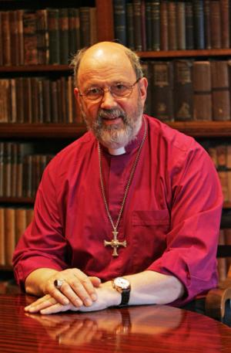
“after death they become at last, by their own effective choice, beings that once were human but now are not, creatures that have ceased to bear the divine image at all. With the death of that body in which they inhabited God’s good world, in which the flickering flame of goodness had not been completely snuffed out, they pass simultaneously beyond hope but also beyond pity”.
Tom Wright

Slide 36
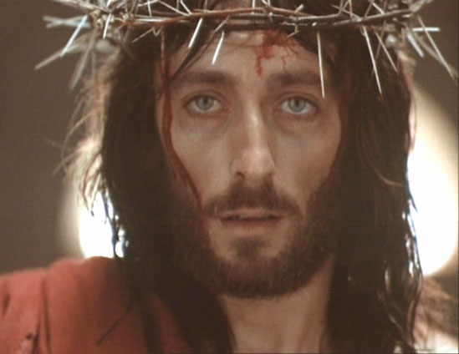

Slide 37
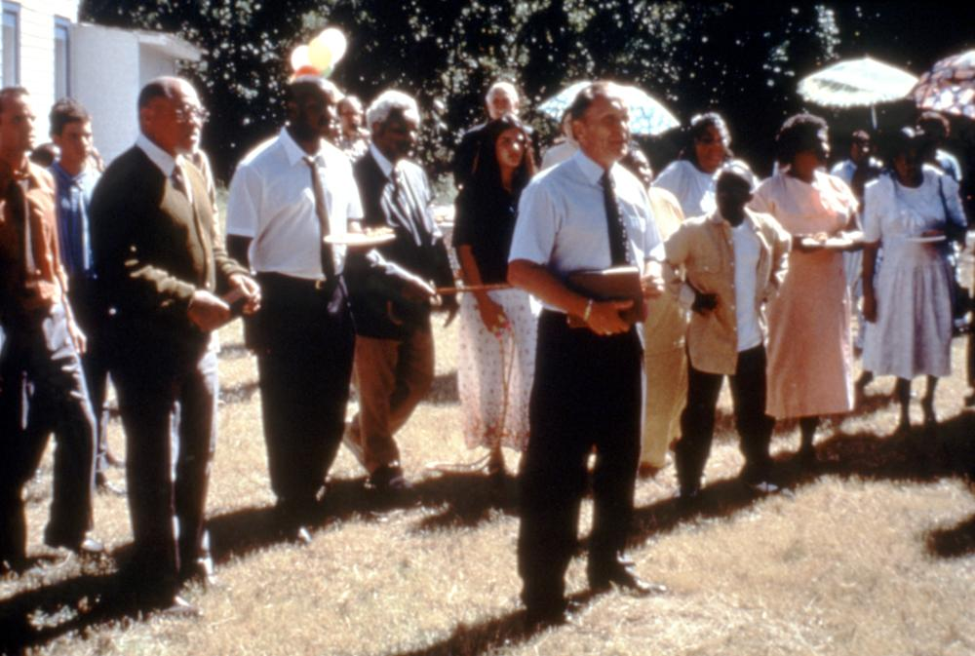
Uncle Otis
“Who goes to heaven?” He would answer something like, “Everybody who can stand that much love.” And when asked, “Who goes to hell?” he responded, “Only those who will have it no other way.” Uncle Otis

Slide 38

Notes:
T.F.Torrance – “if a sinner goes to hell it is not because God rejected them for God has only chosen to love them, and has only accepted them in Christ” If some people go to hell “they go to hell only because, inconceivably, they refuse the positive act of the divine acceptance of them”

Slide 39
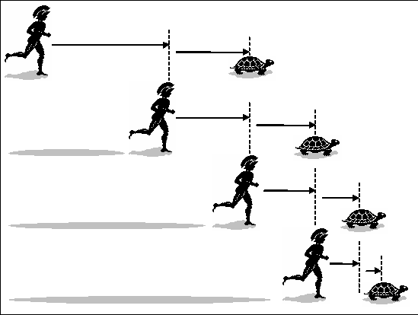

Slide 40
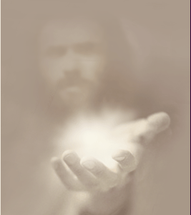
“Lord, will those who are saved be few?”
Jesus said “Strive to enter by the narrow door,
for many I tell you, will try to enter and will not be able”
Luke 13.23-24

Slide 41



Books….

Slide 42
