Slide 1
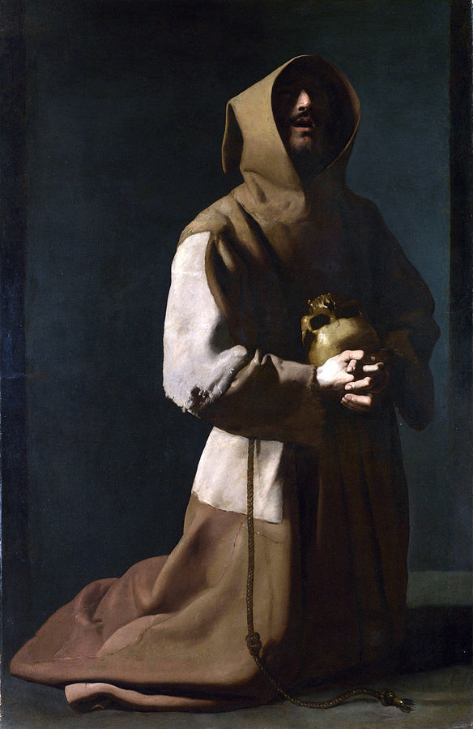
The Last things: death, judgement, heaven and hell
Advent 2020
Notes:
.

Slide 2
Almighty God,
Give us grace to put away the works of darkness
And to put on the armour of light,
Now in the time of this mortal life,
In which your Son Jesus Christ came to us in great humility;
That on the last day,
When he shall come in his glorious majesty
To judge the living and the dead,
We may rise to life immortal;
Through him who is alive and reigns with you,
In the unity of the Holy Spirit,
One God, now and for ever,
Amen

Slide 3
Death

Slide 5
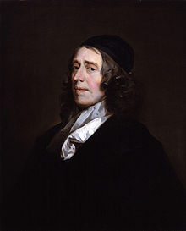
John Owen
1616-1683

Slide 6
In 19th century “women took fever and died from having babies, and babies died from puniness or the harshness of the air. Men died from ….rivers and horses, bulls, steam saws, mill gears, quarried rock, or falling trees and rolling logs; Children lost their lives as …hard things smashed them, like trees and the ground when horses threw them, or they fell; they sickened, earaches wormed into their brains or fever from measles burned them up or pneumonia eased them out overnight” Annie Dillard The Living

Slide 7
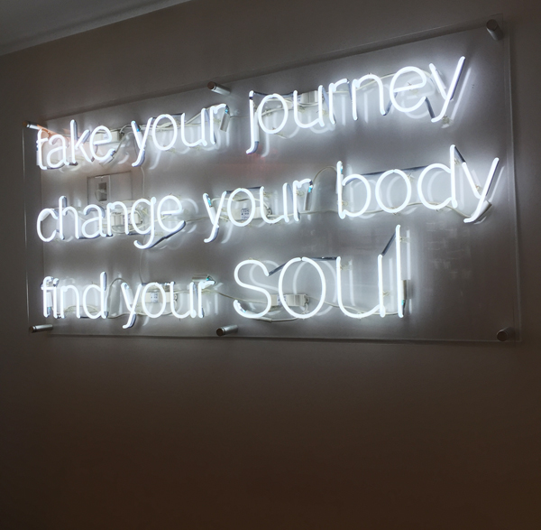
No limits?

Slide 10
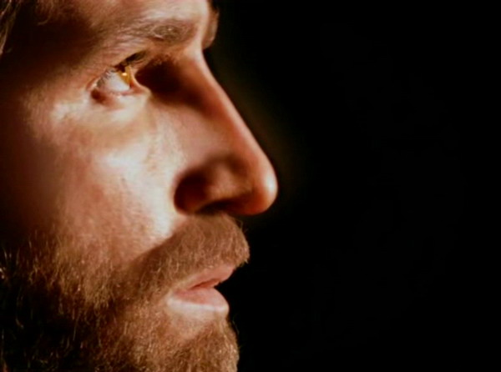
to “…free those who all their lives were held in slavery by the fear of death” Heb 2.15

Slide 12
Death, be not proud, though some have called thee Mighty and dreadful, for thou are not so; For those whom thou think'st thou dost overthrow Die not, poor Death, nor yet canst thou kill me. From rest and sleep, which but thy pictures be, Much pleasure; then from thee much more must flow, And soonest our best men with thee do go, Rest of their bones, and soul's delivery. Thou'art slave to fate, chance, kings, and desperate men, And dost with poison, war, and sickness dwell, And poppy'or charms can make us sleep as well And better than thy stroke; why swell'st thou then? One short sleep past, we wake eternally, And death shall be no more; Death, thou shalt die

Slide 13
Sheol

Slide 14
Hades

Slide 15
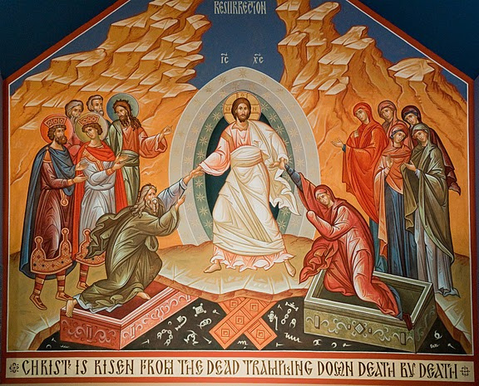
1 Cor 15.3-5
Jesus Christ died.
He was dead and buried.
On the third day he was raised from the dead.
He appeared to the disciples.

Slide 16
“If we live, we live for the Lord; and if we die, we die for the Lord. So, whether we live or die, we belong to the Lord”. Rom 14.8
“therefore beloved, be steadfast, immovable, always excelling in the work of the Lord, knowing that in the Lord your labour is not in vain” (1 Cor 15.58)

Slide 17
When we die…..
Therese of Lisieux
in death

Slide 18
General Resurrection at end of time
²⁸Do not be astonished at this; for the hour is coming when all who are in their graves will hear his voice ²⁹and will come out—those who have done good, to the resurrection of life, and those who have done evil, to the resurrection of condemnation. Jn 5.28-29
⁵¹Listen, I will tell you a mystery! We will not all die, but we will all be changed, ⁵²in a moment, in the twinkling of an eye, at the last trumpet. For the trumpet will sound, and the dead will be raised imperishable, and we will be changed. 1 Cor 15.51-52
I have a hope in God—a hope that they themselves also accept—that there will be a resurrection of both the righteous & the unrighteous. Acts 24.15
For the Lord himself, with a cry of command, with the archangel’s call and with the sound of God’s trumpet, will descend from heaven, and the dead in Christ will rise first. 1Thess 4.16

Slide 19
The Resurrection, Cookham

Slide 20
Immediate ongoing life
Very truly, I tell you, whoever keeps my word will never see death.’ Jn 8.51
and everyone who lives and believes in me will never die. Do you believe this?’ Jn 11.26
“He is the God of the living, not the dead” Mk 12.27
“Today you will be with me in paradise” Lk 23.43
In my Father’s house there are many dwelling-places. If it were not so, would I have told you that I go to prepare a place for you? John 14.2
²¹For to me, living is Christ and dying is gain. ²²If I am to live in the flesh, that means fruitful labour for me; and I do not know which I prefer. ²³I am hard pressed between the two: my desire is to depart and be with Christ, for that is far better; ²⁴but to remain in the flesh is more necessary for you. Phil 1.21-24

Slide 21
Gladiator

Slide 22
When we die…..

Slide 23
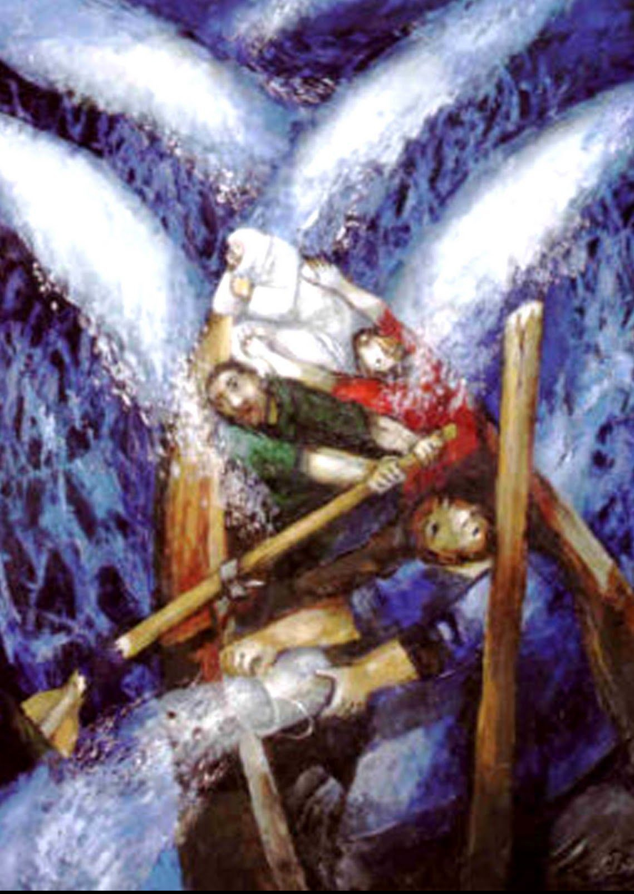
“O you little faiths, why did you doubt?”
Mk 4.40

Slide 24
Resurrection Changes Our Horizon
“if the Christian hope of heaven is an illusion, based upon lies, then it must be abandoned as misleading and deceitful. But if it is true, it must be embraced and allowed to transfigure our entire understanding of the place of suffering in life”. Alistair McGrath
“I regard the sufferings of the present time
as not worthy of comparison with the glory
that is to be revealed to us” Rom 8.21

Slide 25
“if you loved me you would have rejoiced because I go to the Father, for the Father is greater than I” Jn 14.28
“while we are at home in the body we are absent from the Lord …and prefer rather to be absent from the body and to be at home with the Lord” 2 Cor 5.6-8
“for to me, to live is Christ, and to die is gain” Phil 1.21
“so that you may not grieve as others who do not have hope” 1 Thess 4.13

Slide 26
Some helpful books

Slide 27
Ain’t no grave…

