Slide 1
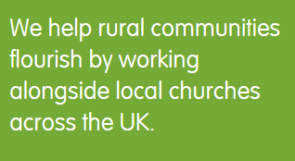
Jerry Marshall, CEO, Germinate: The Arthur Rank Centre
Notes:
Germinate Presentation
Please add your name in the opening slides and adapt the presentation as required.
This set of slides includes:
Background to rural issues (optional, delete if not required)
A brief history of Germinate (optional, leave out if insufficient time)
Main Germinate resources (feel free to leave out or skip through any resources you feel as less relevant to the audience).

Slide 2
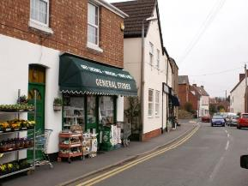
Rural population in England
9.2 m rural residents – 17% population
50% of rural population aged over 45
20% aged over 65
16% aged 15-29
Grown by 6.7% in 10 years in ‘less sparse rural areas’
Net migration to rural approx. 50k p.a.
Notes:
What’s different about rural?
Here’s some brief background.
Rural is defined by DEFRA as communities of under 10,000 people, so includes small market towns
It is sub divided into spare and less sparse rural
(see https://www.gov.uk/government/uploads/system/uploads/attachment_data/file/597751/Defining_rural_areas__Mar_2017_.pdf for detailed information)
Broadly there is a higher proportion of over 45 year olds in rural and lower proportion of 15-29 year olds, compared with the UK as a whole.
The population of ‘less sparse rural areas’ is growing.

Slide 3
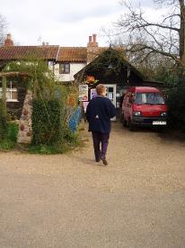
Types of rural people
Established rural residents
the agricultural community
Commuters
Life style shifters
Privacy seekers / trophy owners
Migrant and transient workers
Second home owners
Absent friends
Tourists / visitors
Notes:
Rural communities vary across the country (commuter belt, relatively remote agricultural areas, tourist areas) and are made up of many different groups of people
Absent friends means those who see a particular rural community as home but have moved to a town or city, perhaps for work or affordable housing.

Slide 4
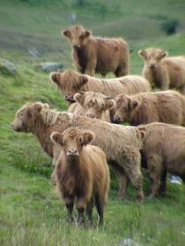
What’s good about rural?
Lower unemployment
Higher household incomes
Smaller numbers on benefits
Higher qualifications
Better health
Lower homelessness
Lower risk of crime
Notes:
Overall there are many good things about rural living in most but not all places

Slide 5
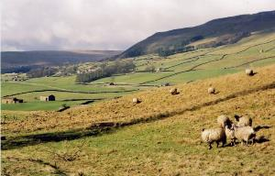
Rural disadvantage
Financial poverty
Low wages, seasonal work, minimum wage, fixed pension, reliance on benefits
Access Poverty
Transport, healthcare, Job Centre Plus, poor mobile and internet
Network Poverty
Isolation, loss of supportive networks, family moved away for affordable housing
Notes:
But even in relatively wealthy areas there is poverty of different sorts, sometimes hidden

Slide 6
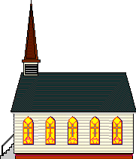
Challenges in rural mission
The days of one ordained minister / one church were brief and are long gone
The number of churches in a group will continue to grow in most areas
Need to move towards collaborative / shared ministry
Buildings can be a challenge
Most churches are small, with limited financial and leadership resources.
Notes:
The church situation can be challenging

Slide 7
BUT… a satsuma is not a failed orange
Notes:
The most visible difference between rural and suburban churches is usually size – BUT a satsuma is not a failed orange. A small rural church may be attracting a much higher proportion of the local population, and perhaps having a greater spiritual impact, than a large suburban church.

Slide 8
Opportunities in rural mission
Many feel a connection with the church and therefore a sense of journey of faith
Sense of connection with God the Creator and opportunities provided by agricultural seasons and traditions
Congregations are embedded in communities
Many churches are at the forefront of Fresh Expressions and ministry by the whole body of Christ
Ecumenical opportunities
Buildings can be an opportunity.
Notes:
There are many opportunities in rural ministry.
Note buildings can be both a challenge (layout, upkeep cost) and an opportunity (developing community uses).

Slide 9
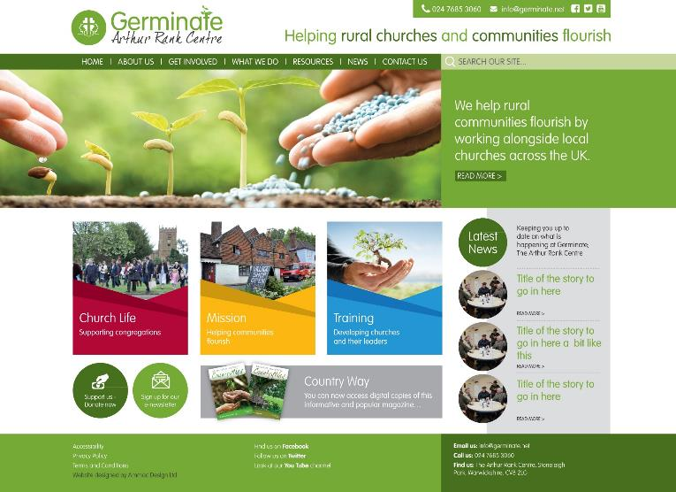
Notes:
So what resources are available to rural churches?
These are some of our main initiatives.
First, our website www.germinate.net. Many of our resources are available as free downloads. The main sections are:
Church Life - Supporting congregations:
• Worship - a wide variety of materials for rural worship
• Discipleship - resources you can use in your church community
• Buildings - resources to help you maintain and get the most out of your buildings
Mission - Helping communities flourish:
• Equipping for Rural Mission – a toolkit to help you understand your local congregation and community better (more information in a moment)
• Journey to Faith – a rural evangelism training resource for local churches
• Rural Mission Sunday – an annual event celebrating the life of rural churches
• Rural Isolation – a practical resource for Churches
Training - Developing leaders and church members:
There is information on our training programme and downloadable presentations and recordings from our biennial Germinate
day conference, the annual Germinate lecture, and other events.

Slide 10
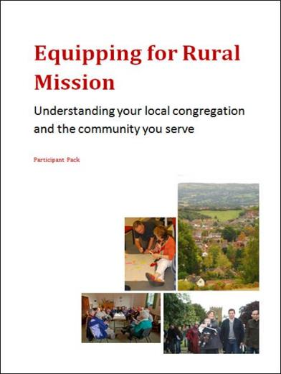
Notes:
This is a typical free downloadable resource which is also particularly important.
It’s a four session programme you can work through with your whole congregation or a sub group. There is a facilitators guide and a participant workbook.
As with all our resources, it is written for a small rural church with limited resources.
The first session helps the group reflect on their church.
The second session is about uncovering the needs and opportunities within their local community.
The third session is a prayerful reflection on the previous thinking and research to consider the vision and big picture for the church.
The final session is about making a simple, practical plan. This might mean stopping something that is past its ‘use-by’ date; doing something else with clearer ‘intentionality’; and perhaps starting one new thing that meets and identified need.

Slide 11
Germinate Groups: affordable rural learning communities
Enables lay and ordained leaders to spend time together and learn from other groups, considering:
what IS (what God is doing in our area)
what COULD BE (the God-given vision for us)
what WILL BE (our six-month action plan)
Notes:
Germinate Groups is an opportunity for teams of 4-6 people from a benefice, circuit, or part of a circuit to get together for two days every six months, to learn from others and reflect on their church group situation, their particular calling and vision, and together prepare a six month action plan. The themes are journey, leadership, discipleship and mission. There’s a brochure, and video and more information on the web site.

Slide 12
“I feel truly transformed by my personal experience in the programme…”
“A ‘grown-up’ leadership programme…”
“Really worthwhile”
(Participants comments)
Programmes start every October
Notes:
Leadership is a key issue for rural leaders. This subsidised 18 month personal development programme for lay and ordained rural church leaders includes two short residentials, several further training days, a 360 degree appraisal, work shadowing and other elements, with a mentor throughout.

Slide 13
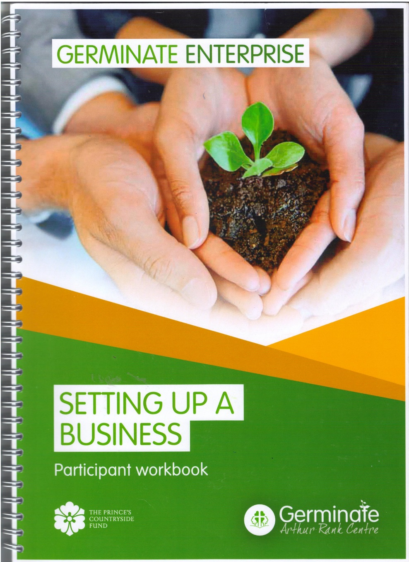
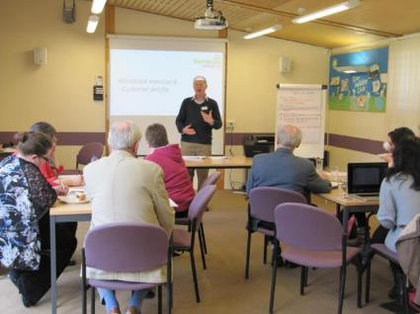
“We ran the course once a week in two hourly evening sessions, a little like running a church home group for example. Everyone found the course materials helpful and felt they gave a good foundation on which to develop their own business ideas.”
(Church member, Northants)
www.germinate.net/enterprise
Notes:
Germinate Enterprise is a way that a church and reach out and bless a community by helping though who perhaps have wondered about starting their own business but are not sure how. Perhaps there is someone in your church able to invest six evenings a year to run the programme? There’s a work book, facilitator guide, step by step session guide, and material for an optional monthly follow gathering called Beer Mat Mentoring, all free to download.
Suggest that your listeners take a look at the short video on our website. Or better still, play the next slide!

Slide 14
Notes:
Celebrate rural mission every July with a wide range of resources. Next Rural Mission Sunday is 15 July 2018.

Slide 15
International Dimension: The International Rural Churches Association was founded 20 years ago to enable leaders of rural churches worldwide to share ideas and resources, champion rural needs, and offer each other support and prayer. There is a global conference every four years.
See www.irca.online for details
Notes:
Include up to March 2018 only

Slide 16
“I find Country Way magazine an easy-to-read, accessible and practical resource, easily digestible and inspiring!”
Rev T Morris, Ashbourne
Notes:
Do subscribe to Country Way., our three times a year full colour printed magazine with a wealth of rural church resources and case studies. The online version is free. See the web site for details.

Slide 17
Free e-News with latest resources, events, and funding
Sign up at www.germinate.net
Notes:
Do also subscribe to our free monthly eNews with information and links to the latest resources, events, and funding. There’s a link on the website to sign up and there’s an instant unsubscribe if you change your mind!

Slide 18
Applying rural wisdom…
Where are the opportunities in your area?
Is there a group in your community, not currently represented in the church, where you could show God’s love?
Is there a church or chapel building that could be used to a greater extent as a community asset?
Are there skills or interests in a congregation that could be a resource for mission?
Notes:
OPTIONAL exercise for say a workshop setting.
Have the audience think about one or more of these in 2s or 3s and then have a plenary session
Think about your community.
Groups: tourists; migrants; commuters; youth; isolated / lonely; ‘just about managing’.
Maybe a useful prompt is the five “love languages” - book by Gary Chapman - different ways to express or receive love:
Gifts – what could we give this group?
Quality time – how can we spend more time with this group to show we value them?
Affirmation – how can we tell this group how much we appreciate them?
Acts of service – what can we do to serve them?
Touch - Jesus touched the untouchables of his day, the lepers, the woman who was bleeding, the prostitutes and tax collectors. Who are the untouchables in our area?

Slide 19
What does the future look like?
Ecumenical
Growing ministry of lay people with leaders coaching and releasing others
A “mixed economy” that values both traditional and new.
Recognition that our involvement in the community is part of mission, part of being an “effective Christian presence”
A willingness to take risks
Notes:
So – how t=do we see the future for rural churches?
We hope and pray that it is ecumenical…
With a growing ministry of lay people with leaders coaching and release others
A “mixed economy” that values both traditional and new ways of being church (e.g. Messy church, café church, etc.)
A recognition that our involvement in the community is part of our mission: being a school governor, or on a village committee, or having tea with a neighbour, all these things are part of mission, part of being an “effective Christian presence”.

Slide 20
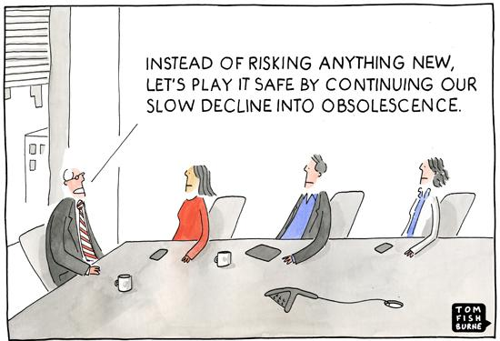
Notes:
Flourishing communities requires risk go together.
Be willing to take a risk!
Mitigate with pilot projects
Involve entrepreneurs in your planning

Slide 21
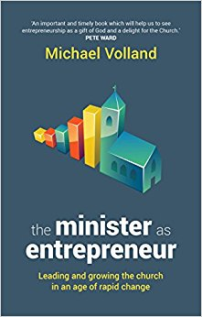
Entrepreneurs and the church
Definition: “A visionary who, in partnership with God and others, challenges the status quo by energetically creating and innovating to shape something of Kingdom value” (Michael Volland)
“The church’s faithful and effective response to Jesus’ Great Commission requires the contribution of entrepreneurs”
“Not all Christians are natural entrepreneurs… but when this potential is recognized, nurtured and give space to breathe, an innovative approach to mission is often the result”

Slide 22
What does an entrepreneurial approach to mission look like?
A story…

Slide 23
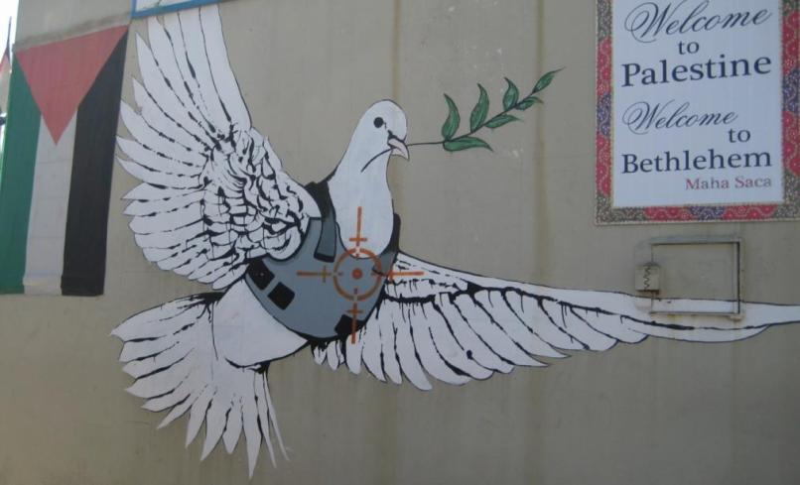
Notes:
My experience is that God honours those who take faithful risks. One of the riskiest thing I have done was to set up a business in Bethlehem.
A business partner and I believed God was calling us to create robust jobs, build hope, and transcend the separation wall. Our company Transcend started in 2012 but by early 2013 it should, humanly speaking, have gone bust. We were losing $10-15k / month.

Slide 24
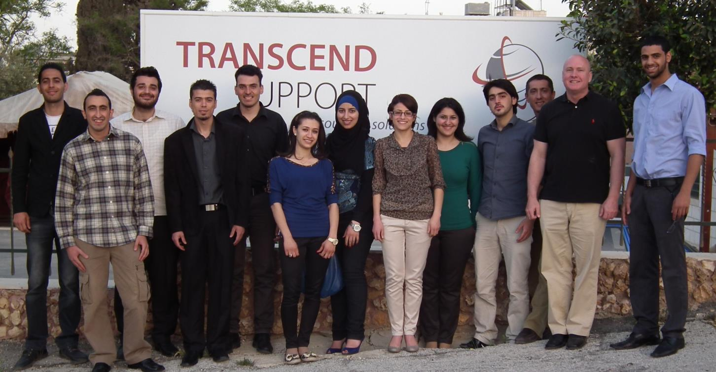
This transcends political barriers and limitations. I really love that. I am the eldest daughter in the family and I am my family’s hope… I love it because it makes me feel renewed every day because I learn about other cultures and it helps my English come to life.”
Yaman Qaraqe (circled)
Notes:
But God intervened and now we have a growing business with nearly 100 staff, serving customers in Israel, Palestine and beyond, generating exports, building capacity, and creating a new sector in the economy. We also model integrity and gender equality.

Slide 25
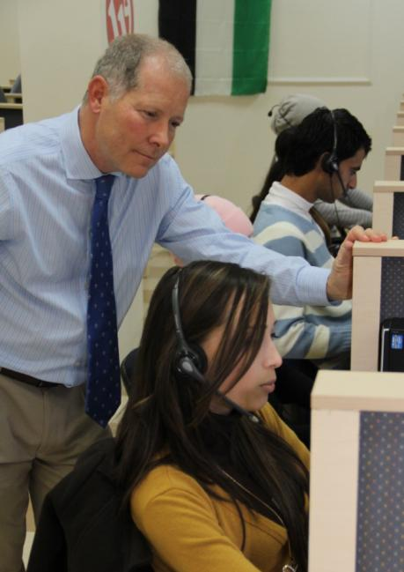
Lessons for entrepreneurial mission
Identify needs
identify resources
Set goals
Work with others, discerning the way forward
Take a risk
Keep on communicating
Keep on praying
Persist
The fruit comes from God not our efforts
Notes:
Here’s a more obviously rural example…

Slide 26
Final thoughts…
Notes:
OPTIONAL
To close, some final thoughts….

Slide 27
Try one audacious new thing each year…

Slide 28
… and enjoy the ride!

Slide 29
Notes:
Offer a Q & A session if appropriate and if time
Workshop – leadership and making it happen

