Slide 1
An Introduction to SIAMS
SIAMS – Are You Ready?
Trinity CEVAP School, Stowmarket
4th February 2020

Slide 2
Introduction to SIAMS
Phil Knowles - Diocesan School Effectiveness Officer & SIAMS Manager
Gemma Kingston - Diocesan Schools Adviser
Daisy Underwood – CW Lead, Acton CEVCP School
Rachel Bacon, Deputy Head, All Saints C of E Primary, Newmarket

Slide 3
Introduction to SIAMS
Aims of this session:
What is SIAMS?
To introduce the new SIAMS schedule
The focus on the school’s Christian vision
An overview of the SIAMS inspection process
The 7 strands
The evaluation schedule and Self evaluation (audit) process

Slide 4
Introduction to SIAMS
Frequently asked questions:
Why does our school have SIAMS inspections?
Is SIAMS optional and is it important?
How often does SIAMS take place?
SIAMS – Isn’t it an inspection of RE?

Slide 5
Introduction to SIAMS
SIAMS has changed:
A SIAMS that is more rigorous
A SIAMS that is more consistent
A SIAMS that is more suitable for the new education landscape
SIAS: focus on distinctiveness
SIAMS: focus on distinctiveness and effectiveness
SIAMS 2: focus on distinctiveness, effectiveness and sustainability

Slide 6
The Vision

Slide 7
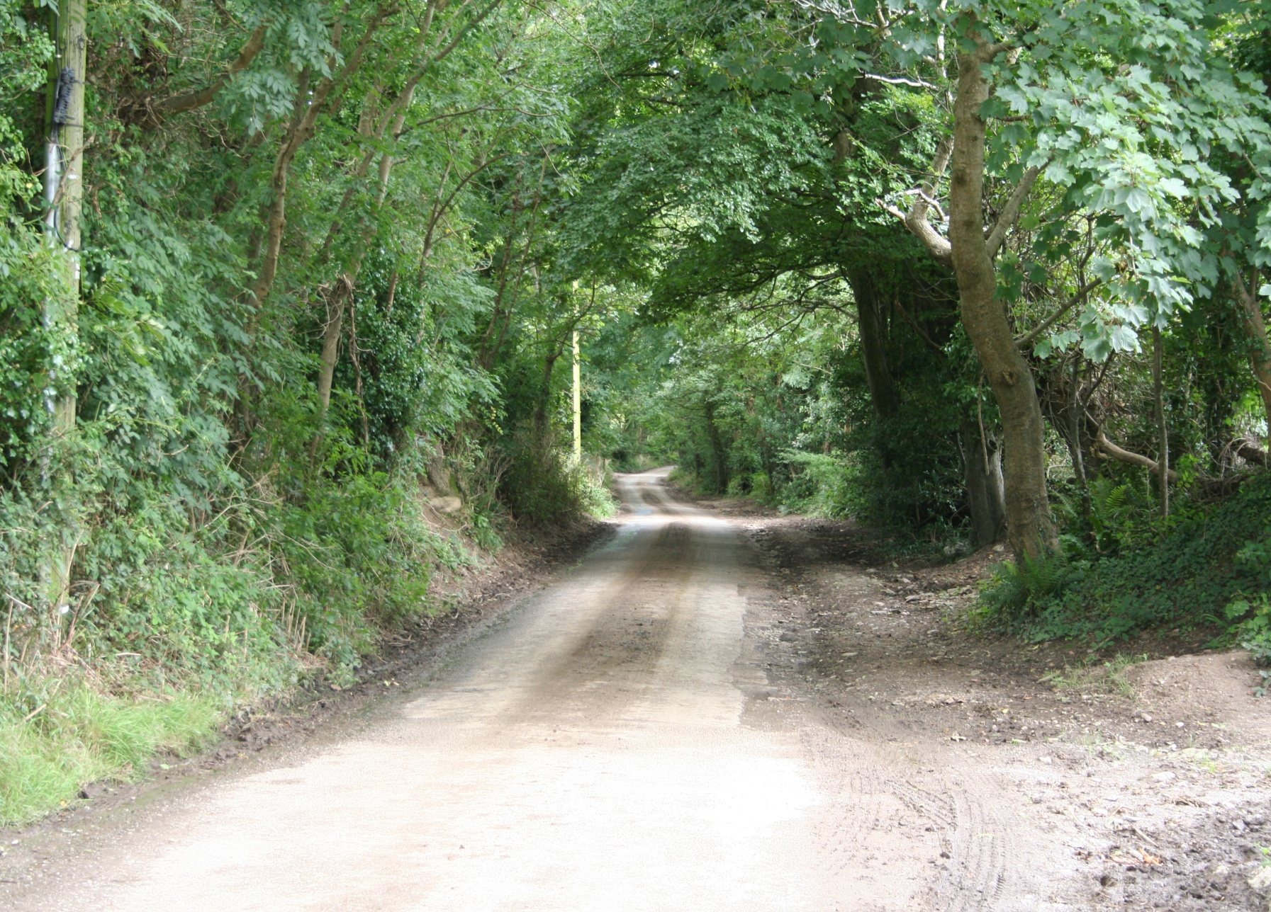
Time for reflection
Who are you as a school?
Why are you here ?
How do you live?
Notes:
If, as a school, you can articulate this, you are a good way along the road to a successful SIAMS inspection

Slide 8
The new schedule gives a high profile to the school’s Christian vision
Deeply Christian sets the criteria
Diocesan vision sets the context
The school’s vision must be unique to the community
It is not about imposing a vision
Inspection is against the school’s vision
Notes:
This is an important message to get across. This SIAMS schedule is not about imposing the Church of England Education Office vision. Each school must have a unique vision tailored to its context BUT there are certain elements or principles that all church schools must include.
There must be a decent standard of education. This is what the school is funded for
Any church school must develop the character of the individual to be the best person they were created to be (aspiration) and there must be a concern for the collective good of society (hope)
Pupils must learn how to live well together in society
They must treat all with respect and dignity.
It is time we are honest with parents and the public about what we are doing. As schools become less and less ‘Bog standard’ all schools should be clear about the who we are and why we are here.
The Christian vision of the school will be written on the front page of the report

Slide 9
Introduction to SIAMS
Strap line or motto
Window into the vision
Vision
(Up to 50 words)
Who are we? Why are we here?
Must be all be linked together
Narrative
Explains the vision and context
To what extent is the school’s vision and its associated values grounded in a clear theology firmly rooted in a Christian narrative?
Could be one Bible story that explains vision and associated values
Associated Values
How then do we live?

Slide 10
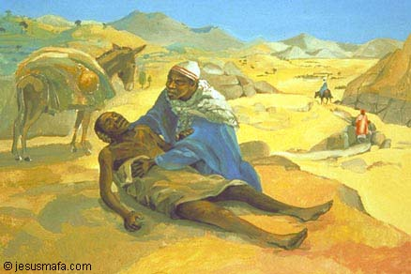
School Christian
Vision
Generosity of Spirit
Service to Others
Notes:
Our school’s patron is the Archangel Gabriel - the logo is a ring of Gabriel’s trumpets.
Gabriel is the bringer of Good News from God, and we want our students and our school to be beacons of Good News.
Two of our school values are Generosity of Spirit (our attitudes towards others) and Service to Others (our actions).
One of the places we get our values is in the Parable of the Good Samaritan.
This is a more radical story that we usually think – the Samaritan was of a different race, religion and culture to the man – but he was the one who recognised him as a neighbour. The Samaritan represents the person you hate. The theology here is one of radical hospitality.

Slide 11
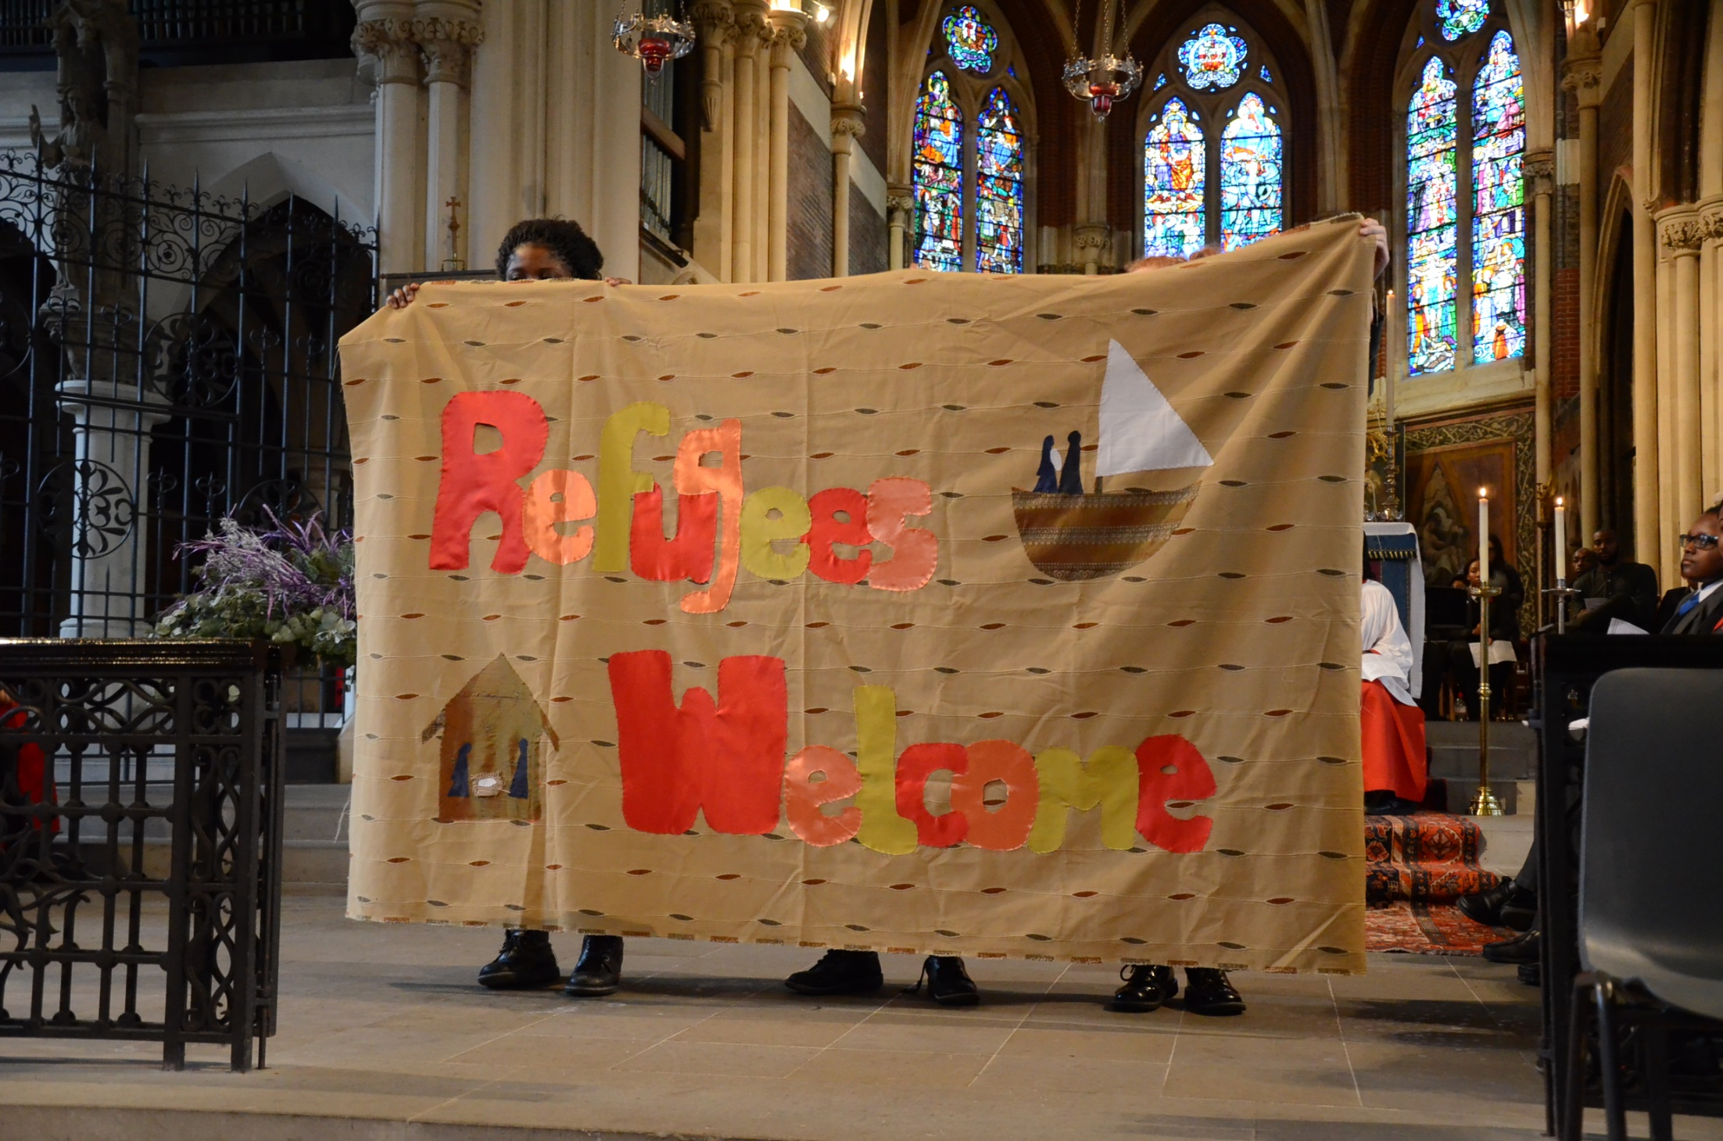

Slide 12
Schools
The Welcome Experience
Teaching and Learning
Public Action
Notes:
With the help of our Citizens UK organiser the students set about developing a “Refugees Welcome school.”
The Refugees Welcome campaign had been running for over a year, mainly through the work of Citizens UK. There were now Refugees Welcome teams all over the country who were organised and ready to take action.
Using the Citizens UK experience in campaigning and supporting refugees, our students came up with a plan to answer the question: “if a refugee were to come to our school, what would we need to do to support them?”
They came up with three areas: the Welcome Experience, Teaching & Learning, and Public Action. I will give a brief overview and also some examples for what we did in our school.

Slide 13
Inspectors will grade the school on the following question:
How effective is the school’s distinctive Christian vision, established and promoted by leadership at all levels, in enabling pupils and adults to flourish?
This question is explored through the seven strands...
Notes:
One question

Slide 14
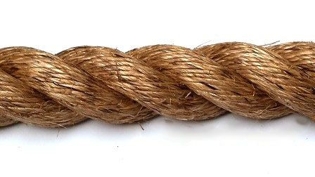
The seven strands
Vision and Leadership
Wisdom KnowledgeSkills
Character Development: Hope, Aspiration, Courageous Advocacy
Community and Living Well Together
Dignity and Respect
The impact of collective worship
The effectiveness of religious education
Notes:
The following slides explain where the strands ‘sit’ in the inspection process and judgements….

Slide 15
SIAMS considers the school in the light of
Vision
Provision
Impact
How effective is the school’s distinctive Christian vision…
…established and promoted by leadership at all levels…
…in enabling pupils and adults to flourish?
Notes:
Three questions are at the heart of this SIAMS
1.What is your vision as a distinctive church school?
2.What do you do because of that vision ?
3.How do you know its working?
Much of what is currently in the LM section is now in the vision and leadership question. RE and CW are obvious. The other 4 questions are the Christian Character section but using the 4 sections to clarify what we are looking for. A ‘writing frame’ if you like.

Slide 16
A new way to think about grades
Notes:
To be excellent schools will need to be consistently in the excellent category in grade descriptors. The inspector will need to make a convincing case to the QA that this is an excellent school.
The judgements for CW and RE will be stand alone judgements made on the quality of RE or CW respectively. ( as of now). They will contribute to the one holistic judgement as well but not in a numerical way as present.
It would be perfectly possible for RE to be excellent but the overall judgement to be RI.

Slide 17
SIAMS – How does it work?
Pre-inspection
The inspection day
The report and follow-up

Slide 18
One holistic judgement
‘St Theresa’s Church of England VA primary school as a church school requires improvement overall. Collective worship is Good. Religious education Requires Improvement.’
‘St Theresa's Church of England VC primary school is a Good school overall. Collective worship is Excellent.’
Notes:
The numerical four sections approach is one of the reasons we have considerable grade inflation. We end up with half of church schools judged to be outstanding under SIAMS.
The inspector will still use a best fit approach.
We have to give a grade for CW and for RE in a VA but these will be stand alone judgements. However at the same time RE and CW will contribute to the overall judgement.
We have attempted to describe what we would expect to find in a ‘good’ church school, what should be the norm. Then a school that goes the extra mile becomes an exceptional church school, one where you could confidently send other schools to look for good practice. One that you would be confident to put in place to support a struggling church school.
Rather than try and define what RI looks like we have borrowed the OFSTED approach of simply saying it is not yet good.
The fourth category is ineffective as a church school. We anticipate very few of these but it remains a possibility.

Slide 19
Self Evaluation
The role and responsibility of Governors
Would an ethos and /or worship committee be right for us?
What should we monitor and why? (The SEF /audit template)
The previous SIAMS report – Focus for Development
Considering the school’s Christian vision and its impact – linking this to learning
Notes:
Church school self evaluation is the responsibility of the Governors, They must make sure it happens. The school does it.
Progress since the last inspection depends on what the issues were last time. In most cases this will have been five years. A lot can happen in education in 5 years!
This attempts to give shape and organisation to what was previously the distinctive Christian character section. SMSC is spread across the first three and this should give more sharpness to this judgement. There is little here that should be new. Mental health and RSE are the only completely new aspects and both of these require that the school has effective policies in place and that the school has it on its agenda.

Slide 20
Priorities – What next for our school?
Consider the vision
Self evaluate (audit)
Action planning /prioritise

Slide 21
Other issues
What have we learnt from recent inspections
Building a case for ‘Excellence’
Self-evaluation and the SIAMS SEF (audit)

Slide 22
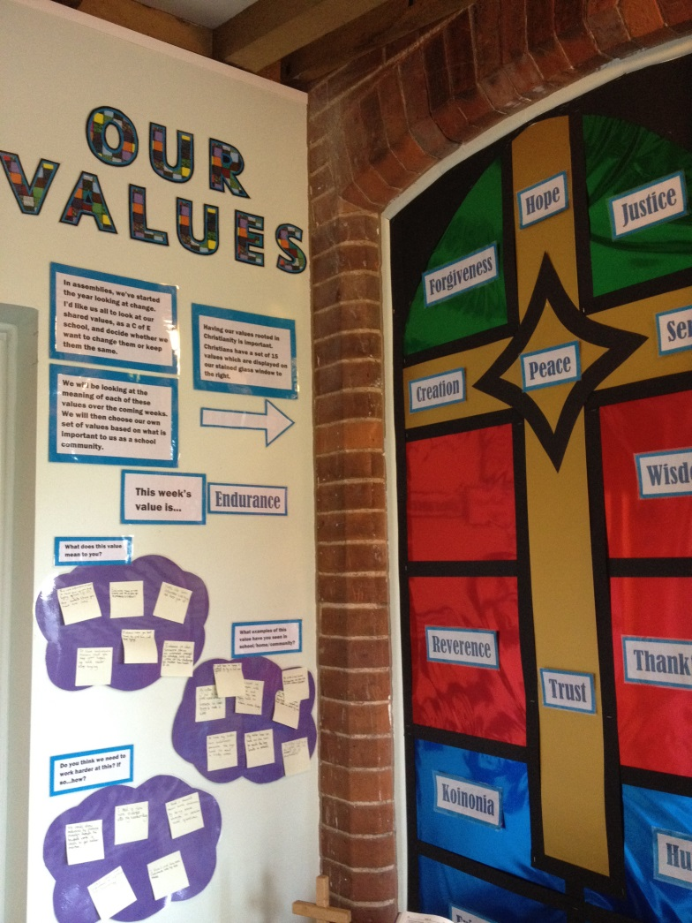
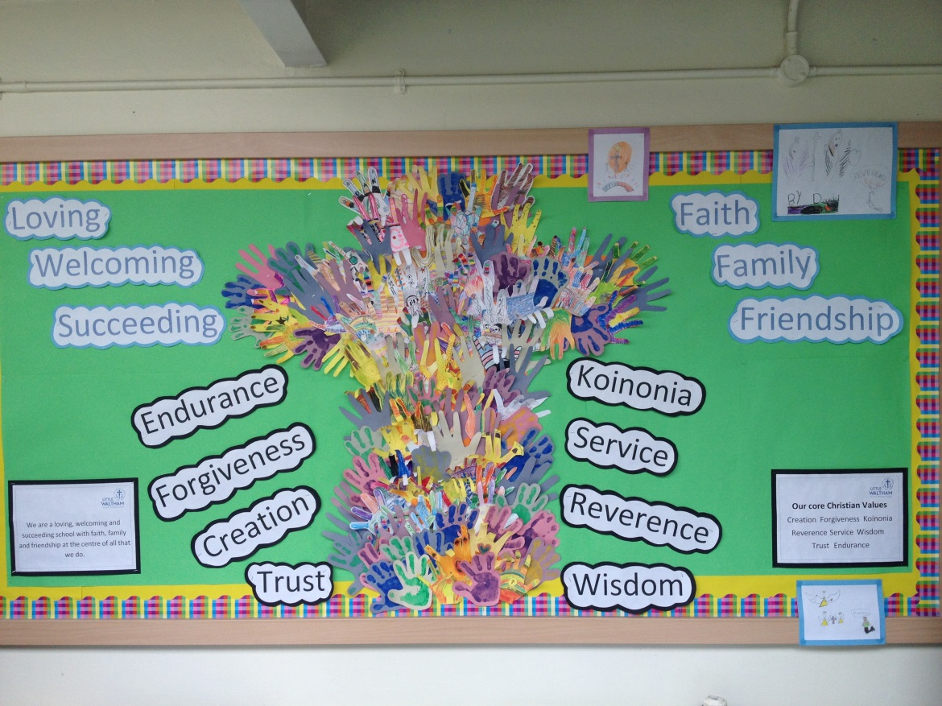
Introduction to SIAMS
Notes:
The following slides used to be used as exemplars of good quality ethos etc displays in church schools. Whilst these sorts of displays are important, the new schedule requires something much deeper.

Slide 23
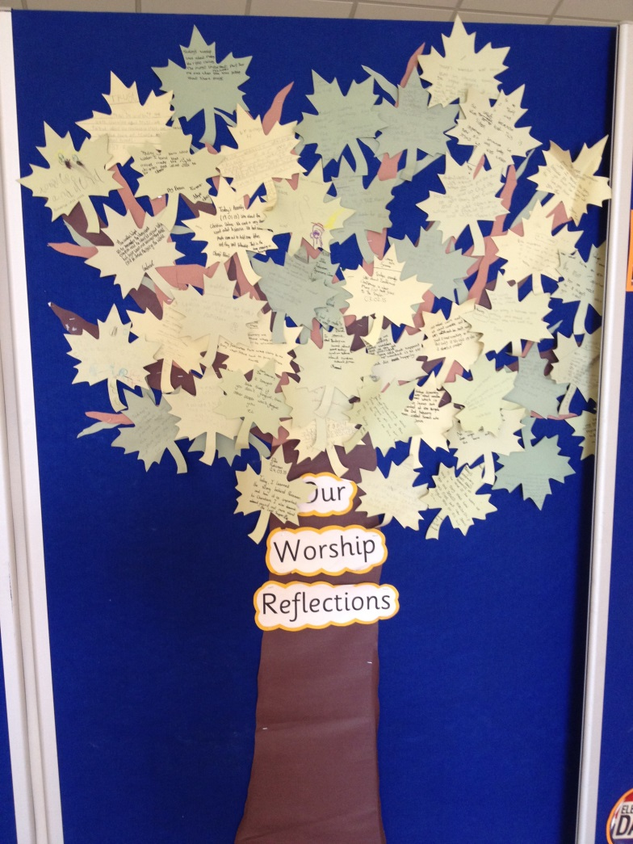
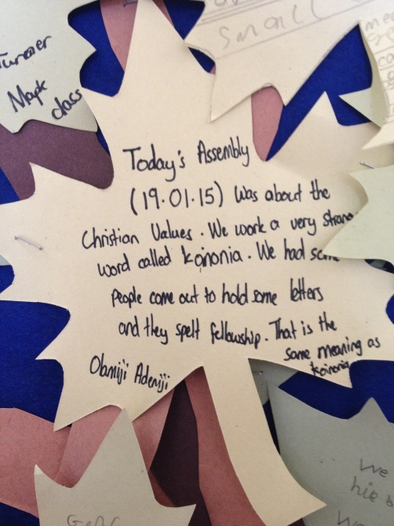
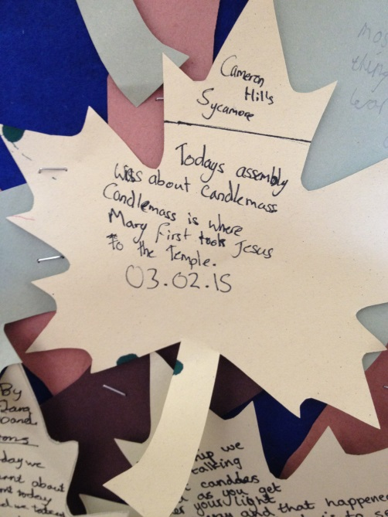
Introduction to SIAMS

Slide 24
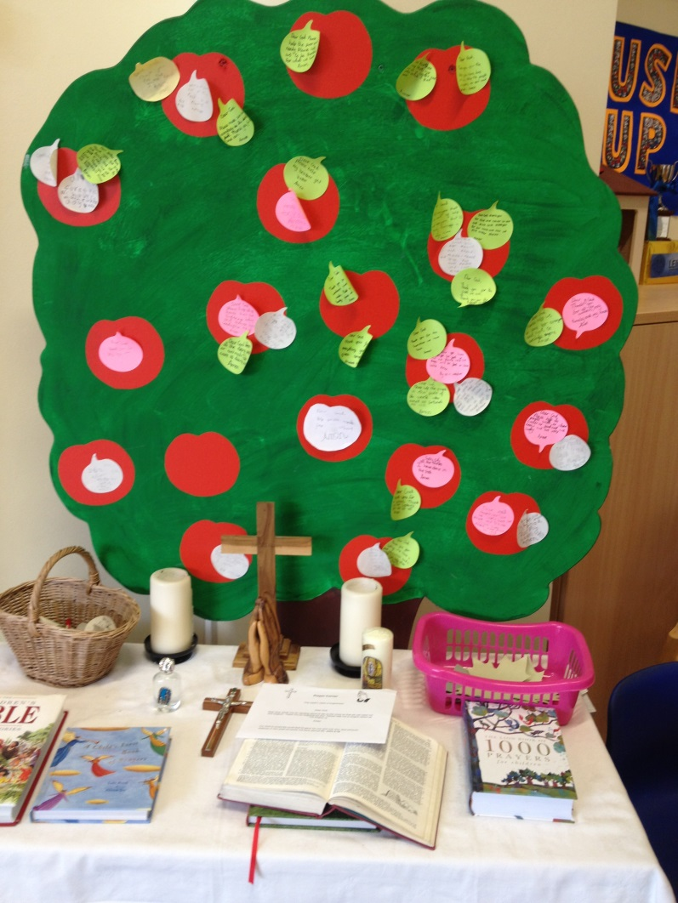
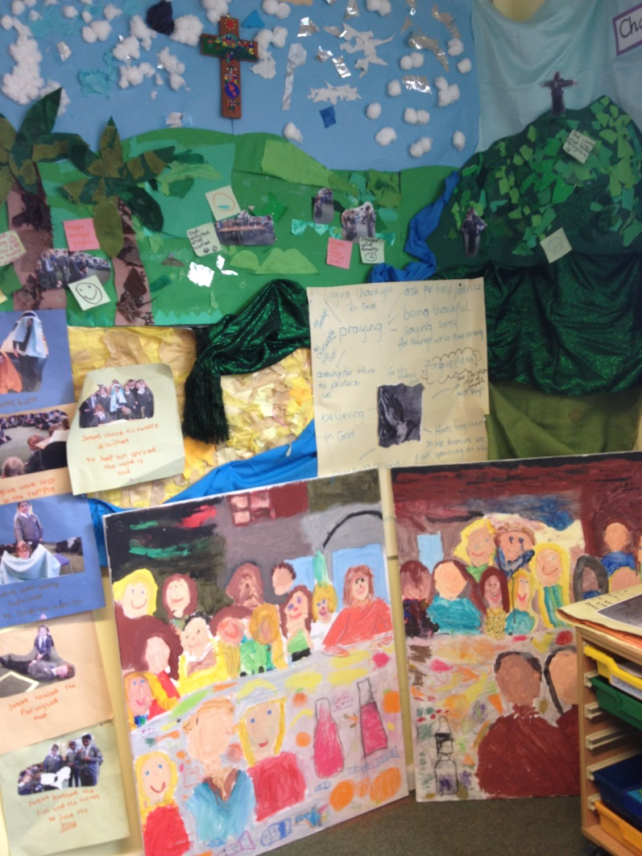
Introduction to SIAMS

Slide 25
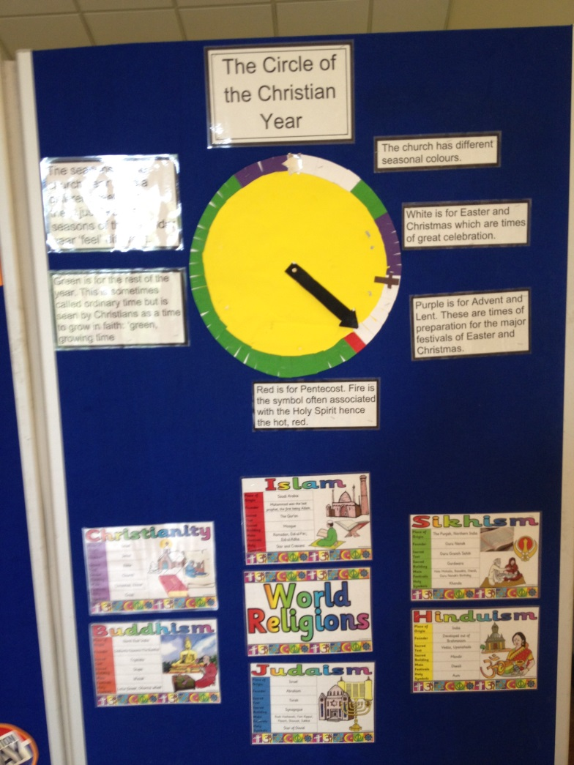
Introduction to SIAMS

Slide 26
Introduction to SIAMS
Questions?
Training needs
The SIAMS schedule and associated documents are available from the Church of England Education Office website:
https://www.churchofengland.org/more/education-and-schools/church-schools-and-academies/siams-school-inspections

