Slide 1
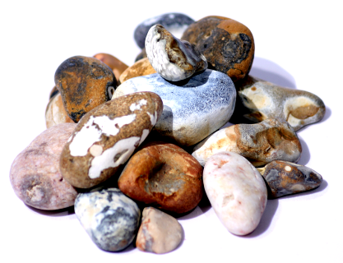
spirituality for mission
B03 spirituality for mission

Slide 2
Learning outcomes
‘mission spirituality’
some marks of an apostolic person, group or community
what you need to grow and flourish spiritually in a mission-shaped ministry
B03 spirituality for mission
2

Slide 3
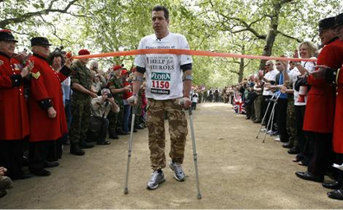
Finishing well
Never let the work you are seeking to
do for God become greater than
the work God is doing in you
B03 spirituality for mission
3

Slide 4
Spiritual formation
The stories we believe
Our
Environment
Habits
Relationships
B03 spirituality for mission
-
Relationships
Relationships
Relationships

Slide 5
intentional Christian formation…
The stories we believe
Christian doctrine
Habits
Relationships
Holy Spirit
Spiritual disciplines
in God’s family
B03 spirituality for mission
-
Relationships
Relationships
Relationships

Slide 6
Marks of apostolic spirituality
Matthew 9.35-10.16
Mark 6.6b-13
Luke 9.1-6
B03 spirituality for mission
4

Slide 7
The stories we believe
Growing into people who are…
called and sent
greatly beloved
adventurers
bearers of God’s message
B03 spirituality for mission
4,5,6,12,15

Slide 8
Relationships
Growing into people who…
go together
(two by two - or more)
pray and depend on the Holy Spirit
B03 spirituality for mission
4, 9, 11

Slide 9
Holy Habits
being people who are…
living rhythmically
praying and depending on the Holy Spirit
people of word and sacrament
learning to see and to listen
travelling light (taking nothing for the journey)
wounded healers
B03 spirituality for mission
4,7,8,9,13

Slide 10
We do not want you to copy or imitate us. We want to be like a ship that has crossed the ocean, leaving a wake of foam, which soon fades away. We want you to follow the Spirit, which we have sought to follow, but which must be sought anew in every generation.
Cited by E Arnold, Why we Live in Community
B03 spirituality for mission
15

Slide 11
At the heart of apostolic spirituality lies one great, central, bewildering, joyful, life-giving discovery - that Jesus is alive. Everything else really does flow from that.
Susan Hope, Mission-shaped Spirituality
B03 spirituality for mission
12

